Slide 1
Gear-Motors Time to Speed & Location
Special Topics In Robotics
David Giandomenico October 23, 2013
2013

Slide 2
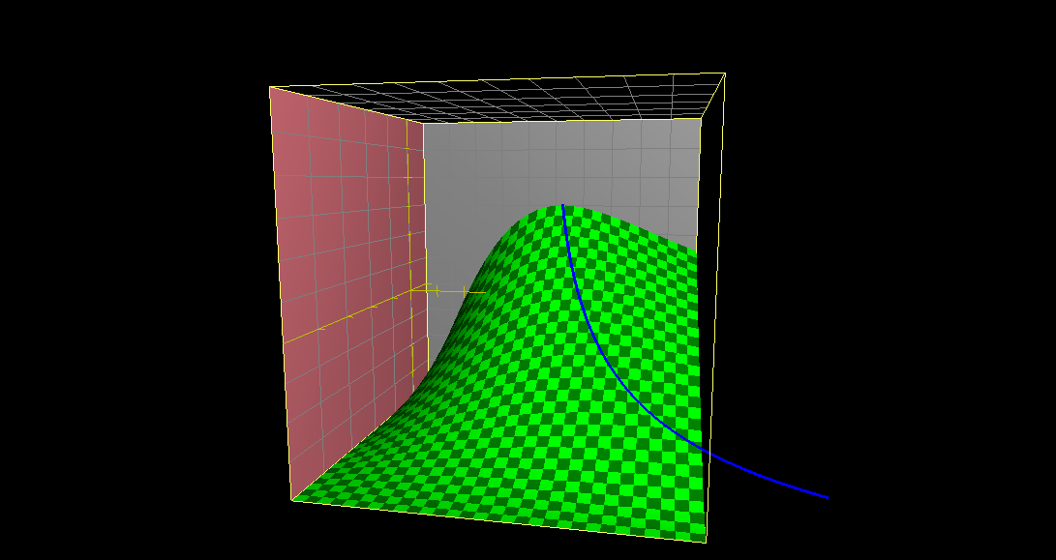
Distance vs time & gear reduction
Distance➔ ✚
Time➔ ✚
⬅ Gear Reduction ➔ ✚

Slide 3
Force vs Speed

Slide 4
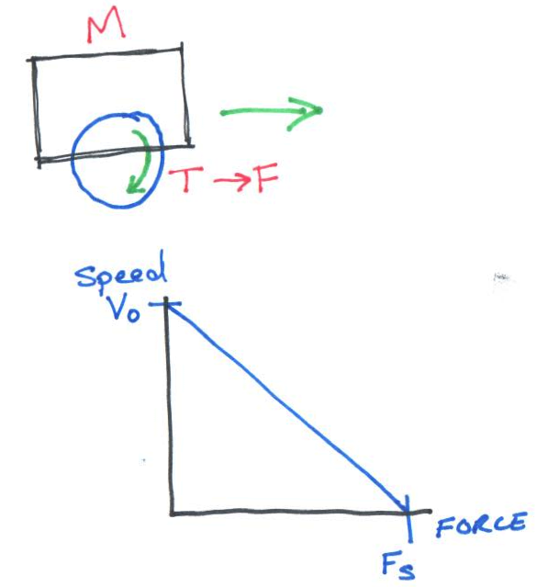
Force vs Speed

Slide 5
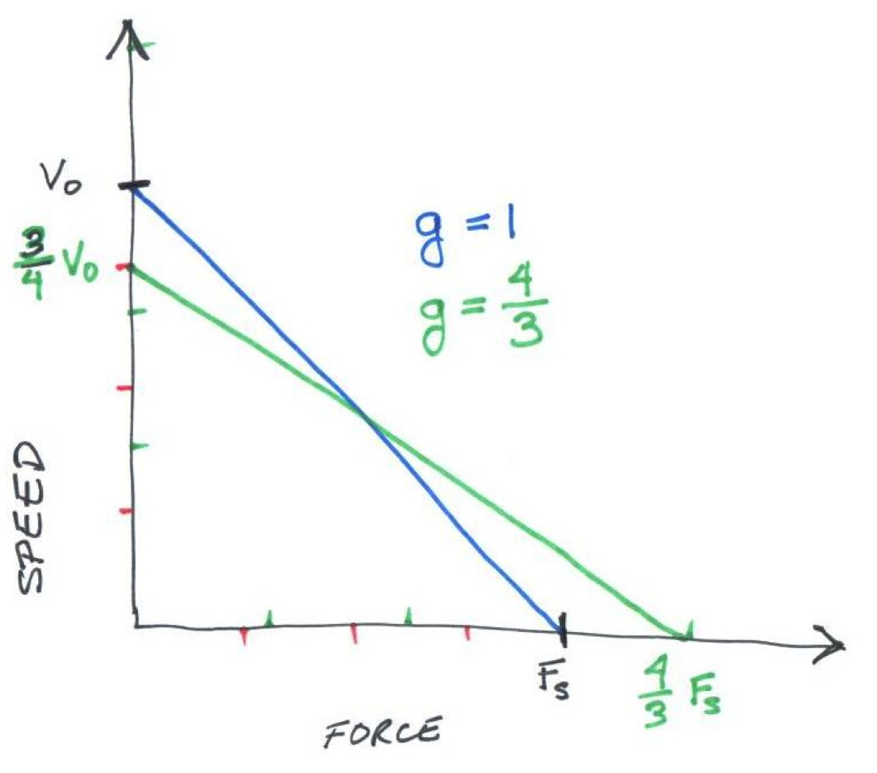
Effect of Gear Reduction
Force

Slide 6
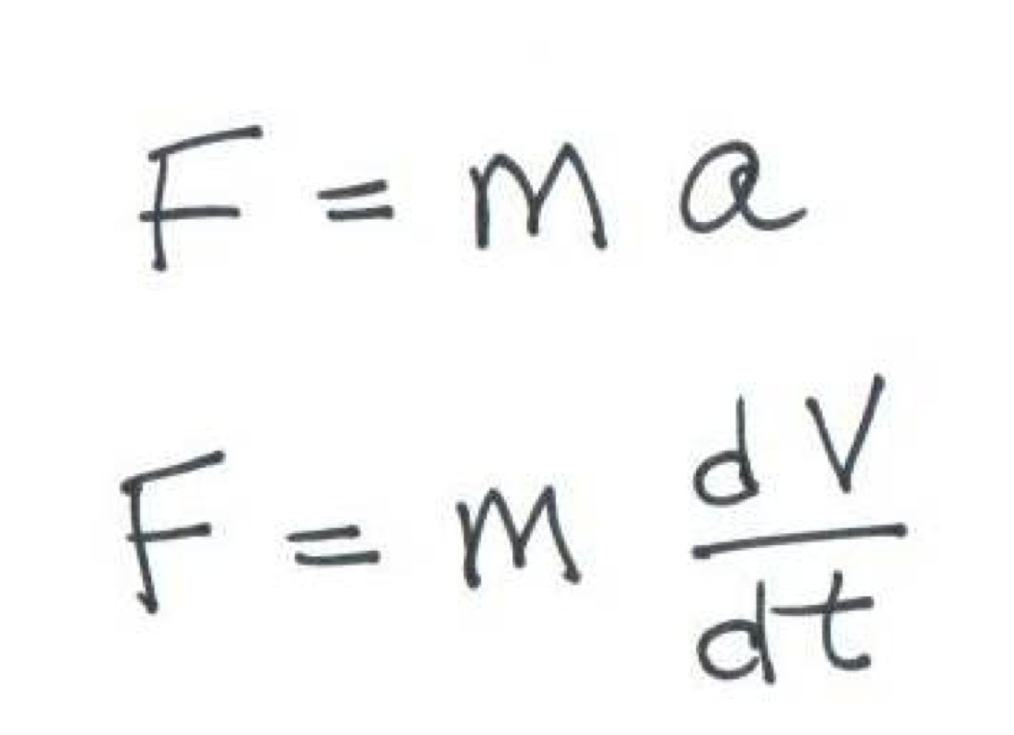
Newton’s 2nd Law

Slide 7
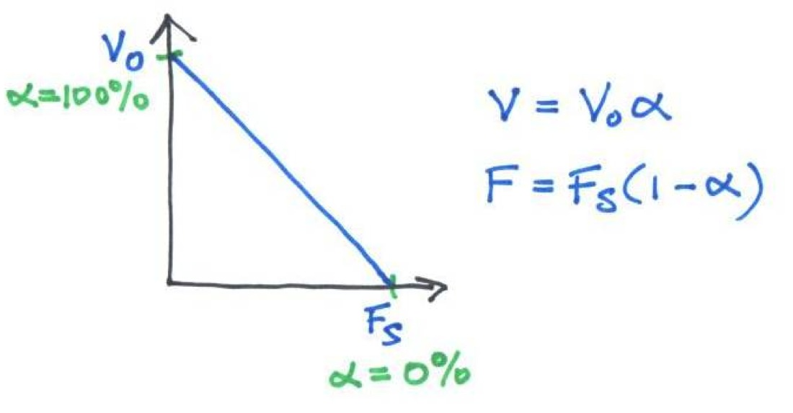
Need 2nd relation

Slide 8
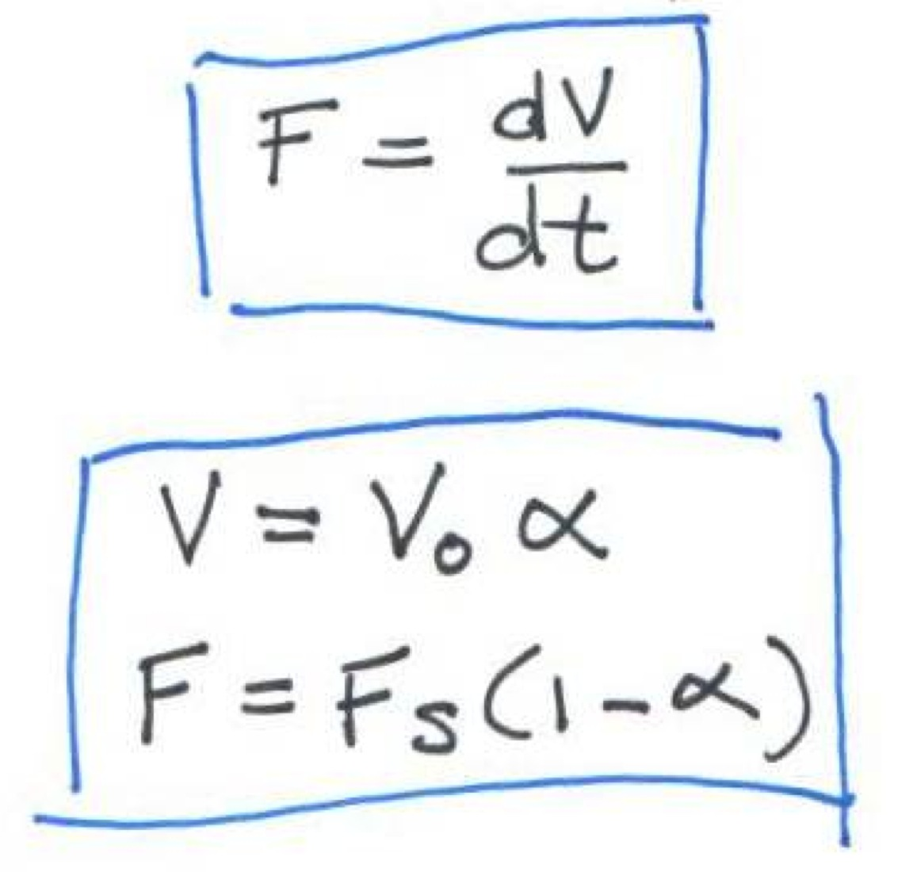
Need 2nd relation
m

Slide 9
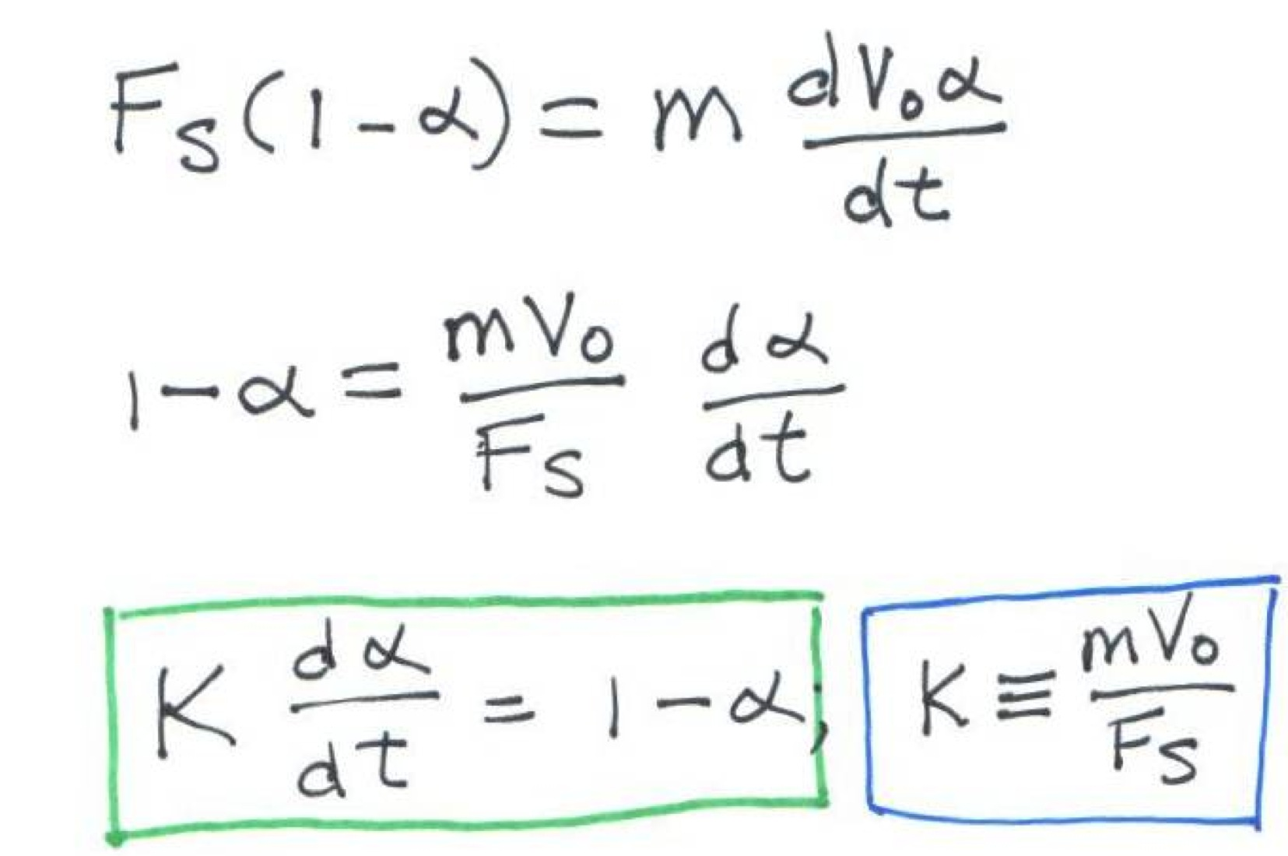
Do the math...
m

Slide 10
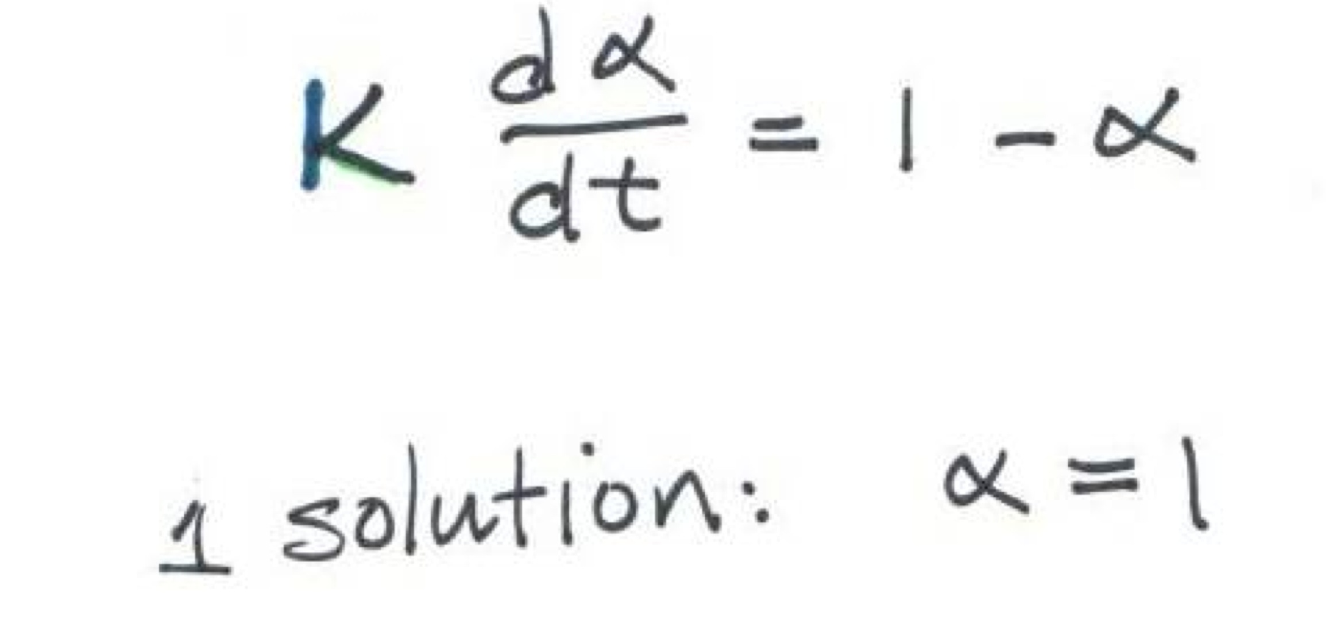
Solve the Differential Equation

Slide 11
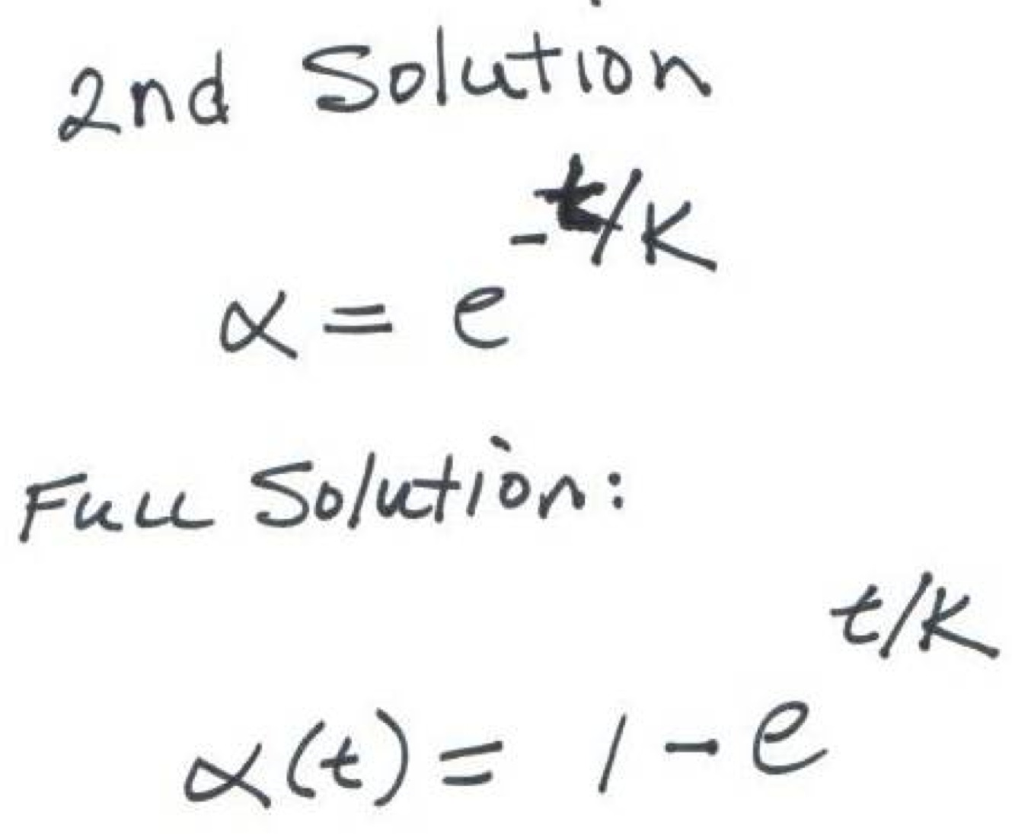
2nd Solution
A
Choose A = -1 so that α(0)=0

Slide 12
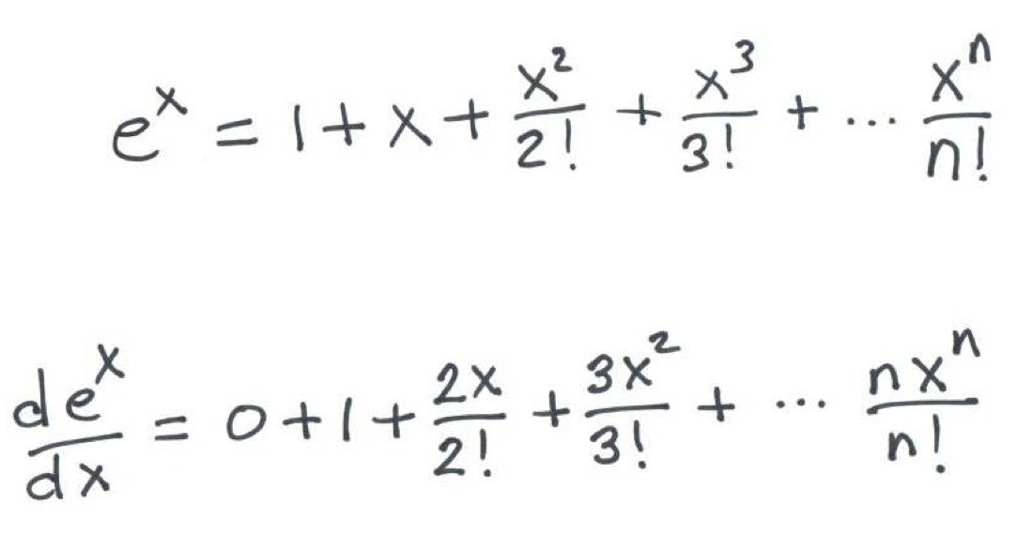
-1

Slide 13
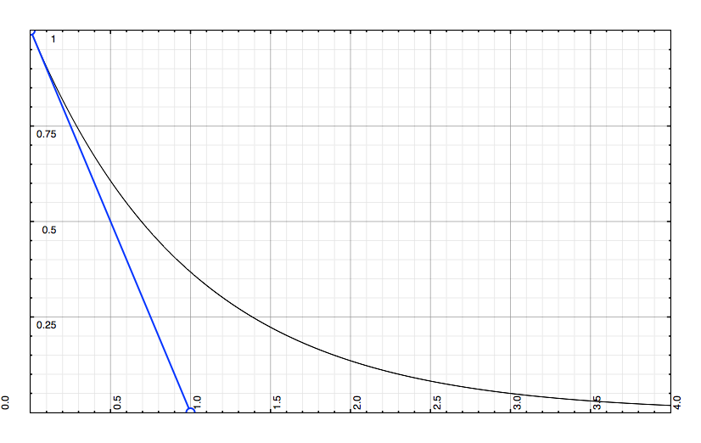
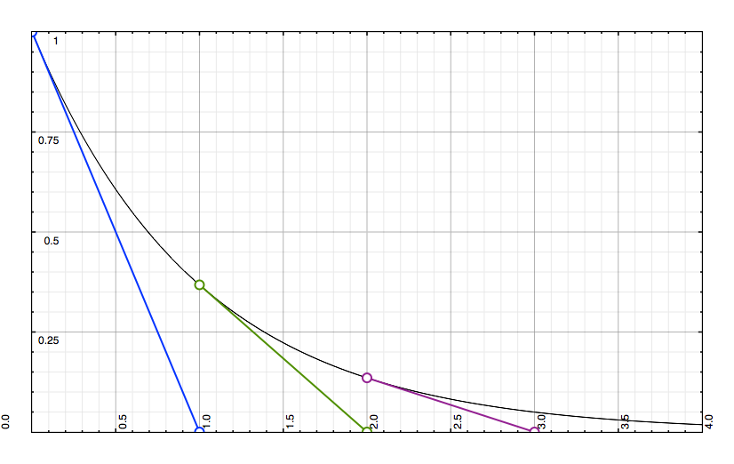
f(x) = e^{-x} Slope of f(x) = -f(x)

Slide 14
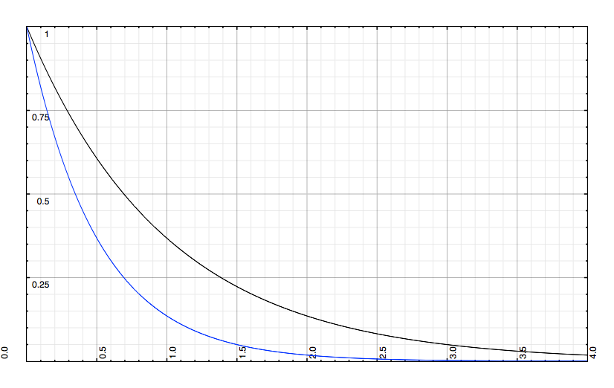
e^{-t/k} Effect of Time constant, K
K = 1
K = 1/2

Slide 15
K for our Robot
Notes:
Analyse for units.

Slide 16
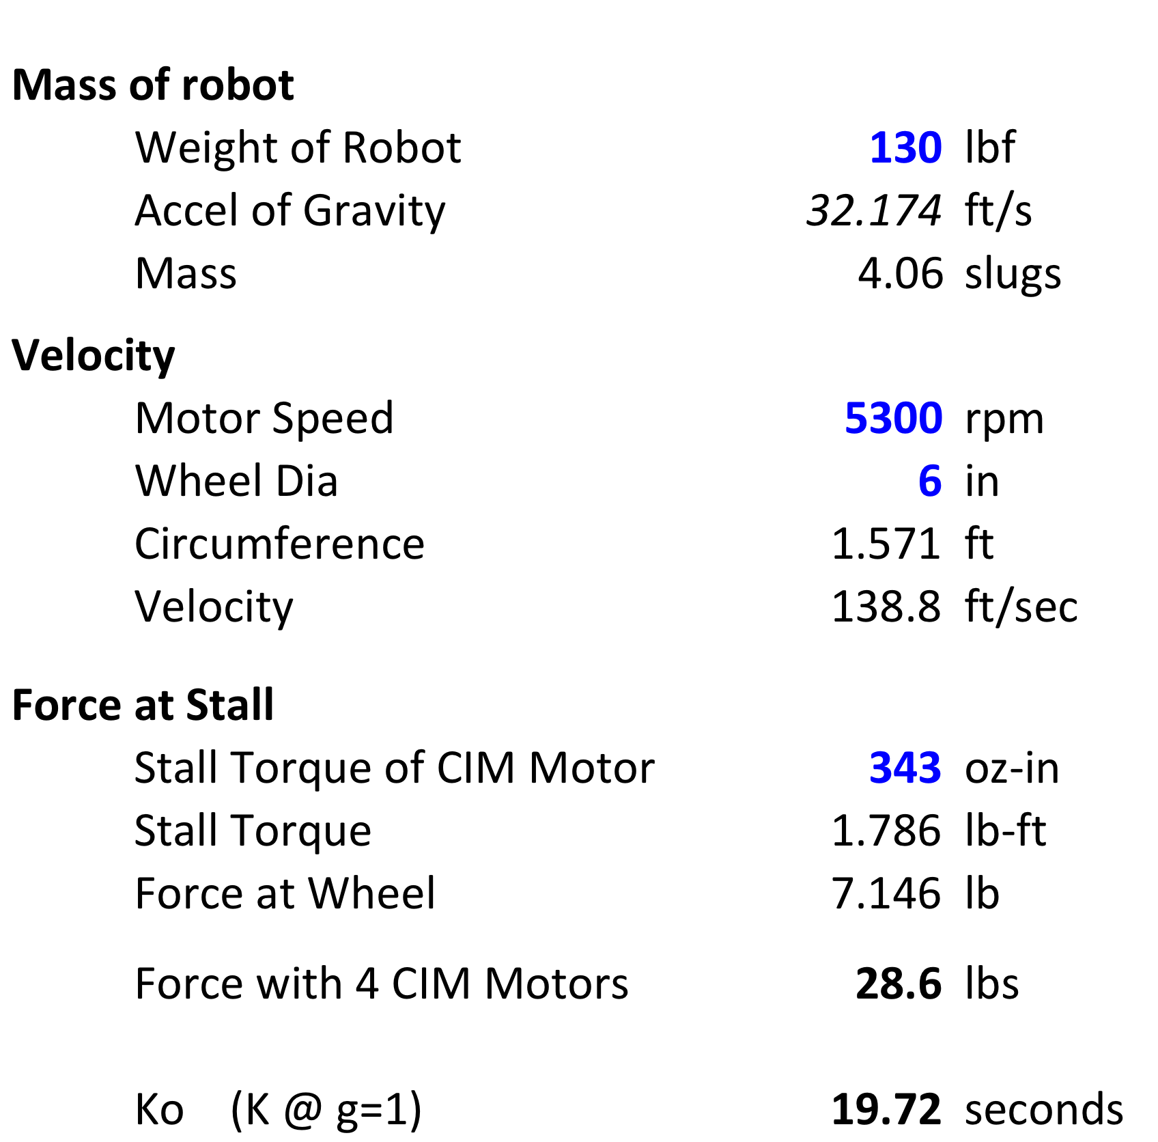
K for our Robot
A pound-force is the amount of force required to accelerate a slug at a rate of 1 ft/s²

Slide 17
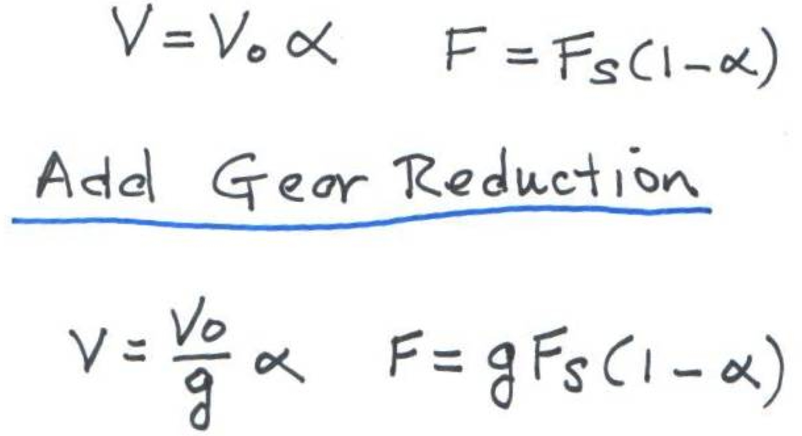
Add Gear Rduction Improve Force at Wheel

Slide 18
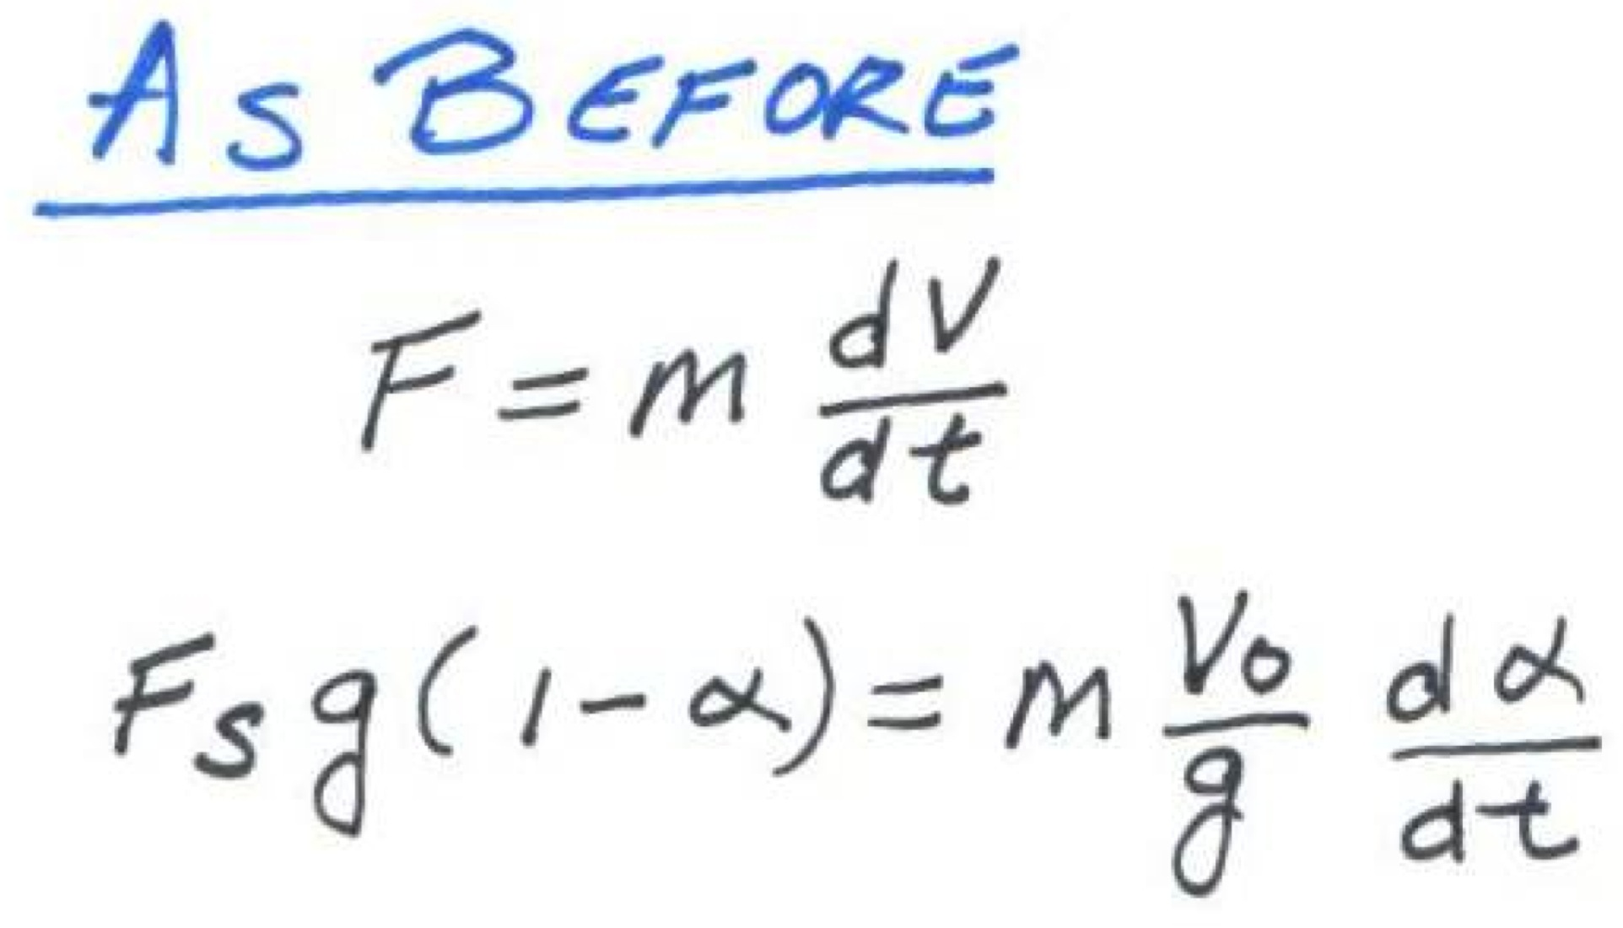
Speed/Force diff.eq. with Gear Reduction

Slide 19
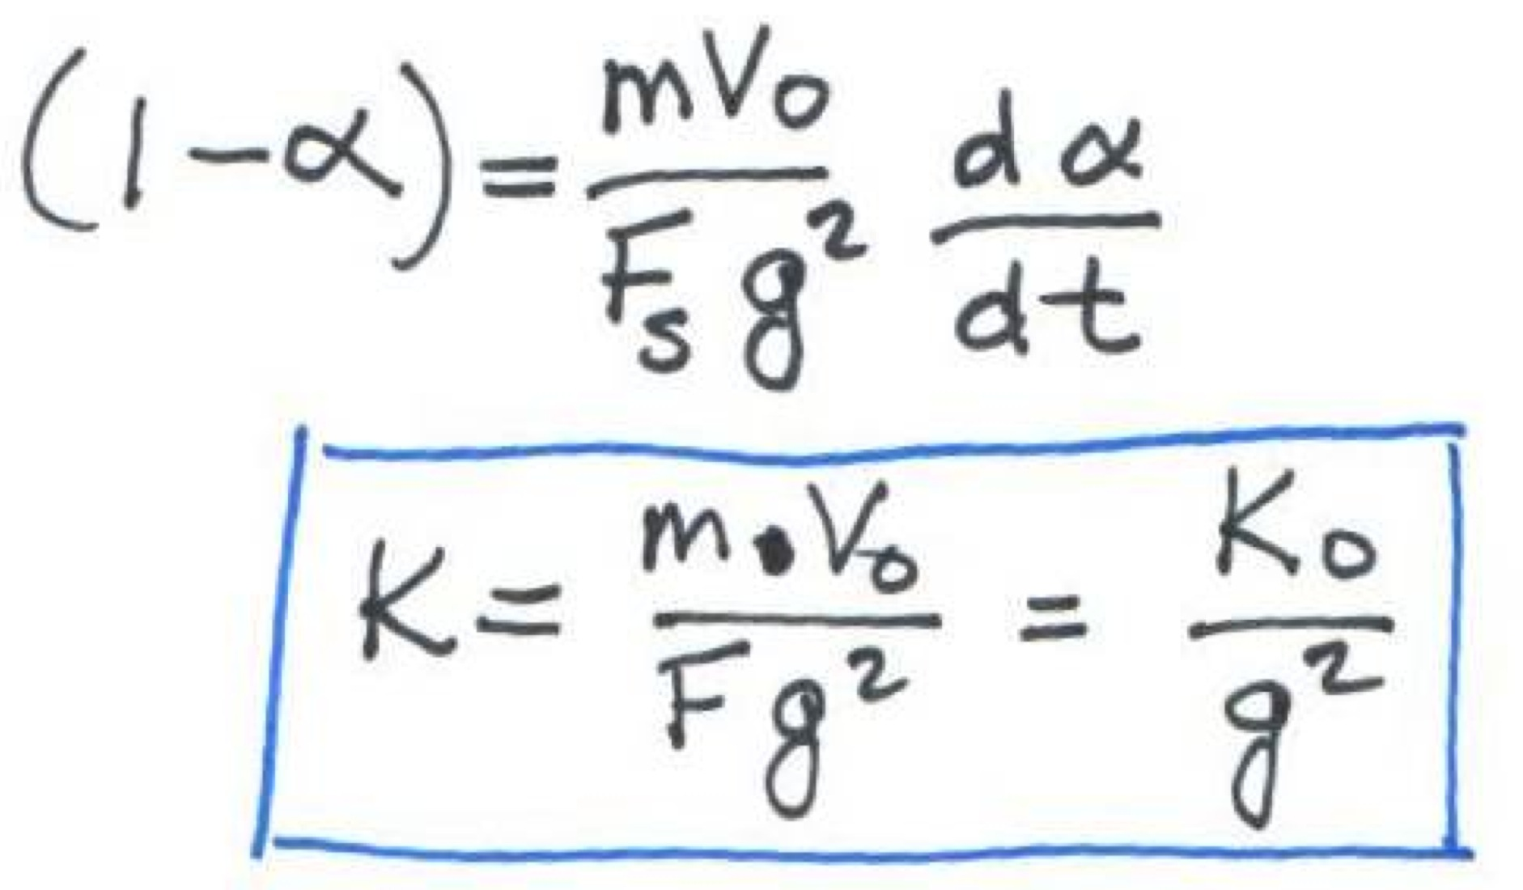
Speed/Force diff.eq. with Gear Reduction

Slide 20
K for our Robot
Notes:
Analyse for units.

Slide 21
Effect on Alpha(t,g)

Slide 22
Velocity as function of GearRedux

Slide 23
Effect on Velocity(t,g)

Slide 24
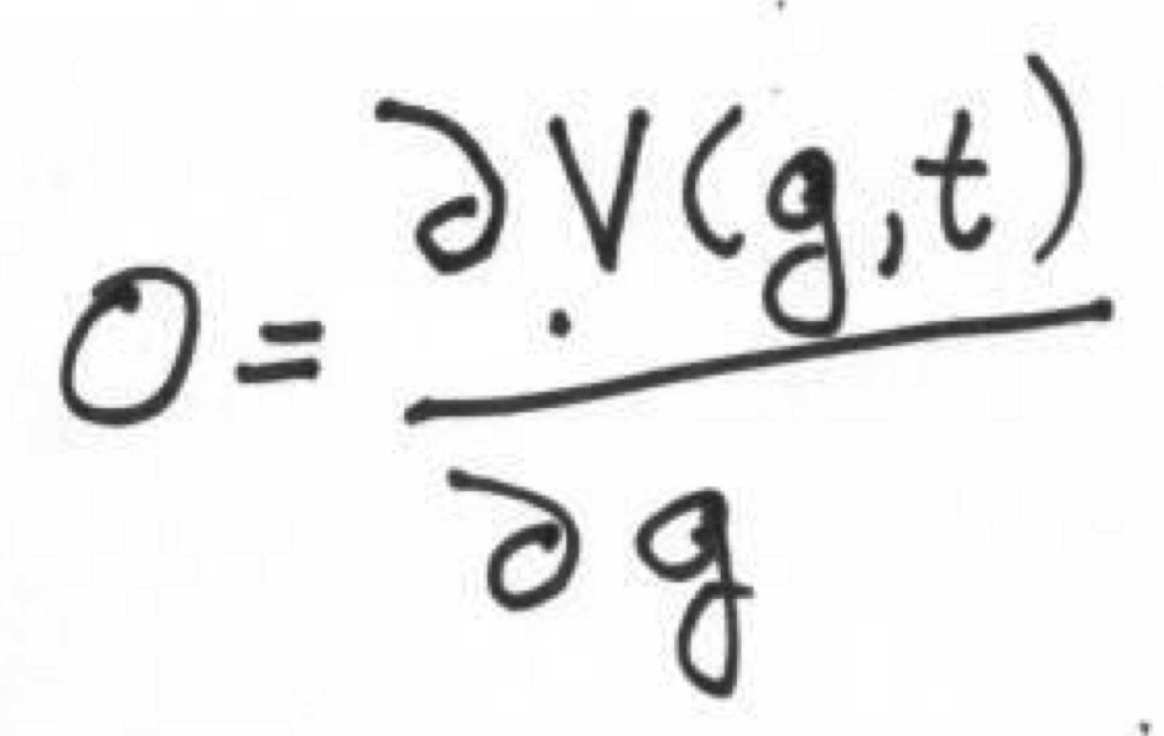
Optimize V – pick best ‘g’

Slide 25
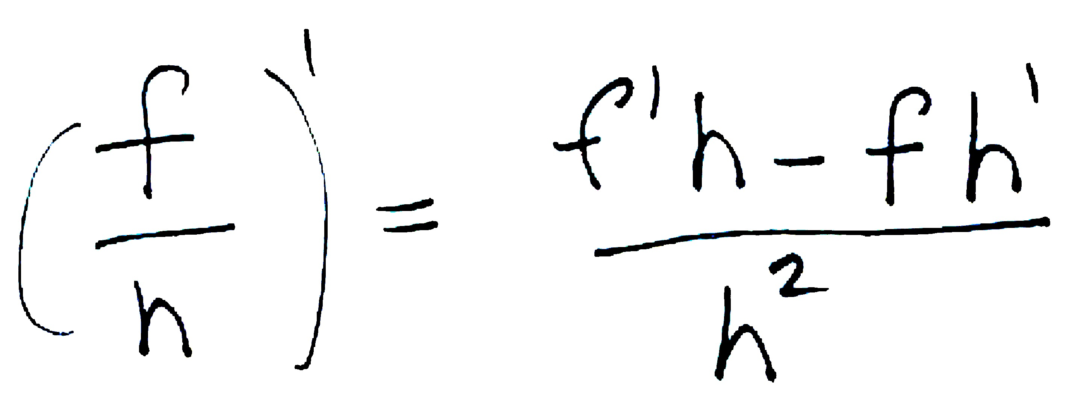
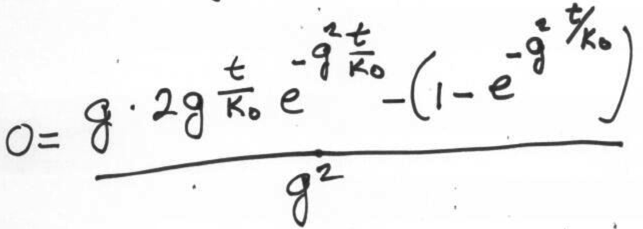
Optimize V – pick best ‘g’
Quotient Rule for derivatives:

Slide 26
Optimize V – pick best ‘g’
Quotient Rule for derivatives:

Slide 27
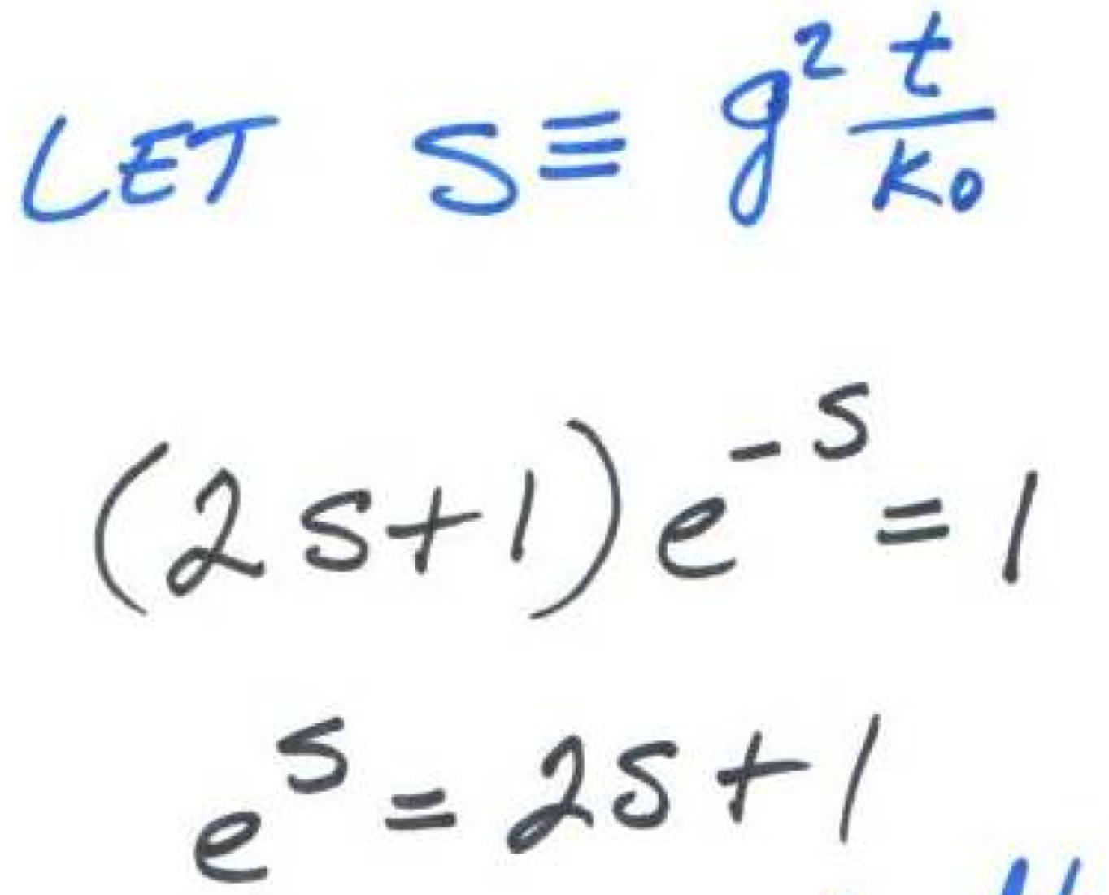
Optimize V – pick best ‘g’

Slide 28
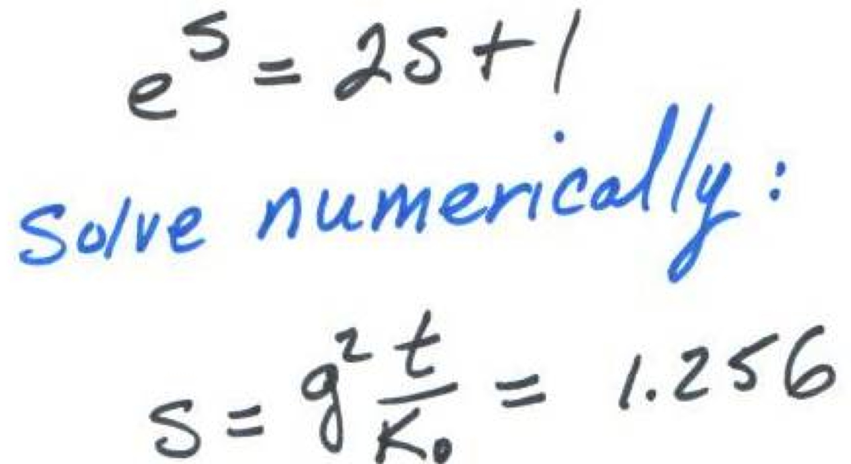
Optimize V – pick best ‘g’

Slide 29
Graphical check: Plot best V
0.63980 @ s=1.2564

Slide 30
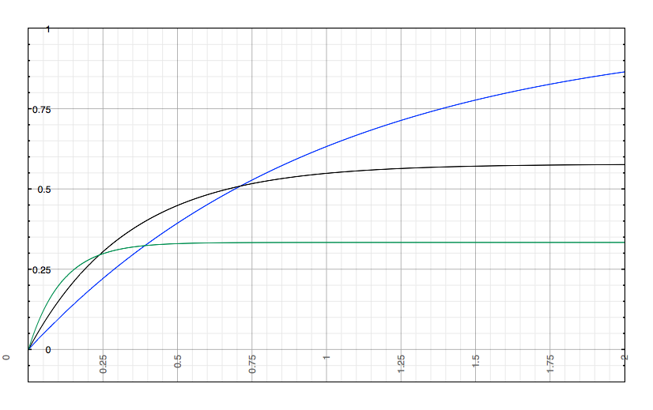
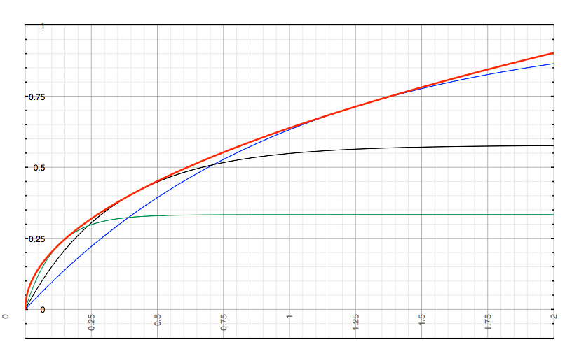
Optimum V
Optimum choice of g envelopes all other curves
This validates the math...
Notes:
Optimum choice of g as function of t envelopes all other curves

Slide 31
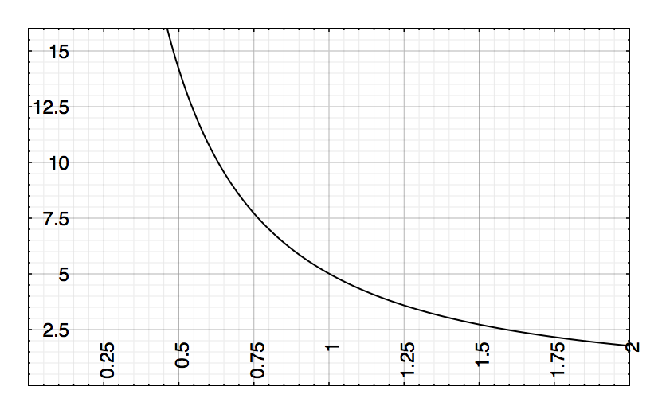
Optimum g for Velocity
K_{o} = 20 seconds
Gear Ratio
Target Time (sec)

Slide 32
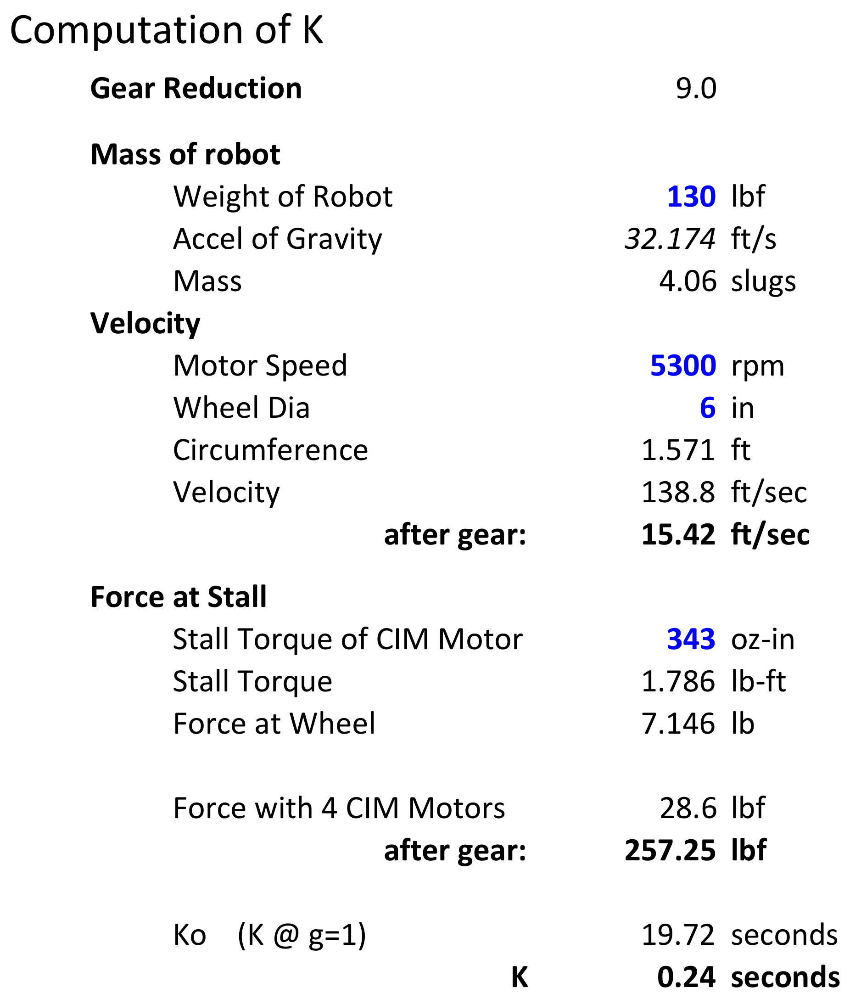
K for our Robot w/GearRedux
Notes:
Analyse for units.

Slide 33
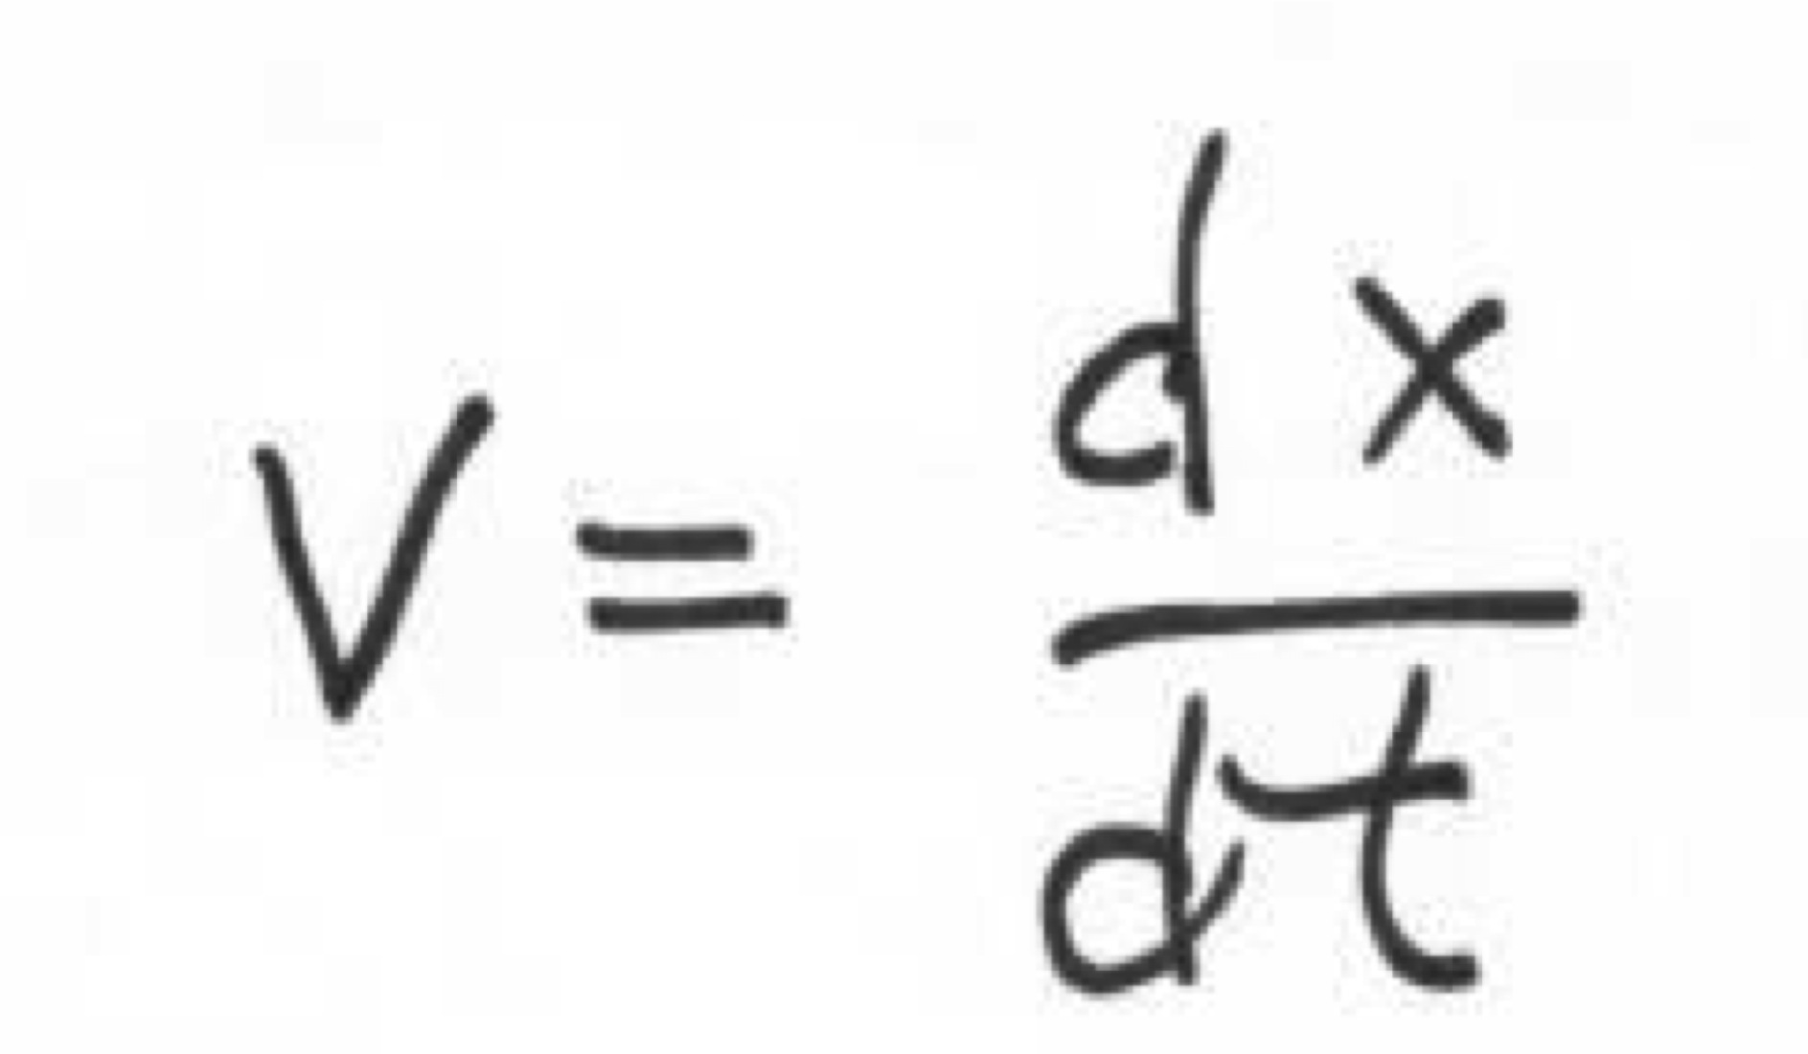
Optimize for Distance

Slide 34
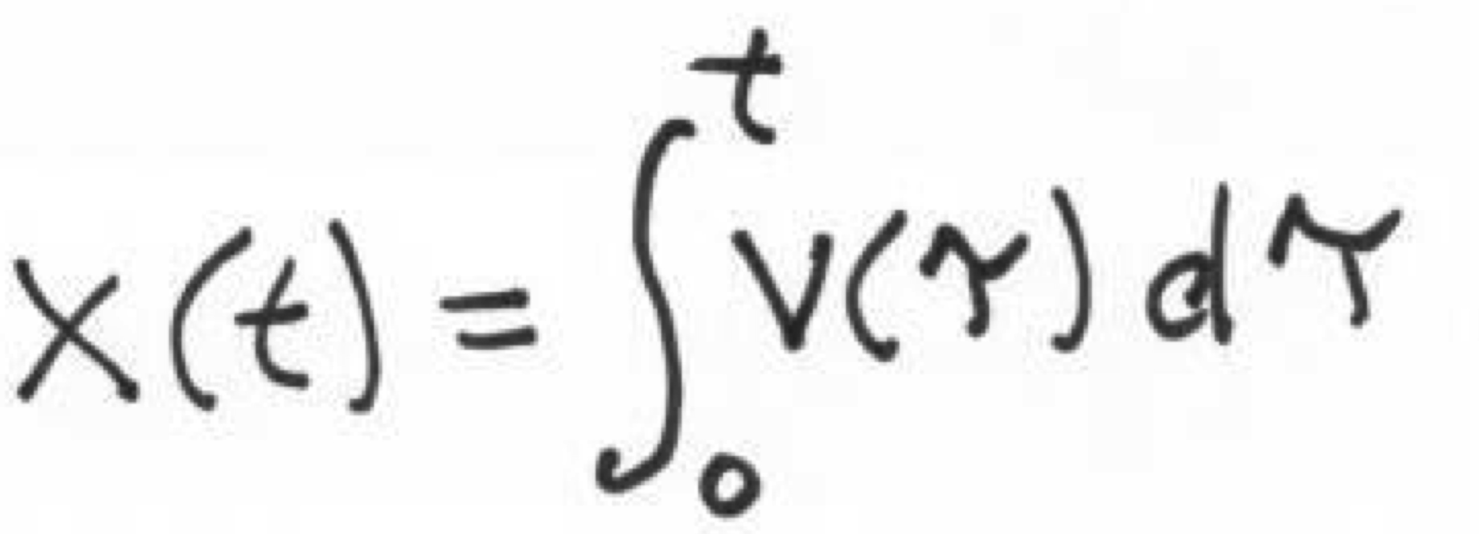
Optimize for Distance

Slide 35
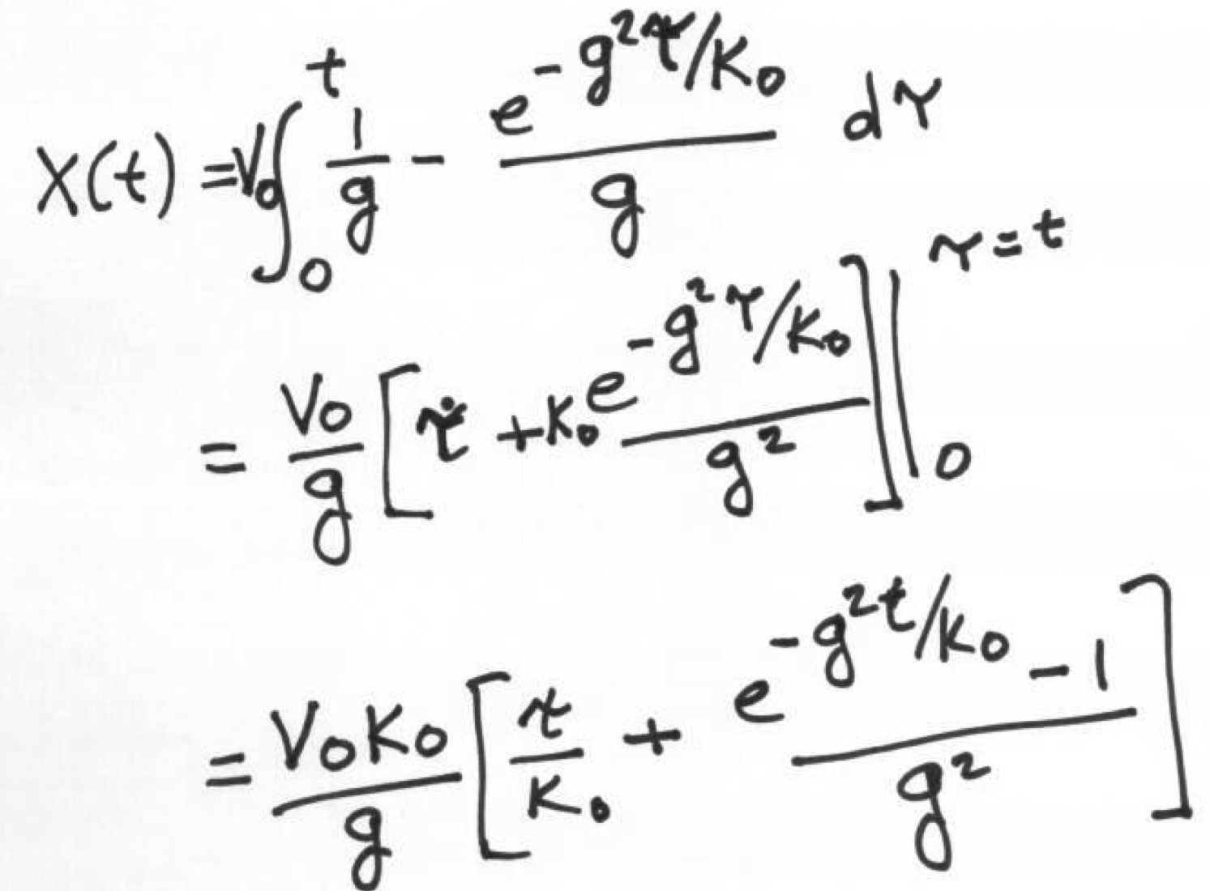
Optimize for Distance

Slide 36
Optimum GearRedux for Distance

Slide 37
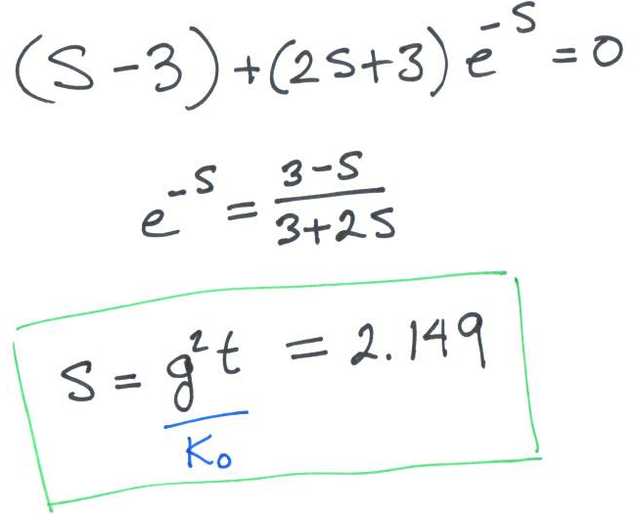
Optimum Ratio for Distance

Slide 38
Optimum Ratio for Distance

Slide 39
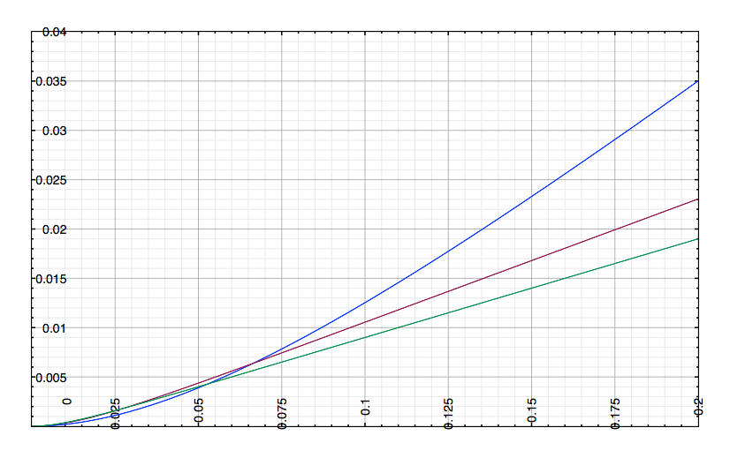
Distance vs Time and Gear Redux.
g=4
g=8
g=10

Slide 40
Distance vs time & gear reduction
Distance➔ ✚
Time➔ ✚
⬅ Gear Reduction ➔ ✚

