Slide 1
Introduction to Robot Subsystems
Presented By:
Lynbrook Robotics, Team 846
Available online at lynbrookrobotics.com
Resources > WRRF Presentations

Slide 2
Pneumatics
Yiming Jen and Haochuan Ni presents…

Slide 3
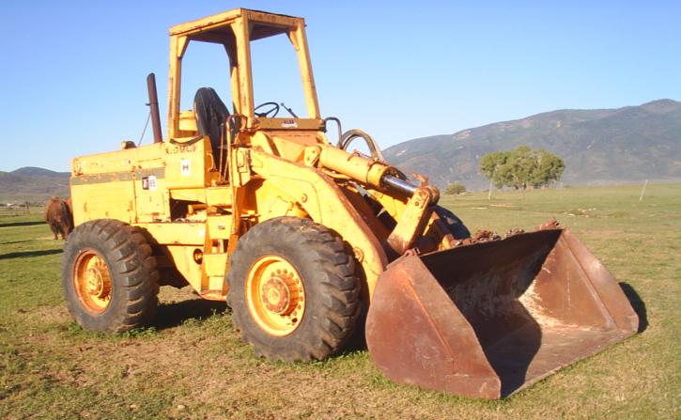
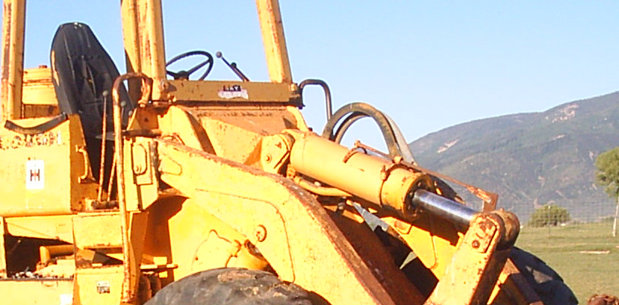
Pneumatics - Definition
Pneumatics is the use of pressurized air to achieve mechanical movement
Notes:
Pneumatics is a term you may have seen or heard on TV. Anyone here watch Mythbusters?

Slide 4
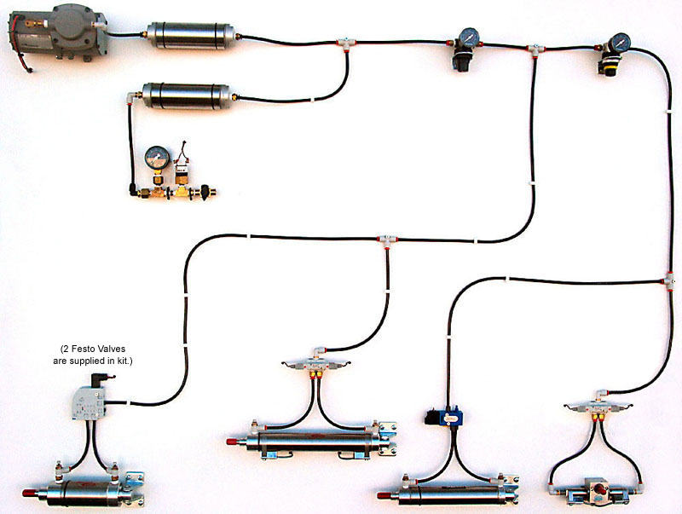
Compressor
Actuator
Valve
From FIRST pneumatics manual
Notes:
What we have here is a thorough pneumatic system. This particular system has pretty much all the components you’ll find on any FIRST robot using pneumatics. This may look intimidating with so many parts laid out. But once we get look at the individual components and see how they work, this picture will make sense.

Slide 5
From FIRST pneumatics manual

Slide 6
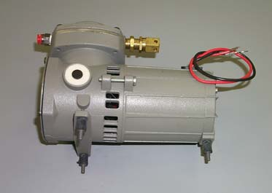
Compressor
Source of energy in pneumatic system
Compacts air
(animation)
Notes:
This is the Denver Gardner Thomas pump that FIRST provides to rookie teams. This is what gives the pneumatic system its energy by compacting air.
Diaphragm compressor, axial compressor (turbine), piston compressor

Slide 7
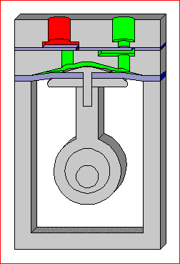
Diaphragm pump
Notes:
DEMO notes: Lets see the pump in action. What we have here is your typical Denver Gardner Thomas compressor that’s powered by this battery here. This is the output of the compressor, and when I turn this plug valve to seal this port, we have an enclosed space that the compressor pumps air into. *hits the switch* This pressure gauge here indicates the pressure at the output of the compressor. When the pressure of the output has reached a certain limit, typically 120 psi, this electrical pressure switch here would open, and that would turn off the compressor. You can hear the compressor pulsing every now and then. We unfortunately have small leaks in the system that vents pressurized air. When this pressure switch detects that the pressure has dropped below a certain value, typically 115 psi, it would close and turn the compressor back on.

Slide 8
From FIRST pneumatics manual
Notes:
Now lets see where the energy of the compressed air is used to get mechanical motion. It’s achieved through these things, called actuators.

Slide 9
Actuators
Actuators convert the difference in air pressure to mechanical motion
Linear actuators (also known as cylinders)
Narrower actuators move more quickly
Notes:
An important note to remember is that the actuator applies full force when the piston isn’t moving.

Slide 10
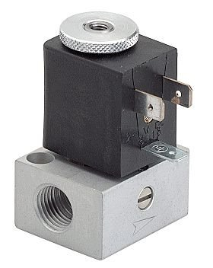
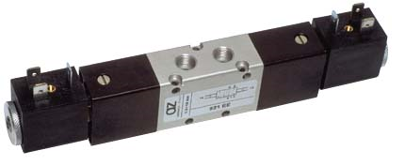
Electric Valves
Controlled by the robot’s CPU
Solenoids opens a port to pressure when a voltage is applied
Double solenoids controls two ports
When one port is open, the other is closed
Festo single solenoid valve
Festo double solenoid valve
Notes:
You see how we controlled which way the cylinder moves with a click of a button. Often times we also want to control when we send compressed air to the cylinders or through which ports. For example, suppose you have a pneumatic pistons that you want to use a cylinder to lift something at the finale. We do this with electric solenoid valves. Although these valves are controlled electrically by the robot’s CPU, they can also be mechanically operated by pressing these buttons. A single solenoid valve allows you to open one port of a cylinder to pressure when voltage is applied, or when I press this button, causing the cylinder to either extend or retract. When voltage is no longer applied, the valve releases the pressure to atmosphere, and whatever load is on the piston will cause it to return to its original position. A double solenoid valve allows you to use the cylinder in both directions. When I press this button or when voltage is applied to this solenoid, the valve would open the blue side to atmosphere and the white side to pressurized air, causing the cylinder have an extending force. When the other solenoid is activated, the white side is open to atmosphere and the blue side to pressurized air, causing the cylinder to have a retracting force.

Slide 11
From FIRST pneumatics manual
Notes:
Now that we see the basics behind pneumatics, we want to know how to usefully incorporate it into our robot when we’re designing it. To do this, we need to control several factors that affect the mechanics of actuators. The first factor is output pressure.

Slide 12
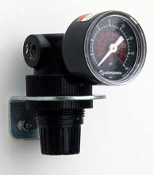
Regulator
Uses air from input to maintain the lower pressure of the output
Maximum of 60 psi for FIRST competitions
Notes:
You can see here that the pressure at the output of the compressor is at 120 psi, but FIRST only allows us to operate our actuators at a maximum of 60 psi. We achieve this pressure drop by using a regulator. It drops the input pressure to an output pressure that you can set by turning this knob. This gauge above the regulator shows pressure that being outputted.

Slide 13
The Force of Linear Actuators
Pressure = Force / Area
Example:
Cylinder bore = 3/4 inch
Operating pressure = 40 psi (pounds/inch²)
Notes:
Demo all components, extending cylinder first, then retracting, then question.
When we design robots, we want to know how much force something can apply. Say that you have a pneumatic device that grips a crystal ball. You can’t grab too hard or the ball will shatter, but you can’t grab to lightly or it will slip from your grasp. You want apply the right amount of force to get the job done.

Slide 14
Forces of Different Bore Cylinders at 40 psi and 60 psi
Bore (inches) | 0.75 | 1.50 | 2.00
Extending (40 psi) | 18 lbf | 71 lbf | 126 lbf
Retracting (40 psi) | 16 lbf | 65 lbf | 113 lbf
Extending (60 psi) | 26 lbf | 106 lbf | 188 lbf
Retracting (60 psi) | 24 lbf | 97 lbf | 170 lbf
From FIRST pneumatics manual

Slide 15
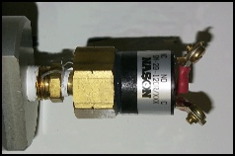
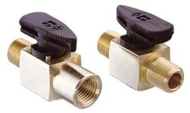
Common Valves and Fittings
Pressure switch
Release valve
Plug valve
Flow-rate valve
Notes:
Notice this cylinder. On this end it has a common L join, but the one on this side has a screw on top. This is a flow-rate valve. <explanation> Because of this, you can fit two of these valves on the cylinder and that allows you to independently control the extending and retracting speeds.

Slide 16
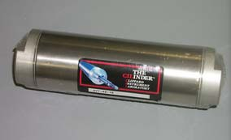
Tank
Tanks allows more air in the system
When air is lost, psi drop is mitigated by larger tanks

Slide 17
From FIRST pneumatics manual

Slide 18
Electrical Components
Karthik Viswanathan presents…
Notes:
Electrical = power distribution + power control
Electronics = low power sensors and circuits
BDCComm

Slide 19
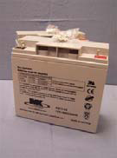
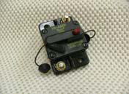
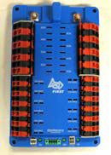
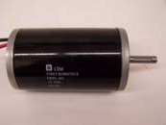
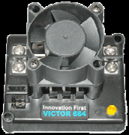
Power Distribution Diagram
20A
CPU
40A
20A
Notes:
Make motor in the corner smaller to resemble scaling
Make CPU darker
Put red/black lines closer together
Put currents for the branches – CPU = 20 A, Spike = 20 A, Speed Controller = 40 A,

Slide 20
Battery
12 V Lead-Acid, 18 AH
Supply over 100 amps of current ~1200W
13 pounds
Take precautions: 700 amps when terminals are shorted
Notes:
Explain battery safety
Two hands because it is heavy
Nylon stop nut is a tip
Remove #10 screw - done
Smaller than a car battery
Fix spacing
Remove bullet point for take precautions
Change text
NEED TO SAY
Terminals are separate
Wrench
Welded together

Slide 21
Power Distribution Diagram
20A
CPU
40A
20A
Notes:
Make motor in the corner smaller to resemble scaling
Make CPU darker
Put red/black lines closer together
Put currents for the branches – CPU = 20 A, Spike = 20 A, Speed Controller = 40 A,

Slide 22
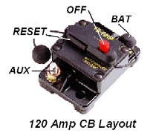
Robot Power Switch
Handles high current
Doubles as 120 amp circuit breaker
Opens if current exceeds 120A
Does not automatically reset
Place in an accessible location
Frequently used
Emergency shut-off
Notes:
Not located accessibly
Should be in an easy-to-access area
On/Off switch
Fire hazard
Retitle to robot power switch
120 amp circuit breaker
Control should be changed to limit
Exceed 120 amps and it will break
Remove bullet points when not necessary
High current switch
Handles high enough current
Primary importance
Doubles as a circuit breaker

Slide 23
Power Distribution Diagram
20A
CPU
40A
20A
Notes:
Make motor in the corner smaller to resemble scaling
Make CPU darker
Put red/black lines closer together
Put currents for the branches – CPU = 20 A, Spike = 20 A, Speed Controller = 40 A,

Slide 24
Power Distribution Board
Provides branches with resettable fuses
Each motor must be on its own branch circuit
20 - 40 amp fuse range
Depends on wire diameter
Smaller diameter creates higher resistance and can be dangerous
Notes:
Speaking
Smaller diameter wire has a higher resistance Fuses based on wire size
Resistance higher will draw high enough current even with 120 amp circuit
Personal experience on popping
Explain fuses
Change red circles on master slide
“Enough current…” seems a bit cryptic
Possibly pull up sheet on fuses
Personal experience on popping
Smaller wires have less resistance
Smaller fuses to reduce the risk of fires
Required to use large diameter for higher current circuits

Slide 25
Power Distribution Diagram
20A
CPU
40A
20A
Notes:
Make motor in the corner smaller to resemble scaling
Make CPU darker
Put red/black lines closer together
Put currents for the branches – CPU = 20 A, Spike = 20 A, Speed Controller = 40 A,

Slide 26
Power Distribution Diagram
20A
CPU
40A
20A
Notes:
Make motor in the corner smaller to resemble scaling
Make CPU darker
Put red/black lines closer together
Put currents for the branches – CPU = 20 A, Spike = 20 A, Speed Controller = 40 A,

Slide 27
Power Distribution Diagram
20A
CPU
40A
20A
Notes:
Make motor in the corner smaller to resemble scaling
Make CPU darker
Put red/black lines closer together
Put currents for the branches – CPU = 20 A, Spike = 20 A, Speed Controller = 40 A,

Slide 28
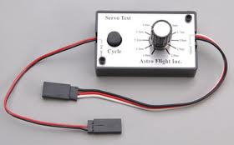
CPU
Sends commands to the electronic speed controller
Can be replaced with servo tester
Generates control signal
Found at hobby stores
CPU
Notes:
Servo testers at hobby stores to generate control signal for ESCs
Speaking
Servo is closed loop motor control
Expand ESC
Fix
CPU darkness

Slide 29
Power Distribution Diagram
20A
CPU
40A
20A
Notes:
Make motor in the corner smaller to resemble scaling
Make CPU darker
Put red/black lines closer together
Put currents for the branches – CPU = 20 A, Spike = 20 A, Speed Controller = 40 A,

Slide 30
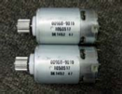
Motors
Only allowed to use motors inside the kit of parts
Rules may allow purchasing extra motors of the same type
CCL Industrial Motor (CIM)
Mabuchi Motor
Johnson Electric Motor
Notes:
Replace with collection of motors
Only allowed to use motors inside the kit
Be aware that the rules may specify that you can buy extra motors (of the same type)
Discuss major types of motors
FIX:
scaling of pictures
Mabuchi is the motor on the left
Caption
Properly identify with companies
CIM = CCL industrial motor
Johnson electric motors for FP
Mabuchi

Slide 31
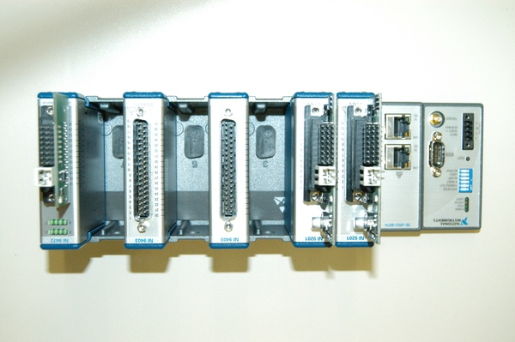
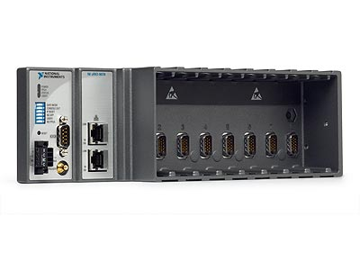
CPU
2010 cRIO microcomputer
Cannot directly control motors; not enough power
Use relays as an intermediary
Notes:
Change terminology to CPU (2010 cRIO microcomputer [check terminology on National Instruments])

Slide 32
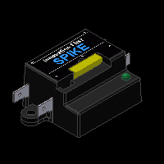
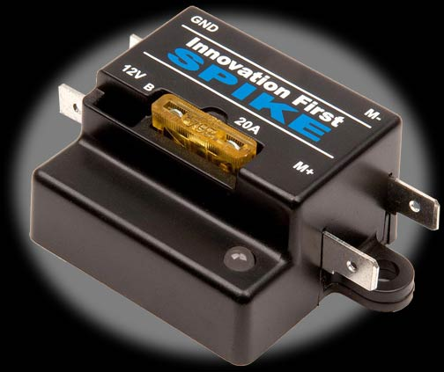
Spike Relay Specifics
Control direction
Only +12 V supply
How do we go both forward and back?

Slide 33
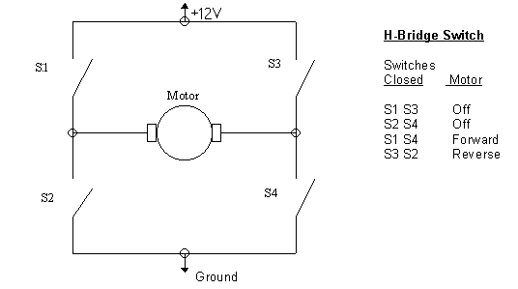
H-Bridge
4 switches used to change direction
Inside Spike relay
Notes:
Spike in capital and italics
NEED TO SAY
Two different relays
Transistors

Slide 34
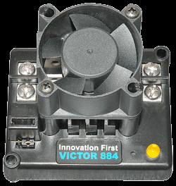
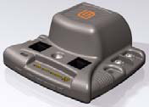
Speed Controller
2004 Victor
2009 Jaguar
How is direction controlled?
Variable amount of power
Notes:
2004+ Victor
2009+ Jaguar

Slide 35
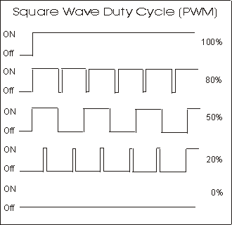
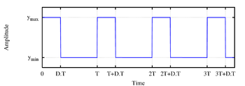
Pulse-Width Modulation
Applying variable power by electronically switching between fully on and fully off
Notes:
Voltage applied only 50% instead of power
Variable resistor first
On and off so no mechanical switch
Transistor
Introduce new slide for communication (see bottom of these notes)
Remove odd picture
Radio control signal for the Victor
Describe frame from 20ms to 40ms
PWM communication
Immune to electronic noise
Introduce slide for communication
Spike with three wires - 3 wire servo cable
Victor/Jag use PWM data signal + description
Jaguar also has data communication port for the CAN-Bus

Slide 36
ESC Communications
Victor/Jaguar use PWM data signal
Send information on how to power the motors based off the width of pulses
1ms for full reverse, 1.5 ms for off, 2 ms for full forward
Immune to noise
Jaguar also has a port for the CAN-Bus

Slide 37
CAN-Bus
Controller-Area Network
Vehicle communication network between the CPU and Jaguar speed controllers
Benefits: less wiring, current and temperature polling
Drawbacks: learning curve, hard to find support
Notes:
Area capitalized
NEED TO SAY
Comm method similar to Internet network but for autos

Slide 38
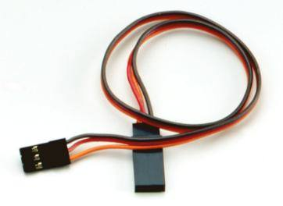
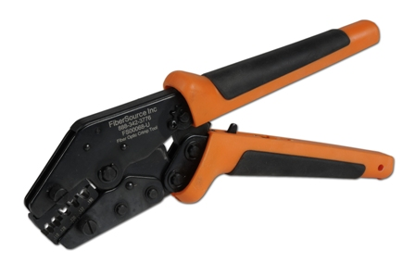
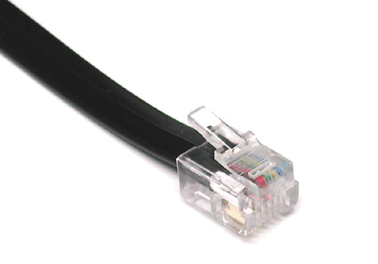
CAN-Bus Wiring
Telephone-style RJ11 instead of servo wire
Easy to make custom length with crimp tool
Daisy-chained
Notes:
Called servo wire because it is used to connect to the servos of remote-controlled vehicles
NEED TO SAY
Servo wire coming loose
Crimper cheap at Radio Shack/Home Depot

Slide 39
CAN-Bus Software
cRIO’s serial port communication is slow
Ethernet to CAN adapter for $200 provides fast communication
Software solution for serial port
Separate process designed solely to communicate with the CAN-bus
Avoid redundancy by caching old values
Notes:
NEED TO SAY
Show BDC-Comm software utility with the lightbulb example
Show how much current is flowing and the temperature
Questions

Slide 40
Sensors and Electronics
Brian Axelrod and Nikhil Unni present…

Slide 41
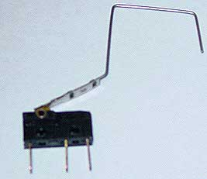
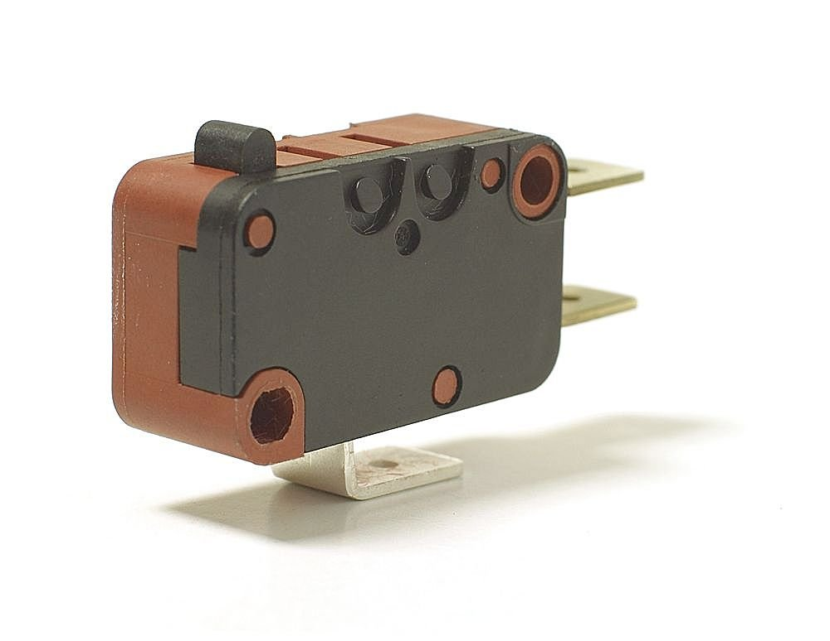
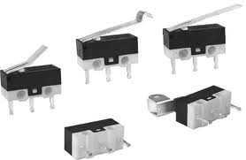
Limit switch
A simple switch
Can be set up to be triggered near a physical limit

Slide 42
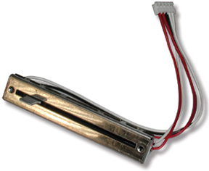
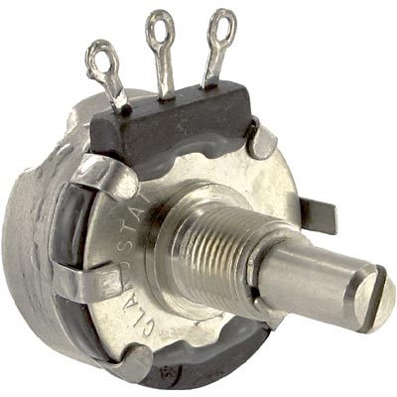
Potentiometers (Pots)
Sensor for measuring position:
Rotation, distance, etc.

Slide 43
Potentiometers
Slider is connected to output.
Simplest type:
Slider
+5V
+5V
+5V
5V
100%
Output
2.5V
50%
10 KΩ
0V
0%
GND
Ground/0V
Ground/0V

Slide 44
Reading the Value
Analog voltage level
Analog-to-Digital Converter (ADC)
Converts to number
0-1023 for 10-bit ADC
Comes in kop with cRio as analog module 8 ports
Easy to implement in code
m_liftPot.GetAverageValue()

Slide 45
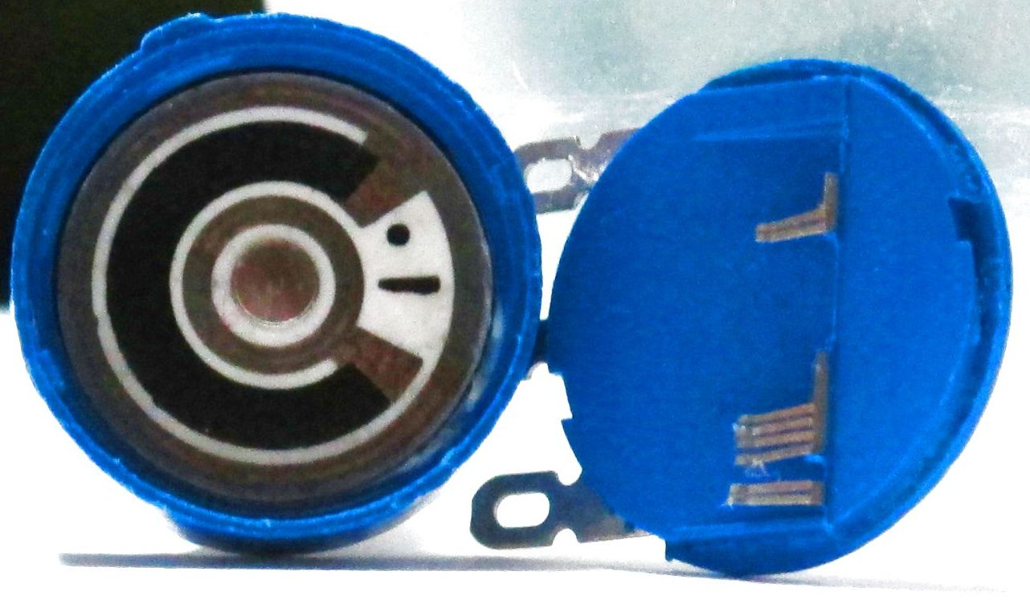
Pots: Uses
Sense position: e.g. lift
How to sense the lift position?
Travel length is 6 feet
No linear pot long enough
Rotary Pots

Slide 46
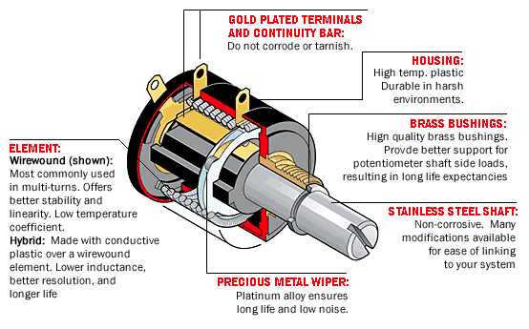
Pots
Multi-turn pot:
Usually 3, 5, or 10 turns
Alignment is important!
Continuous rotation: use encoder

Slide 47
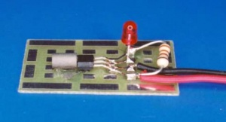
Hall effect sensor
Detects a magnetic field
Longer range
Can be switched really frequently

Slide 48
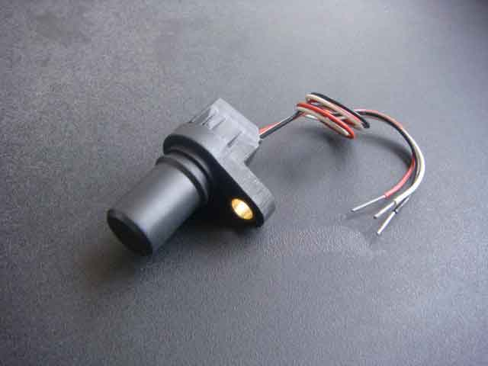
Gear tooth sensor
Counts the teeth that went by on a nearby gear

Slide 49
Optical Encoders
to controller
Optical Sensor
Optical Sensor
to controller

Slide 50
Optical Encoders
to controller
Optical Sensor
Optical Sensor
to controller

Slide 51
Optical Encoders
Determining Distance Travelled
Count pulses
Example:
Given: Encoder stripes = 128
Given: Wheel diameter = 6”
Given: counted 85 pulses
= 12.52 inches

Slide 52
Optical Encoders
Determining Speed
A. Count pulses per interval
Example: in 1 second, 256 pulses.
Speed = 2 revolutions/second
Inaccurate and slow

Slide 53
Optical Encoders
Determining Speed
B. Measure time between pulses
Example: time between two pulses = 3.9ms
Only requires observing two consecutive pulses

Slide 54
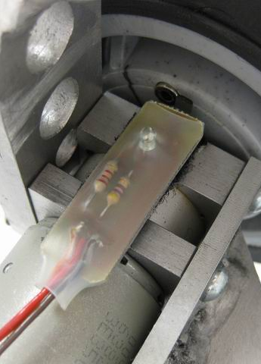
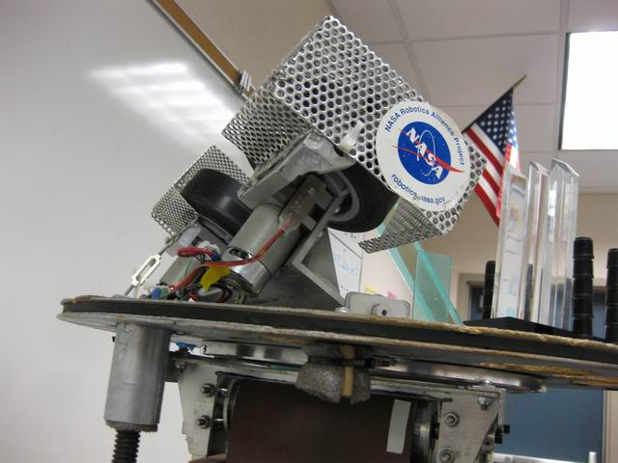
Other Encoders
Hall Effect Sensor, and embedded magnet in wheel
Our 2006 robot’s ball launcher
using encoder as a speed sensor

Slide 55
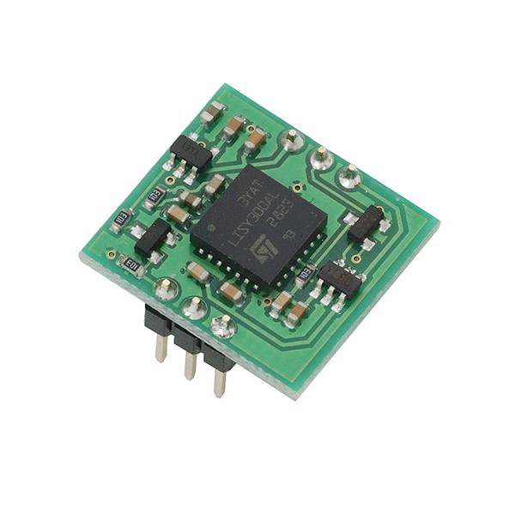
Yaw Rate Sensor/Gyro
Also commonly known as a gyro
Indicates rotational velocity

Slide 56
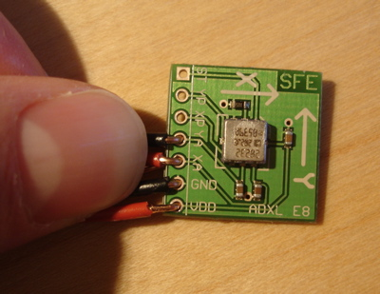
Accelerometer
Measures acceleration
Detects gravity
Going above max acceleration will give you wrong readings
Detect if going up a bump straight

Slide 57
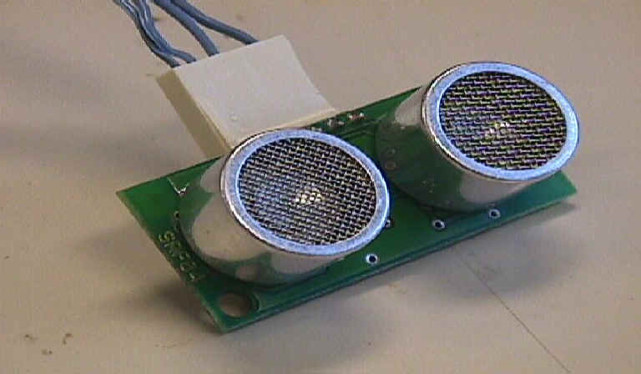
Sensing Distance: Ultrasonic Sensors
Determine distance
Send pulse of sound
Measure time until echo

Slide 58
Infrared Proximity Sensors
Determines distance to object in front of it
Analog voltage reading
vs. ultrasound:
Shorter range
More accurate
Strip of light sensitive material
IR light source

Slide 59
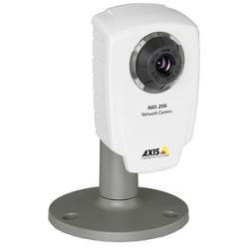
Camera
Not a magic bullet
Always use other sensors if possible
Can choke your machine
Image processing

Slide 60
Conclusion
Never rely on the operator to do the right thing
Useful for adding functionality and as safety features
Large variety of sensors that can detect a variety of parameters
Can buy sensors at
Trossen robotics
Digi-key
Mouser

Slide 61
Choosing the Right DriveTrain
Sarat Calamur, Chinmay Jaju & Alric Siu present…

Slide 62
Required Capabilities
General Requirements
Speed
Controllability
Game Specific Requirements
Point-to-point movement
Turning in place

Slide 63
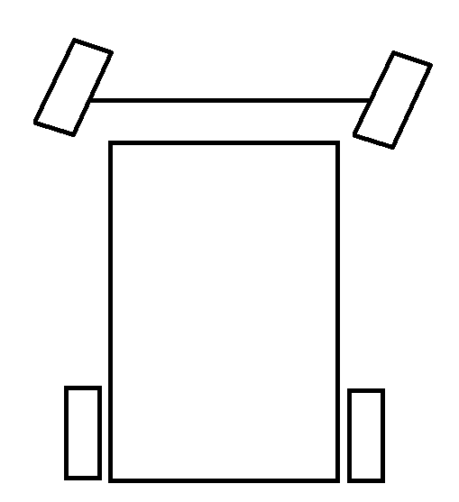
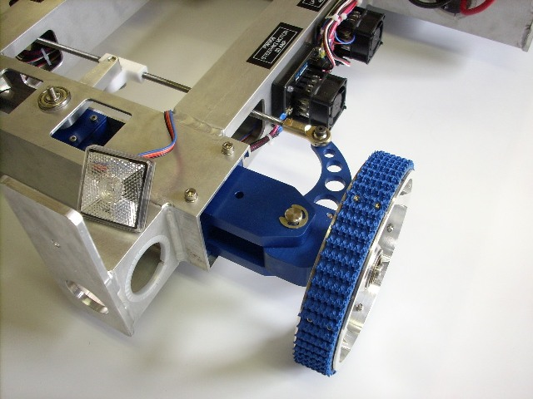
Ackerman Steering
Team 34’s Design on Chief Delphi
Notes:
Distinction b/ween common for frc and everyday

Slide 64
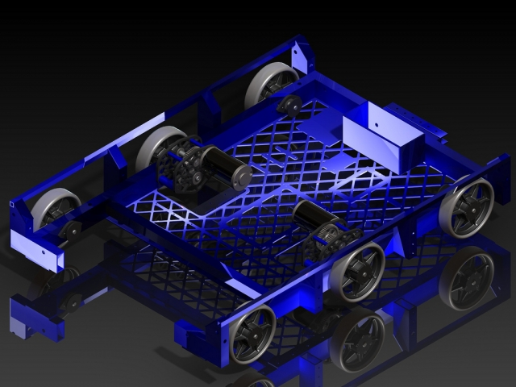
Differential/Tank Steering
Power left and right sides independently
1 Joystick Per Side
Notes:
Swap picture… comment that not only treds we have wheels same concept

Slide 65
4 Wheels Differential Steering
Wheels slide to turn
Notes:
Bt how well does this work???? Lets look at some math.

Slide 66
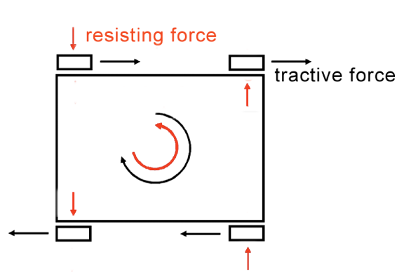
Ability to Turn
Wheels generate force while friction resists
Turning Torque – Resisting Torque

Slide 67
Terminology:
Track (W )
µ = Coefficient of Friction
Weight = Weight of the robot
F = Force
T = Torque
Wheelbase
(L)

Slide 68
Maximum Turning Force Per Wheel (F_{TMax})
Track (W )
Wheelbase
(L)

Slide 69
Maximum Turning Torque of robot (T_{TMax})
Track (W )
W/2
Wheelbase
(L)
Notes:
Loosely speaking, torque is a measure of the turning force on an object such as a bolt or a flywheel. For example, pushing or pulling the handle of a wrench connected to a nut or bolt produces a torque (turning force) that loosens or tightens the nut or bolt.

Slide 70
Maximum Resisting Torque (T_{Resisting})
Track (W )
L/2
Wheelbase
(L)

Slide 71
Turning Torque v. Resisting Torque

Slide 72
Wheel layouts
Remember: Turning Force – Resisting Force
Only square and wide robots can turn

Slide 73
6 Wheel Layout
Weight spread over 6 wheels
Only 4 wheels resist turning

Slide 74
Turning Torque v. Resisting Torque

Slide 75
6 Wheel Layout
4/6 the resisting force

Slide 76
6 Wheels dropped center
Center wheels dropped about 1/8 inch
“Rock” on center when turning
Improvement of 33% - 100%
10%
30%
10%
Notes:
But now lets look at some other ways to make robots turn more easily

Slide 77
Swerve Drive
Maneuverability
Complicated design
Inability to turn in place
Unless….
Craig Hickman’s Design on Chief Delphi

Slide 78
Wheels
Rubber
Roughtop
Omni-wheels
Tank Treads
Mecanum
AndyMark Wheels
Notes:
Lets take a look at omnis first

Slide 79
Mecanum Wheels
45° Rollers allow lateral movement

Slide 80
Video
Mechanum Wheel Demo
http://www.youtube.com/watch?v=JGAlalbpBLA&feature=related

Slide 81
How it works: Forward movement
http://wiki.robojackets.org/images/0/08/2007_TE_Session_-_Drive_Trains_(Handouts).pdf

Slide 82
How it works: Sideways movement
http://wiki.robojackets.org/images/0/08/2007_TE_Session_-_Drive_Trains_(Handouts).pdf

Slide 83
How it works: Turn in Place
http://wiki.robojackets.org/images/0/08/2007_TE_Session_-_Drive_Trains_(Handouts).pdf

Slide 84
Videos
Omni, Mechanum, Swerve drive examples
http://www.youtube.comatch?v=r5WKgQJtToM&feature=fvw
Nona-drive
http://www.youtube.com/watch?v=6fLf71xlVhE

Slide 85
Conclusion
Covered major components of FIRST robots
Slides available at lynbrookrobotics.com
Resources > “WRRF Presentations”

