Slide 1
Introduction to Robot Subsystems
Presented By:
Funky Monkeys, Team 846
Available online at lynbrookrobotics.com
Resources > WRRF Presentations

Slide 2
Choosing the Right DriveTrain
Presented by:
Miles Chan
Notes:
I am Miles Chan, and I would like to talk to you about choosing the right drivetrain for your FRC robot. A drivetrain is the system responsible for moving your robot.

Slide 3
Drivetrain Requirements
Common Features:
Fast
Easy to turn
High acceleration
FIRST Competition Demands:
Point-to-point movement
Turn in place
Push hard

Slide 4
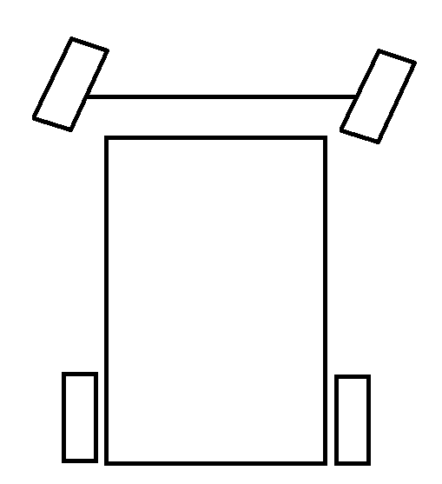
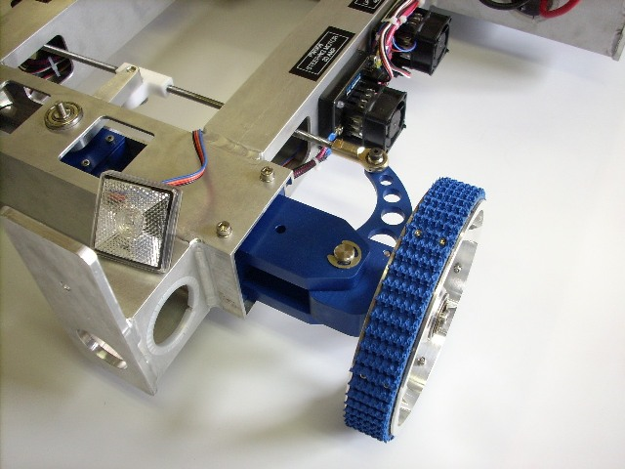
Ackerman Steering
Team 34’s Design on Chief Delphi
Notes:
Distinction between common for frc and everyday

Slide 5
Differential/Tank Steering
Power left and right sides independently
Features
Simple
Easy to drive
Pushes hard
Notes:
Swap picture… comment that not only treads we have wheels same concept

Slide 6
4 Wheels Differential Steering
Wheels slide to turn
Notes:
Bt how well does this work???? Lets look at some math.

Slide 7
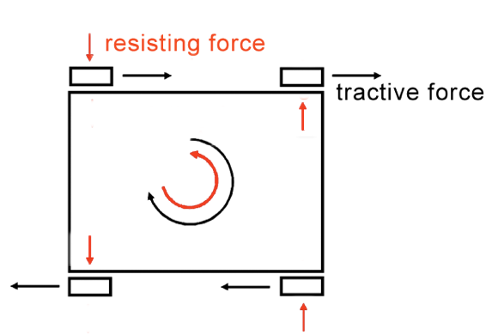
Ability to Turn
Wheels generate force while friction resists
Turning Torque – Resisting Torque

Slide 8
Terminology:
Track (W )
µ = Coefficient of Friction
Weight = Weight of the robot
F = Force
T = Torque
Wheelbase
(L)

Slide 9
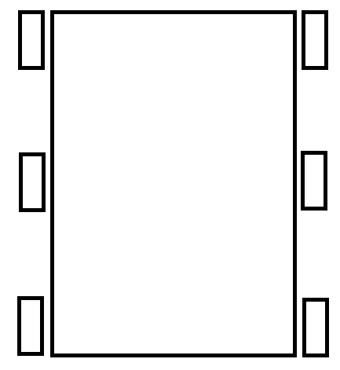
Maximum Tractive Force Per Wheel (F_{TMax})
Track (W )
Wheelbase
(L)
Notes:
Let’s say that the maximum tractive force that your robot exerts on the ground is 80 pounds. If your gearmotors can apply 150 pounds of force, what’s going to happen?

Slide 10
Maximum Turning Torque (T_{TMax})
Track (W )
W/2
Wheelbase
(L)
Notes:
Loosely speaking, torque is a measure of the turning force on an object such as a bolt or a flywheel. For example, pushing or pulling the handle of a wrench connected to a nut or bolt produces a torque (turning force) that loosens or tightens the nut or bolt.

Slide 11
Maximum Resisting Torque (T_{Resisting})
Track (W )
L/2
Wheelbase
(L)

Slide 12
Turning Torque v. Resisting Torque

Slide 13
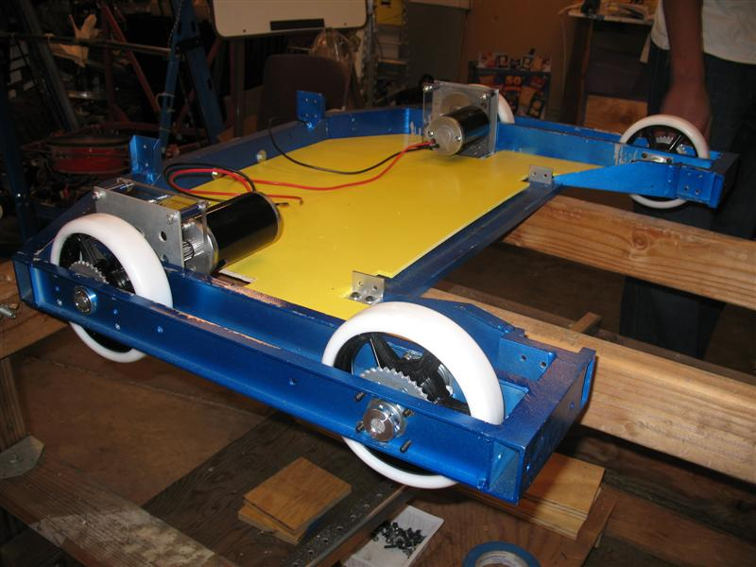
4 Wheel Layout
Remember: Turning Force – Resisting Force
Only wide robots can turn
Notes:
What are the disadvantages of having a short wheelbase? How can you have the stability of a long wheelbase with the ability to turn of a short wheelbase?

Slide 14
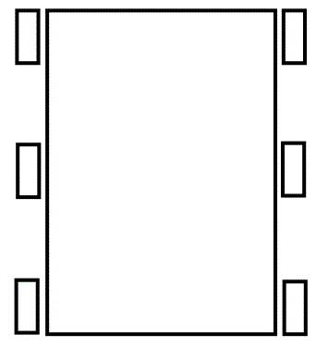
6 Wheel Layout
Weight spread over 6 wheels
Only 4 wheels resist turning
Notes:
View the slide with the animations.

Slide 15
Turning Torque v. Resisting Torque

Slide 16
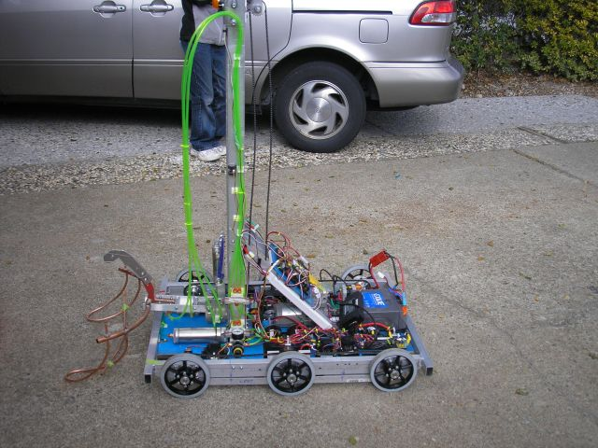
6 Wheels Dropped Center
Center wheels dropped about 1/8 inch
Improvement of 33% - 100%
Rocks on center when turning
10%
30%
10%
Notes:
But now lets look at some other ways to make robots turn more easily

Slide 17
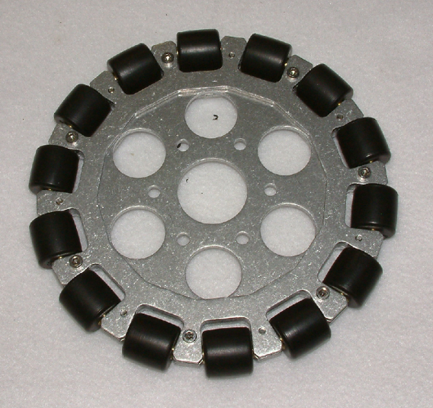
2 Wheels, 2 Omniwheels
Omniwheels
90° rollers allow sideways motion
Center of rotation between non-omni wheels
4 wheels provide tractive force
No Wheels Resist
c
c
c
c
c
c
Notes:
Please view this slide as it will be animated during the presentation or slide the omniwheel over to see the text.

Slide 18
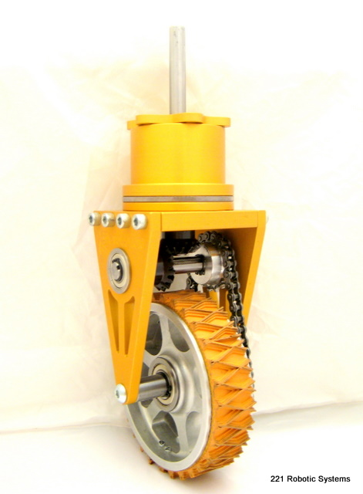
Swerve Drive
Wheel modules rotate
Advantages
Translational movement
Pushes hard
Disadvantages
Complicated design
Increased need for driver training
Requires additional steering motor
Craig Hickman’s Design on Chief Delphi

Slide 19
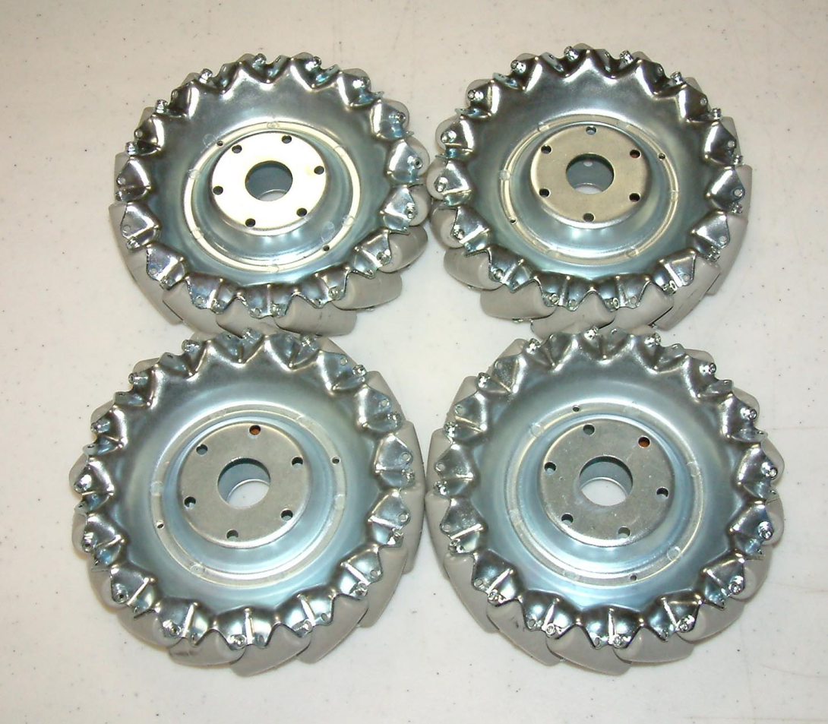
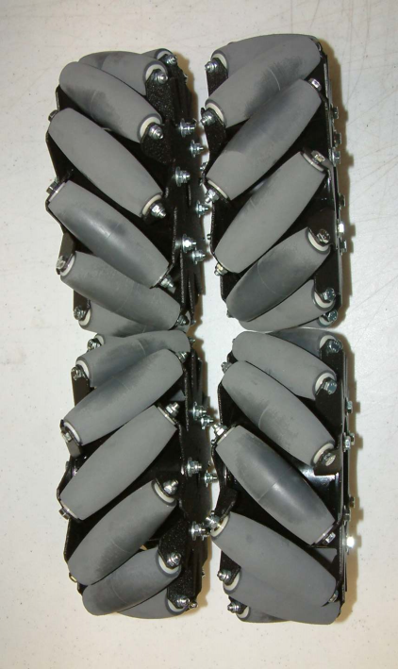
Mecanum Wheels
45° Rollers allow lateral movement

Slide 20
Mecanum Drive
Demo: http://www.youtube.com/watch?v=JGAlalbpBLA&feature=related
Advantage
Translational movement
Disadvantage
More gearboxes
Expensive wheels
Low pushing force
Notes:
http://www.youtube.com/watch?v=JGAlalbpBLA&feature=related

Slide 21
How it works: Forward movement
http://wiki.robojackets.org/images/0/08/2007_TE_Session_-_Drive_Trains_(Handouts).pdf

Slide 22
How it works: Sideways movement
http://wiki.robojackets.org/images/0/08/2007_TE_Session_-_Drive_Trains_(Handouts).pdf

Slide 23
Videos
Omni, Mecanum, Swerve drive examples
http://www.youtube.com/watch?v=r5WKgQJtToM
Nona-drive (variant of Slide Drive)
http://www.youtube.com/watch?v=_hTyXQUgYLE&feature=related

Slide 24
Conclusion
Exotic Drives
Cool factor
May give key advantage in a particular game.
Tank Drivetrain
Simple solution - rugged & reliable
Notes:
Irfanview

Slide 25
Electrical Subsystem
Presented by:
The Funky Monkeys Team 846
Akshat Agrawal, Anurag Makineni, and Jackie Zhang
Notes:
Electrical = power distribution + power control
Electronics = low power sensors and circuits
BDCComm

Slide 26
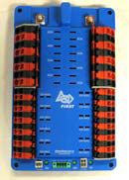
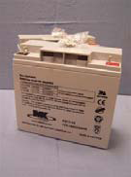
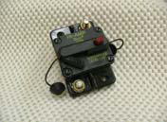
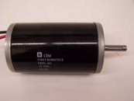
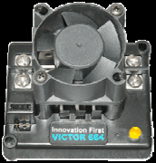
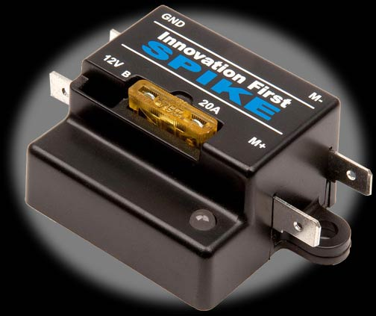
Power Distribution Diagram
Robot Controller
Notes:
Make motor in the corner smaller to resemble scaling
Make CPU darker
Put red/black lines closer together
Put currents for the branches – CPU = 20 A, Spike = 20 A, Speed Controller = 40 A,

Slide 27
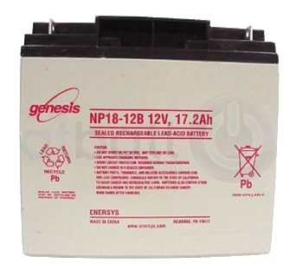
Battery
12V Lead Acid Battery (18Ah)
13 Pounds
Provides over 100 amperes of current. Total output of over 1200 watts of power.
Can supply over 700 amperes of current when terminals are shorted.
Notes:
Explain battery safety
Two hands because it is heavy
Nylon stop nut is a tip
Remove #10 screw - done
Smaller than a car battery
Fix spacing
Remove bullet point for take precautions
Change text
NEED TO SAY
Terminals are separate
Wrench
Welded together

Slide 28
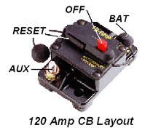
Robot Power Switch
Used to turn robot on and off, including emergency shut off
Also a 120 amp circuit breaker
Must be placed in an accessible location
Notes:
Not located accessibly
Should be in an easy-to-access area
On/Off switch
Fire hazard
Retitle to robot power switch
120 amp circuit breaker
Control should be changed to limit
Exceed 120 amps and it will break
Remove bullet points when not necessary
High current switch
Handles high enough current
Primary importance
Doubles as a circuit breaker

Slide 29
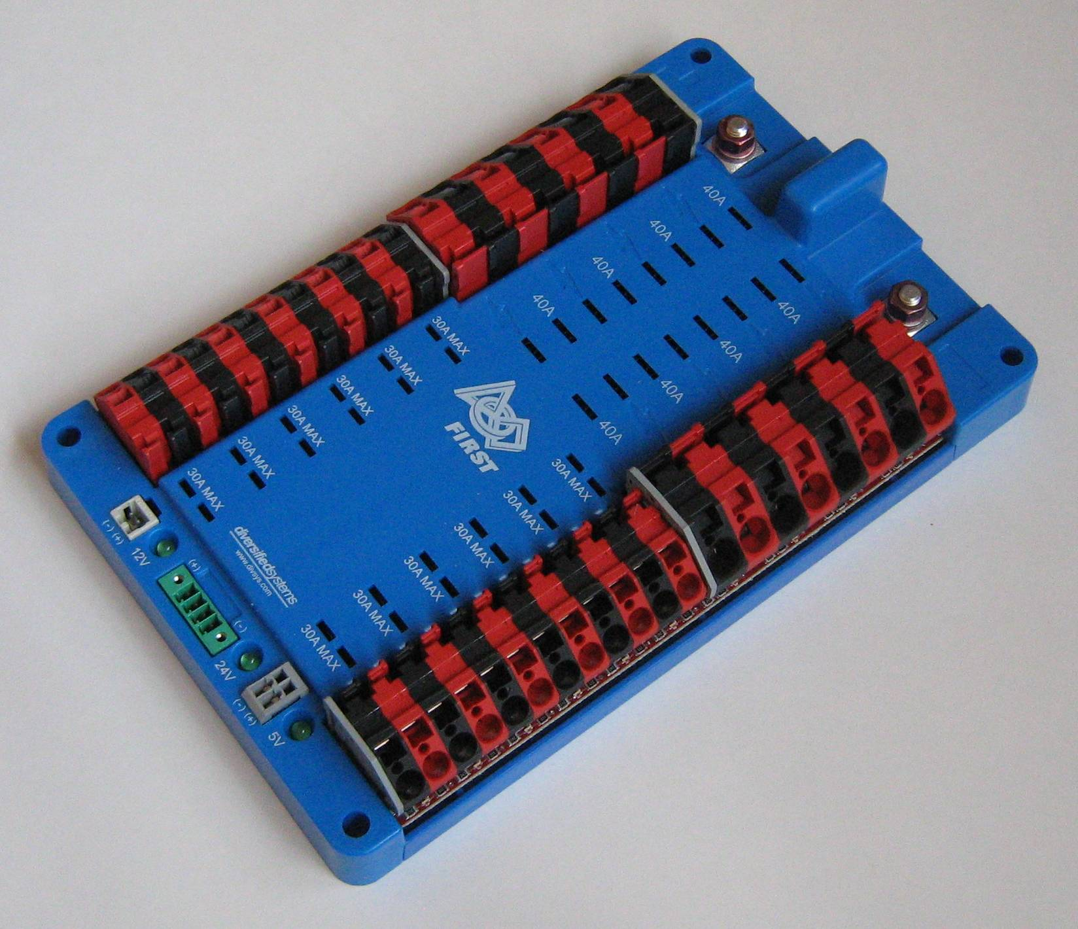
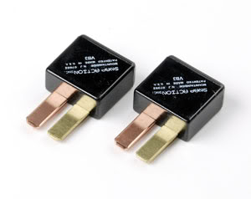
Power Distribution Board
Main Power Circuit connection
20-40 Ampere Fuse Location
Branch circuit power connection

Slide 30
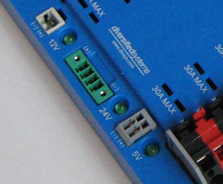
DC To DC Converters
Used to change voltage coming from battery to specific voltage required in branch circuit
12V-5V
12V-24V (for robot controller)

Slide 31
Power Distribution Diagram
18AWG
Robot Controller
100A
6AWG
40A
20A
12AWG
18AWG
Notes:
Make motor in the corner smaller to resemble scaling
Make CPU darker
Put red/black lines closer together
Put currents for the branches – CPU = 20 A, Spike = 20 A, Speed Controller = 40 A,

Slide 32
American Wire Gauge
Sizes are based on the AWG (American Wire Gauge) System
AWG sizes are based on number of wire draws – Higher gauge = thinner wire
Notes:
Explain safety concerns when using smaller diameter wires

Slide 33
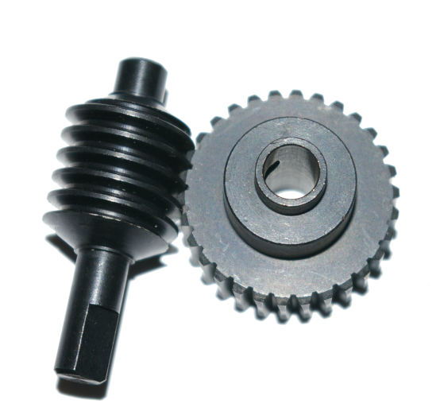
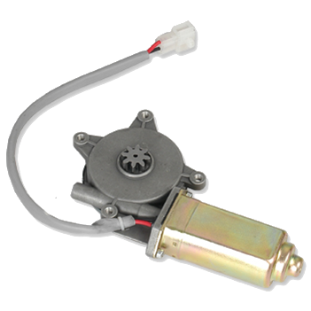
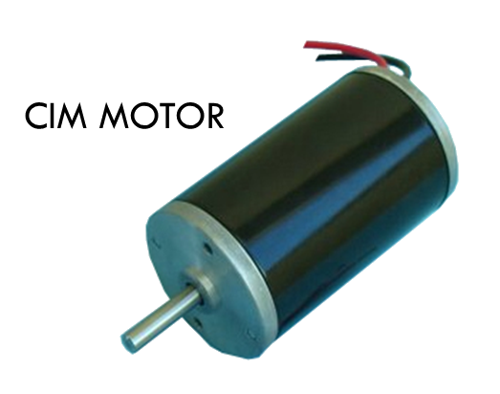
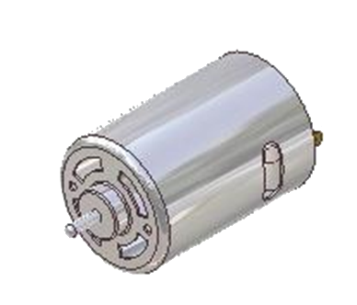
Motors (FRC 2011)
Name | # in KOP | Additional Allowed | Total
CIM | 2 | 2 | 4
BaneBots | 4 | 0 | 4
Fisher Price | 1 | 0 | 1
Window Motors | 4 | 0 | 4
Worm Gear
Automotive Window Motor
RS Series Motor
CCL Industrial Motors Limited (CIM)
Notes:
Replace with collection of motors
Only allowed to use motors inside the kit
Be aware that the rules may specify that you can buy extra motors (of the same type)
Discuss major types of motors
FIX:
scaling of pictures
Mabuchi is the motor on the left
Caption
Properly identify with companies
CIM = CCL industrial motor
Johnson electric motors for FP
Mabuchi

Slide 34
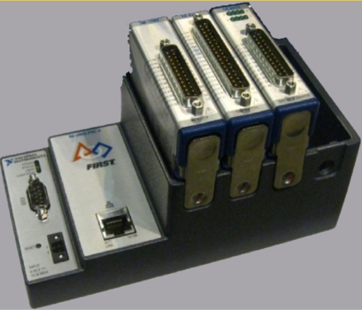
Robot Controller CompactRio National Instruments Embedded Controller
The “Brain” of the robot
Sends control signals to components
In 2012, rookie teams will receive new smaller cRIO.
Costs $525 for veteran teams
Costs $285 without I/O modules
Notes:
Servo testers at hobby stores to generate control signal for ESCs
Speaking
Servo is closed loop motor control
Expand ESC
Fix
CPU darkness

Slide 35
cRIO Specs
2012 cRIO-4 Slots
Power
24V Power via PD Board
Proccessor
400 MHz
Freescale MPC5125
Memory
256MB System Memory
512MB Storage Memory
Software
VXWorks Operating System
Lab View, C++, Java
Has an Field Programmable Gate Array (FPGA) allows for real time access to the robot

Slide 36
PROBLEM!
The cRIO cannot directly control the motors.
Cannot provide enough power – will get fried if that much power runs through it.
Solution
Intermediary Motor Controllers
Relays
Electronic Speed Controllers

Slide 37
Spike Relays
Relays close or open the circuit based on signals from the cRIO.
Use an H-Bridge

Slide 38
How an H-Bridge Works
+12V
S1+S4
FULL FORWARD
S1+S3
BRAKE
S3+S2
FULL REVERSE
S1
S3
S2
MOTOR
S4
Ground

Slide 39
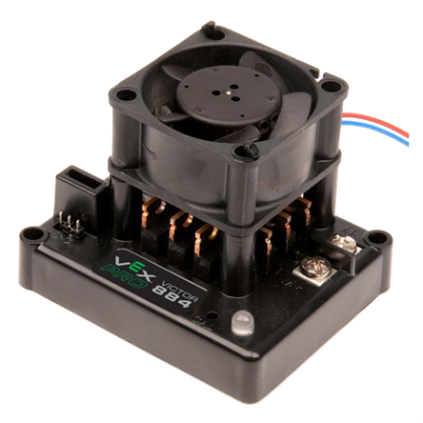
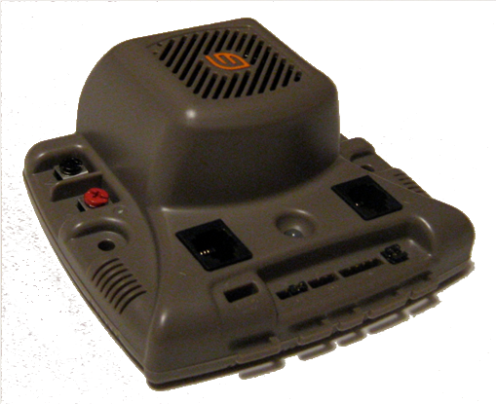
Electronic Speed Controller (ESC)
Control the amount of power sent to the motors in addition to direction that motor turns.
Two types of ESC’s:
Victor 884 ESC Jaguar ESC
Notes:
2004+ Victor
2009+ Jaguar

Slide 40
Speed Controller Comparison
Victor ESC
Smaller
Communication via:
Servo Wire
Jaguar ESC
Larger
Communication via:
Servo Wire
CAN-bus
Notes:
2004+ Victor
2009+ Jaguar

Slide 41
Pulse Width Modulation (PWM)
Pulse Width Modulation is used in two ways on our FIRST Robots:
To provide a varying amount of power to the motors.
To communicate with the Speed controller.

Slide 42
Variable Power Delivery
The Speed Controller varies the power delivered to the motors by changing the “Duty Cycle.”
DUTY CYCLE (%) = TIME ON
PERIOD
12V
0V
DUTY CYCLE
PERIOD (ms)
12V
0V

Slide 43
Speed Controller Communications
There are two ways to communicate with the ESC
CAN-bus
Uses “Message based protocol” (like Ethernet)
Servo Cable
Uses Pulse Width Modulation

Slide 44
Speed Controller Communications using PWM
RC Model Aircraft standard:
The width of the pulse is measured as unit of time. Time which each pulse lasts is the pulse width.
Signal:
2.0 ms = full forward
1.75 ms = 50% fwd
1.5 ms = off
1.0 ms = full reverse
1.5 ms
±
0.5 ms
40 ms
(20ms-50ms)
Notes:
Voltage applied only 50% instead of power
Variable resistor first
On and off so no mechanical switch
Transistor
Introduce new slide for communication (see bottom of these notes)
Remove odd picture
Radio control signal for the Victor
Describe frame from 20ms to 40ms
PWM communication
Immune to electronic noise
Introduce slide for communication
Spike with three wires - 3 wire servo cable
Victor/Jag use PWM data signal + description
Jaguar also has data communication port for the CAN-Bus

Slide 45
CAN-Bus
“CAN” Stands for “Controller Area Network”
Is a single chain of point-to-point connections
The “bus” goes around the chain delivering the signal to different addresses – each ESC has its own address
cRIO
2 CAN
ESC
ESC
ESC
ESC
ESC
ESC
ESC
ESC

Slide 46
How does the CAN-bus simplify wiring?
cRIO
cRIO
2 CAN
(Daisy Chaining)
ESC
ESC
ESC
ESC
ESC
ESC
ESC
ESC
ESC
ESC
ESC
ESC
ESC
ESC
ESC
ESC
Although the amount of wires is the same in each case, without the CAN-bus, the wires have to stretch all the way across the robot from the cRIO to each ESC, whereas with the CAN-bus, they are all linked together in a single chain.

Slide 47
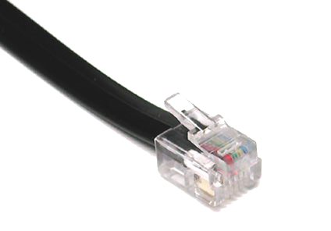
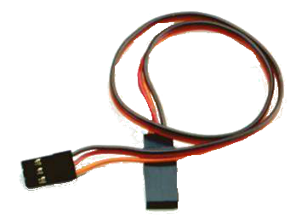
CAN-Bus Wiring
Telephone-style RJ11 instead of servo wire
Easy to make custom length with crimp tool
Can’t be put in backwards
Servo Wire
Telephone Wire
Notes:
Called servo wire because it is used to connect to the servos of remote-controlled vehicles
NEED TO SAY
Servo wire coming loose
Crimper cheap at Radio Shack/Home Depot

Slide 48
Power Distribution Diagram
Robot Controller
Notes:
Make motor in the corner smaller to resemble scaling
Make CPU darker
Put red/black lines closer together
Put currents for the branches – CPU = 20 A, Spike = 20 A, Speed Controller = 40 A,

Slide 49
Sensors and Electronics
Presented by:
Brian Axelrod
Notes:
Manual vs Automation

Slide 50
Sensors and Electronics
Presented by:
Brian Axelrod
Notes:
Manual vs Automation

Slide 51
Why use sensors?

Slide 52
Why use sensors?

Slide 53
Why use sensors?
Increased performance
Speed
Preset Positions
Safety
Prevent robot from damaging itself

Slide 54
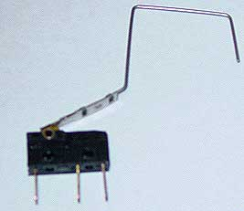
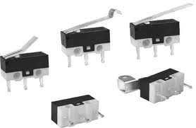
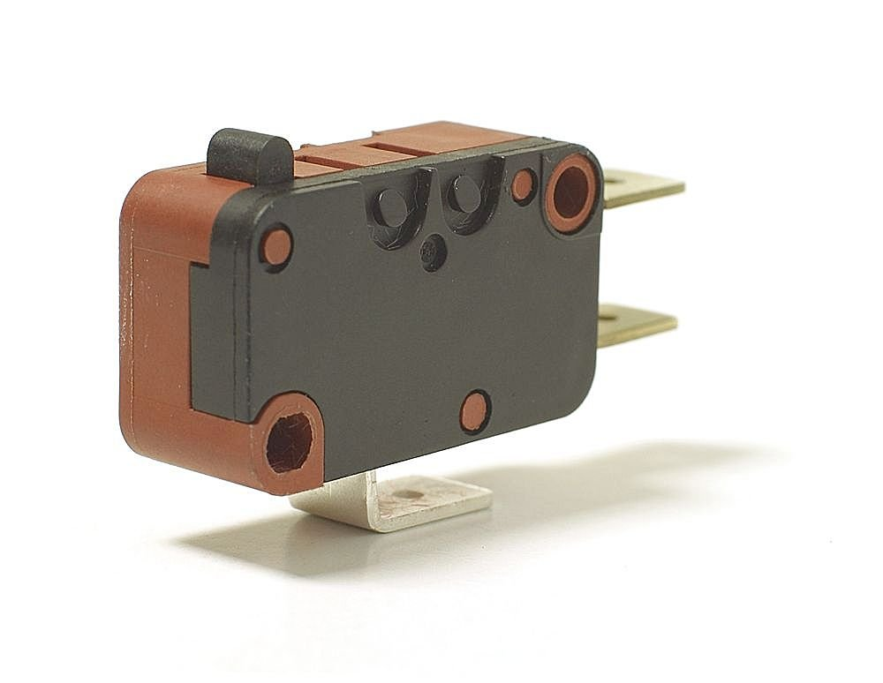
Limit switch
A simple switch
Can be set up to be triggered near a physical limit
$

Slide 55
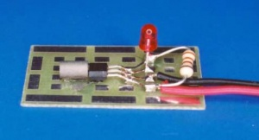
Hall effect sensor
Detects a magnetic field
Longer range
Can switch much faster than a mechanical switch
$

Slide 56
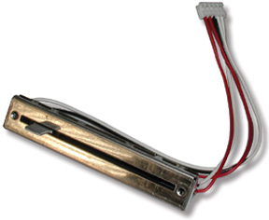
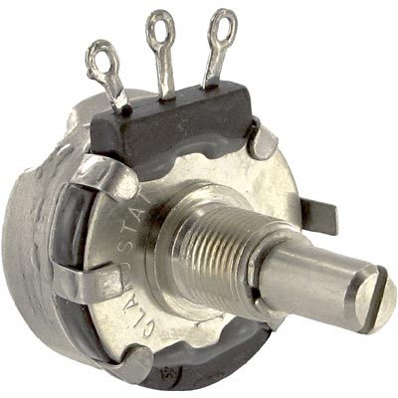
Potentiometers (Pots)
Sensor for measuring position:
Rotation, distance, etc.
$

Slide 57
Potentiometers (Pots)
Slider is connected to output.
Simplest type:
Slider
+5V
+5V
+5V
5V
100%
Output
2.5V
50%
10 KΩ
0V
0%
GND
Ground/0V
Ground/0V

Slide 58
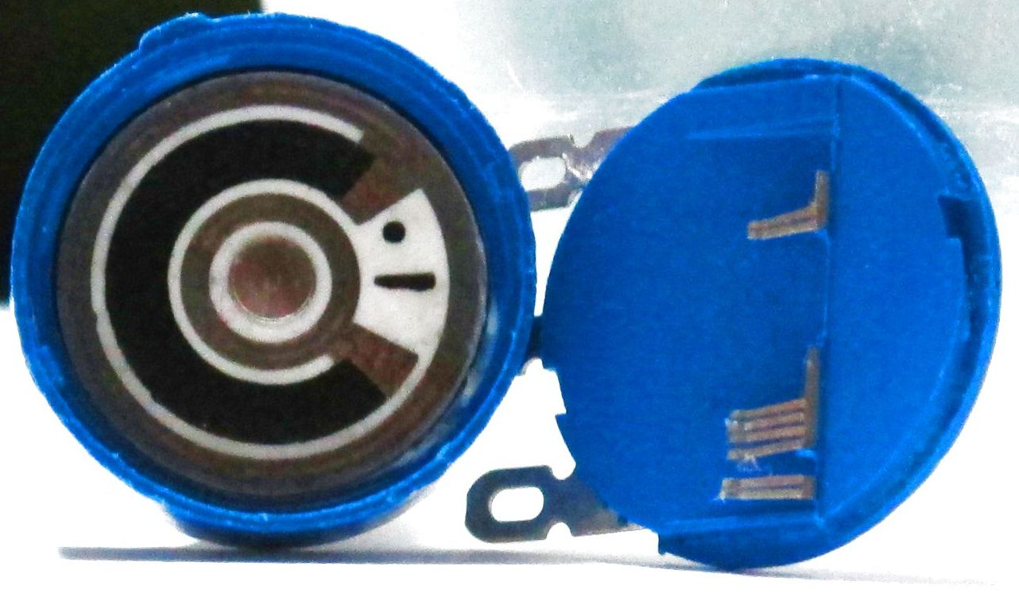
Types of Potentiometers (pots)
Slide
Rotary

Slide 59
Pots: Uses
Sense position: e.g. lift
How to sense the lift position?
Travel length is 6 feet
No linear pot long enough

Slide 60
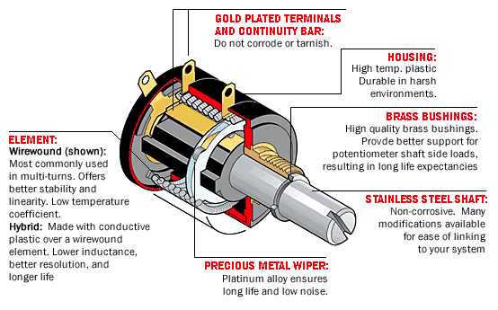
Multi-turn Pots
Multi-turn pot:
Usually 3, 5, or 10 turns
$$
Alignment is important!
Continuous rotation: use encoder
Notes:
Move pot picture

Slide 61
Reading the Value
Analog voltage level
Analog-to-Digital Converter (ADC)
Converts to number
0-1023 for 10-bit ADC
Comes in kop with cRio as analog module 8 ports
Easy to implement in code
m_liftPot.GetAverageValue()

Slide 62
Optical Encoders
to controller
Optical Sensor (A)
Optical Sensor (B)
to controller
A Channel
B Channel
Notes:
Improve animation and show waveform
Angles?
More than one tick
Directions
Spin animation

Slide 63
Optical Encoders
to controller
Optical Sensor
Optical Sensor
to controller
Notes:
Brush over
Just more ticks
Remove optical sensor

Slide 64
Optical Encoders
Determining Distance Travelled
Count pulses
Determining Speed
Distance over time
Time over distance
Notes:
Do in one slide just say two different ways

Slide 65
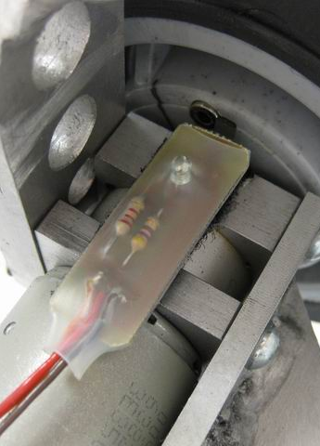
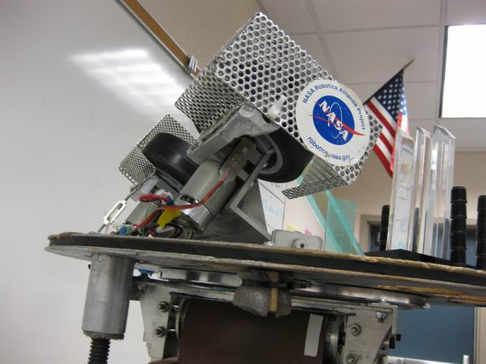
Other Encoders
Hall Effect Sensor, and embedded magnet in wheel
Our 2006 robot’s ball launcher
using encoder as a speed sensor
Notes:
Make your own encoders
Don’t need quadrature

Slide 66
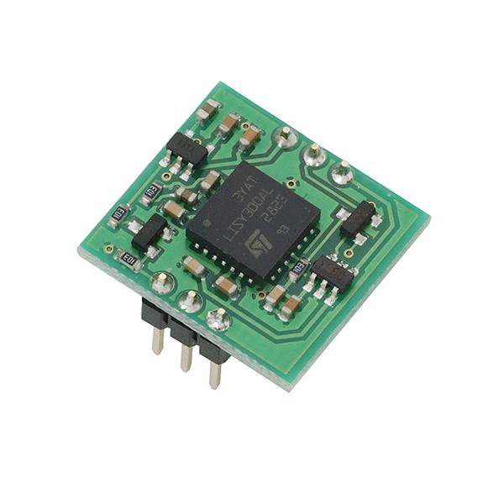
Yaw Rate Sensor/Gyro
Also commonly known as a gyro
Indicates rotational velocity

Slide 67
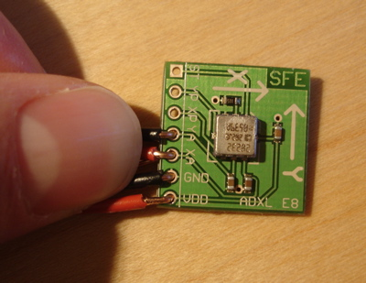
Accelerometer
Measures acceleration
Detects gravity
Going above max acceleration will give you wrong readings
Detect if going up a bump straight

Slide 68
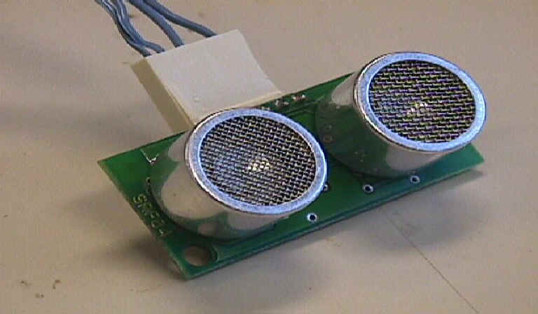
Sensing Distance: Ultrasonic Sensors
Determine distance
Send pulse of sound
Measure time until echo
Notes:
CONS such as sensitivity to soft and irregular surfaces
Noisy environment may cause problems

Slide 69
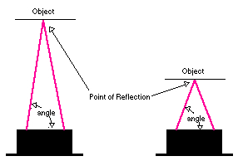
Infrared Proximity Sensors
Determines distance to object in front of it
Analog voltage reading
vs. ultrasound:
Shorter range
More accurate
Notes:
Sensing game pieces inside your robot
Short range non contact sensing

Slide 70
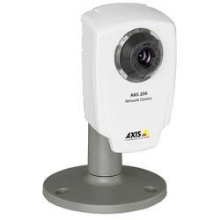
Camera
Not a magic bullet
Can choke your machine
Image processing
Can sense enviroment
Notes:
CAUTION

Slide 71
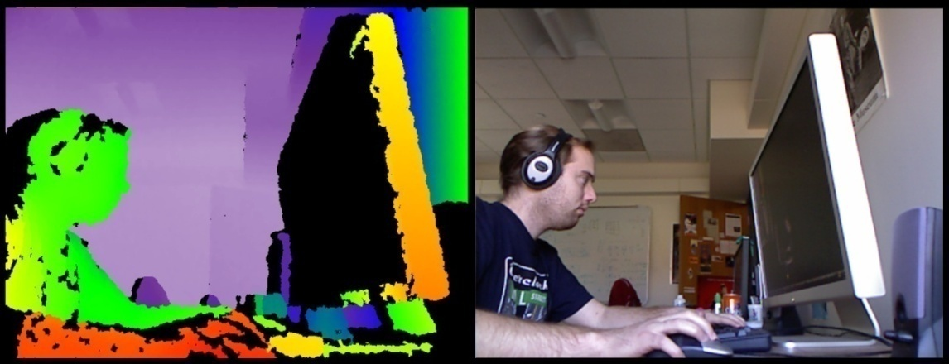
Kinect
Still not a magic bullet
RGB-D
With proper processing easier to make reliable
Depth image not dependant on lighting
Notes:
CAUTION

Slide 72
Conclusion
Never rely on the operator to do the right thing
Useful for adding functionality and as safety features
Large variety of sensors that can detect a variety of parameters
Can buy sensors at
Trossen robotics
Digi-key
Mouser
Acroname

Slide 73
Pneumatics
Michael Lin and Eric Yeh presents…
Notes:
Presenter: Michael Lin + Eric
EY: Hello My name is Eric
ML: Hello My name is Michael, and we are here today to talk about the pneumatics subsystem.

Slide 74
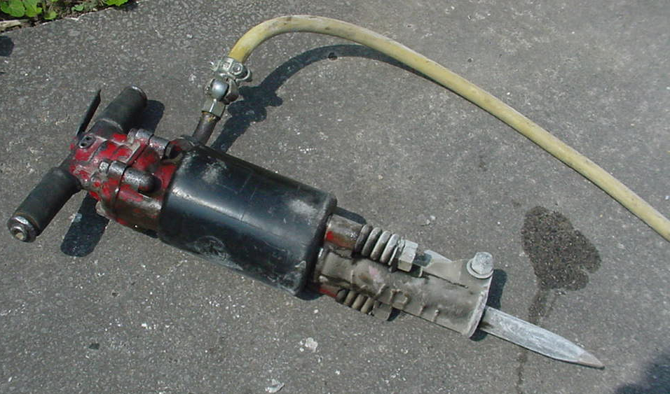
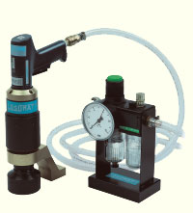
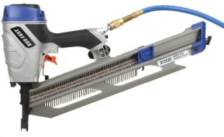
Pneumatics - Definition
Pneumatics is the use of pressurized air to achieve mechanical movement
Drill
Nail gun
Jack Hammer
Pneumatics?
Notes:
Presenter: Michael Lin
Pneumatics is commonly confused with hydraulics.
- Difference = pneumatics uses are and Hydraulics uses oil. Key difference FIRST does not allow use of hydraulics. But they do allow use of pneumatics

Slide 75
Overview of Pneumatics
Notes:
Presenter: Michael Lin
-compressor generate pressure
-actuator transform pressure to motion
-solenoid controls the motion
-tubings and fittings to let the air flow
-above is everything we need, to generate motion, but it is not safe and reliable
-regulators are used to transform stored air pressure to working pressure
-value for safety, is the pressure’s sensor which if sense too much pressure it will release the air, so the system won’t explode

Slide 76
From FIRST pneumatics manual
Notes:
Presenter: Michael Lin
Lets start with what powers the entire system; the compressor.

Slide 77
Compressor
Source of energy in pneumatic system
Can Generate up to 120 PSI
Compacts air
Notes:
Presenter: Michael Lin
This is the Compressor (Denver Gardner Thomas pump) that FIRST provides to rookie teams. This is what gives the pneumatic system its energy by compacting air.
Diaphragm compressor, axial compressor (turbine), piston compressor

Slide 78
Diaphragm pump
Notes:
Presenter: Michael Lin
DEMO notes: Lets see the pump in action. What we have here is your typical compressor that’s powered by a battery. This is the output of the compressor, and when I turn this plug valve to seal this port, we have an enclosed space that the compressor pumps air into. *hits the switch* This pressure gauge here indicates the pressure at the output of the compressor. When the pressure of the output has reached a certain limit, typically 120 psi, this electrical pressure switch here would open, and that would turn off the compressor. You can hear the compressor pulsing every now and then. We unfortunately have small leaks in the system that vents pressurized air. When this pressure switch detects that the pressure has dropped below a certain value, typically 115 psi, it would close and turn the compressor back on.

Slide 79
From FIRST pneumatics manual
Notes:
Presenter: Michael Lin
Lets start with what powers the entire system; the compressor.

Slide 80
Common Valves and Fittings
Pressure switch, Release valve, Plug valve,
Notes:
Presenter: Michael Lin
Notice this cylinder. On this end it has a common L join, but the one on this side has a screw on top. This is a flow-rate valve. <explanation> Because of this, you can fit two of these valves on the cylinder and that allows you to independently control the extending and retracting speeds.
*Make sure to make it a point that a team will only need to use on type of valve. All valves here are just types of valves that can be used.

Slide 81
From FIRST pneumatics manual
Notes:
Presenter: Michael Lin
Now lets say we want 60 psi but from before we know that if we feed the pressurized air directly to the system we would be outputting more than that. How would we achieve this daunting task? By adding a regulator!
Now that we see the basics behind pneumatics, we want to know how to usefully incorporate it into our robot when we’re designing it. To do this, we need to control several factors that affect the mechanics of actuators. The first factor is output pressure.

Slide 82
Regulator
Maintains a constant level of pressure.
Working air pressure
Maximum of 60 psi for FIRST competitions
Notes:
Presenter: Michael Lin
You can see here that the pressure at the output of the compressor is at 120 psi, but FIRST only allows us to operate our actuators at a maximum of 60 psi. We achieve this pressure drop by using a regulator. It drops the input pressure to an output pressure that you can set by turning this knob. This gauge above the regulator shows pressure that being outputted.

Slide 83
From FIRST pneumatics manual
Notes:
Presenter: Eric Yeh
Now lets see where the energy of the compressed air is used to get mechanical motion. It’s achieved through these objects, called actuators.

Slide 84
Actuators
Actuators convert the difference in air pressure to mechanical motion
Takes the working air and makes it into mechanical motion
Linear actuators (also known as cylinders)
Narrower actuators move more quickly
Notes:
Presenter: Eric Yeh
An important note to remember is that the actuator applies full force when the piston isn’t moving.

Slide 85
From FIRST pneumatics manual
Notes:
Presenter: Eric Yeh
Now that we see the basics behind pneumatics, we want to know how to usefully incorporate it into our robot when we’re designing it. To do this, we need to control several factors that affect the mechanics of actuators. The first factor is output pressure.

Slide 86
Solenoid Valves
Controlled by the robot’s CPU
Solenoids opens a port to pressure when a voltage is applied
Double solenoids controls two ports
When one port is open, the other is closed
Festo single solenoid valve
Festo double solenoid valve
Notes:
Presenter: Eric Yeh
You see how we controlled which way the cylinder moves with a click of a button. Often times we also want to control when we send compressed air to the cylinders or through which ports. For example, suppose you have a pneumatic pistons that you want to use a cylinder to lift something at the finale. We do this with electric solenoid valves. Although these valves are controlled electrically by the robot’s CPU, they can also be mechanically operated by pressing these buttons. A single solenoid valve allows you to open one port of a cylinder to pressure when voltage is applied, or when I press this button, causing the cylinder to either extend or retract. When voltage is no longer applied, the valve releases the pressure to atmosphere, and whatever load is on the piston will cause it to return to its original position. A double solenoid valve allows you to use the cylinder in both directions. When I press this button or when voltage is applied to this solenoid, the valve would open the blue side to atmosphere and the white side to pressurized air, causing the cylinder have an extending force. When the other solenoid is activated, the white side is open to atmosphere and the blue side to pressurized air, causing the cylinder to have a retracting force.

Slide 87
From FIRST pneumatics manual
Notes:
Presenter: Michael Lin
When we try and apply pneumatics to our FIRST Robots we can not have a compressor on the robot compressing air constantly to meet our demands. So how can we get compressed air on our robots? We use tanks to store the air we need!
we want to know how to usefully incorporate it into our robot when we’re designing it. To do this, we need to control several factors that affect the
mechanics of actuators. The first factor is output pressure.

Slide 88
Tank
Tanks are a reserve of compressed air
Maximum of 120 psi for First competitions
Notes:
Presenter: Michael Lin
Plastic vs. Metal = weight concern
How many movements can we do with one tank?

Slide 89
Finding Linear Force
$$D$$
89
Notes:
Presenter: Eric Yeh
What is area – pi x radius squared
What is pressure – force divided by area
What is force – pressure times area
Lets calculate the amount of force which will be needed…

Slide 90
Finding Linear Force
$$D$$
$$d$$
90
Notes:
Presenter: Eric Yeh
What is area – pi x radius squared
What is pressure – force divided by area
What is force – pressure times area
Lets calculate the amount of force which will be needed…

Slide 91
Finding Linear Force
$$D$$
$$d$$
91
Notes:
Presenter: Eric Yeh
What is area – pi x radius squared
What is pressure – force divided by area
What is force – pressure times area
Lets calculate the amount of force which will be needed…

Slide 92
Forces of Different Bore Cylinders at 40 psi and 60 psi
Bore (inches) | 0.75 | 1.50 | 2.00
Extending (40 psi) | 18 lbf | 71 lbf | 126 lbf
Retracting (40 psi) | 16 lbf | 65 lbf | 113 lbf
Extending (60 psi) | 26 lbf | 106 lbf | 188 lbf
Retracting (60 psi) | 24 lbf | 97 lbf | 170 lbf
From FIRST pneumatics manual
Notes:
Presenter: Eric Yeh
Wasn’t doing all that math fun!? Well here is a table with basic numbers so you don’t need to do all that math again.

Slide 93
From FIRST pneumatics manual
Notes:
Presenter: Michael Lin
When we try and apply pneumatics to our FIRST Robots we can not have a compressor on the robot compressing air constantly to meet our demands. So how can we get compressed air on our robots? We use tanks to store the air we need!
we want to know how to usefully incorporate it into our robot when we’re designing it. To do this, we need to control several factors that affect the
mechanics of actuators. The first factor is output pressure.

Slide 94
Finding Linear Force
$$D$$
$$Area=π{∗r}^{2}$$
$$Pressure=\frac{Force}{Area}$$
$$Area=π{∗\left(\frac{d}{2}\right)}^{2}$$
$$Force=Pressure∗Area$$
$$Area=\frac{π}{4}∗D^{2}$$
$$F=\frac{π}{4}∗PD^{2}$$
$$F=\frac{π}{4}∗P{(D}^{2}−d^{2})$$
$$Area=\frac{π}{4}∗{(D}^{2}−d^{2})$$
$$d$$
94
Notes:
Presenter: Eric Yeh
What is area – pi x radius squared
What is pressure – force divided by area
What is force – pressure times area
Lets calculate the amount of force which will be needed…

Slide 95
Conclusion
Covered major components of FIRST robots
Slides available at lynbrookrobotics.com
Resources > “WRRF Presentations”

