Slide 1
Introduction to Robot Subsystems
Notes:
Introductions raphael

Slide 2
Drivetrain
Presented by:
Owen Li
Vijay Venkatesan
Kushal Tirumala
Notes:
Manual vs Automation

Slide 3
What is a Drivetrain?
Subsystem of the robot responsible for movement on the FIRST Competition Field
Includes:
Motors
Gearboxes
Wheel Layout
Notes:
Which consists of the motors that convert electrical energy into rotational motion, reduced to the right speed through gearboxes, and transferred through a chain or belt arrangement of some sort to the wheels that contact the ground to produce movement. This subsystem has to satisfy a certain set of requirements to be effective in FRC.

Slide 4
Drivetrain Requirements
Common Features:
Fast
Turns Easily
High Acceleration
FIRST Competition Demands:
Turns in Place
Pushes Hard
Notes:
Now, let’s see a drivetrain design that does not meet these requirements . . .

Slide 5
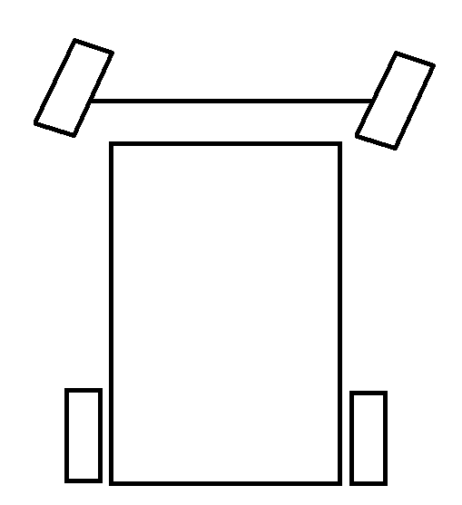
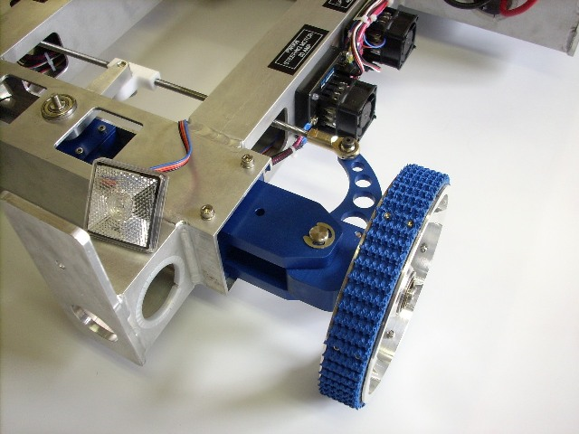
Ackerman Steering
Team 34’s Design on Chief Delphi
Notes:
Distinction between common for frc and everyday. So . . . Let’s talk about what does work.

Slide 6
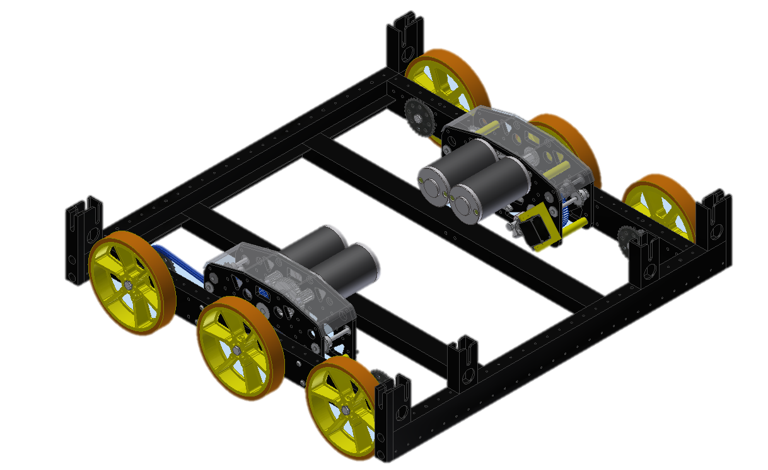
Differential/Tank Steering
Power left and right sides independently
Features:
Simple
Easy to program
Team 846’s 2013 Drivetrain Design
Notes:
Swap picture… comment that not only treads we have wheels same concept

Slide 7
Four Wheels Differential Steering
Wheels slide to turn
Notes:
Bt how well does this work???? Lets look at some math.

Slide 8
Terminology:
Track (W )
µ = Coefficient of Friction
Weight = Weight of the robot
F = Force
T = Torque
Wheelbase
(L)
Notes:
Coefficient of friction is the ratio between the force acting horizontally required to produce sliding and the normal force between the surfaces.
Force is an influence that causes an object to move.

Slide 9
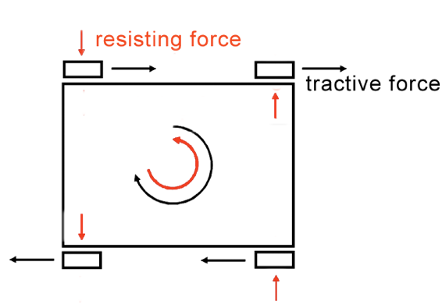
Ability to Turn
Ability to Turn =
Turning Torque – Resisting Torque
Wheels generate force while friction resists

Slide 10
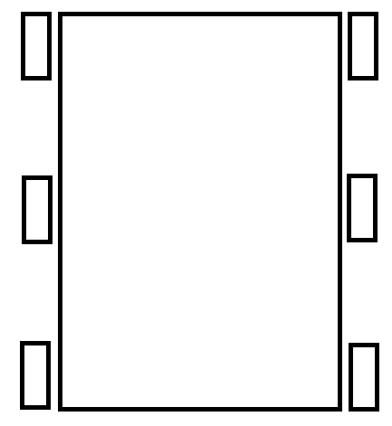
Maximum Tractive Force Per Wheel (F_{TMax})
Track (W )
Wheelbase (L)

Slide 11
Max Turning Torque (T_{TMax})
Track (W )
W/2
Wheelbase
(L)
Notes:
Loosely speaking, torque is a measure of the turning force on an object such as a bolt or a flywheel. For example, pushing or pulling the handle of a wrench connected to a nut or bolt produces a torque (turning force) that loosens or tightens the nut or bolt.
Max tractive force [maximum force exert on ground so it doesn’t slip] per wheel is coefficeint of friction (ratio of force needed to push it over the normal force object is inserting [weight] ) times total weight over number of wheels.
Maximum

Slide 12
Maximum Resisting Torque (T_{Resisting})
Track (W )
L/2
Wheelbase
(L)
Notes:
Maximum force apply to wheel so it doesn’t move sideways.

Slide 13
Turning Torque v. Resisting Torque
Track (W) > Wheelbase (L)

Slide 14
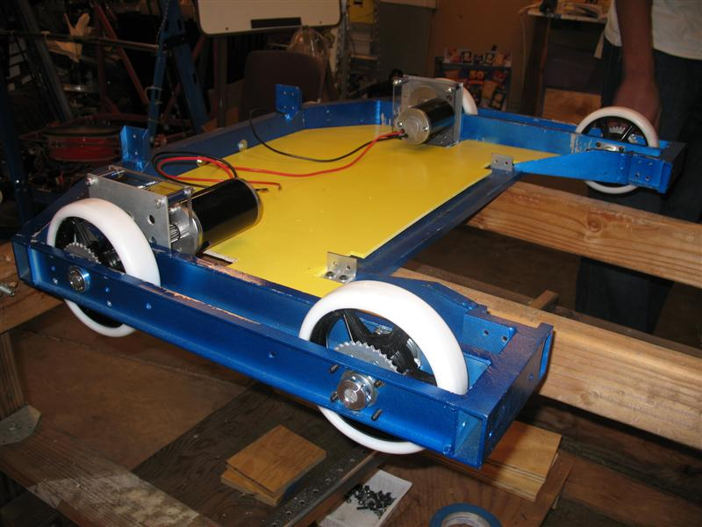
4 Wheel Layout
Remember: Turning Force – Resisting Force
Only wide robots can turn
Team 846’s 2009 Drivetrain Design
Notes:
What are the disadvantages of having a short wheelbase? How can you have the stability of a long wheelbase with the ability to turn of a short wheelbase?

Slide 15
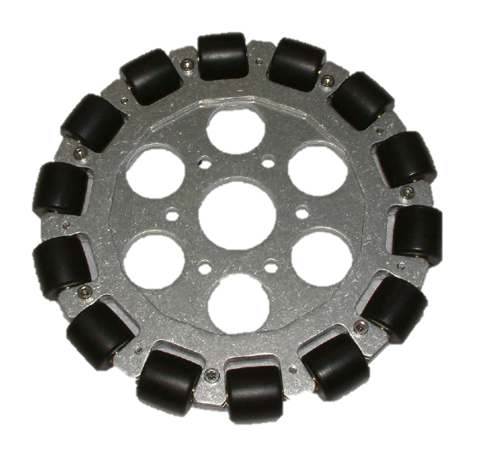
2 Wheels, 2 Omniwheels
Omniwheels
90° rollers allow sideways motion
Center of rotation between non-omni wheels
4 wheels provide tractive force
No Wheels Resist
c
c
c
c
c
c
Notes:
Please view this slide as it will be animated during the presentation or slide the omniwheel over to see the text.

Slide 16
2 Wheels, 2 Omniwheels
Advantages
No resisting torque
Simple
Disadvantages
Asymmetric
Susceptible to defense
c
c
c
c
c
c
Notes:
Please view this slide as it will be animated during the presentation or slide the omniwheel over to see the text.

Slide 17
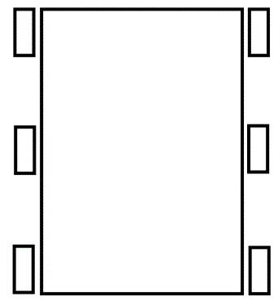
6 Wheel Layout
Weight spread over 6 wheels
Only 4 wheels resist turning
Notes:
View the slide with the animations.

Slide 18
Turning Torque v. Resisting Torque

Slide 19
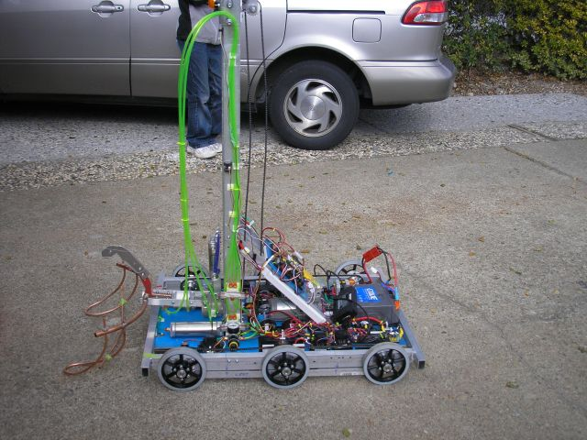
Six Wheels Dropped Center
Center wheels dropped about 1/8 inch
Theoretical Zero Resisting Torque
Rocks on center when turning
Team 846’s 2007 Robot
20%
60%
20%
Notes:
But now lets look at some other ways to make robots turn more easily

Slide 20
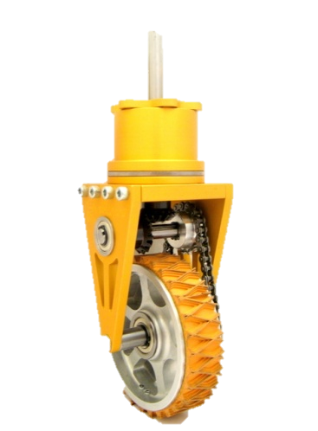
Swerve Drive
Wheel modules rotate
Features:
Sideways movement
High traction wheels
Drawbacks:
More complicated
Higher Software Skill Required
Heavy load on resources
More parts to machine
More gearboxes
Craig Hickman’s Design on Chief Delphi

Slide 22
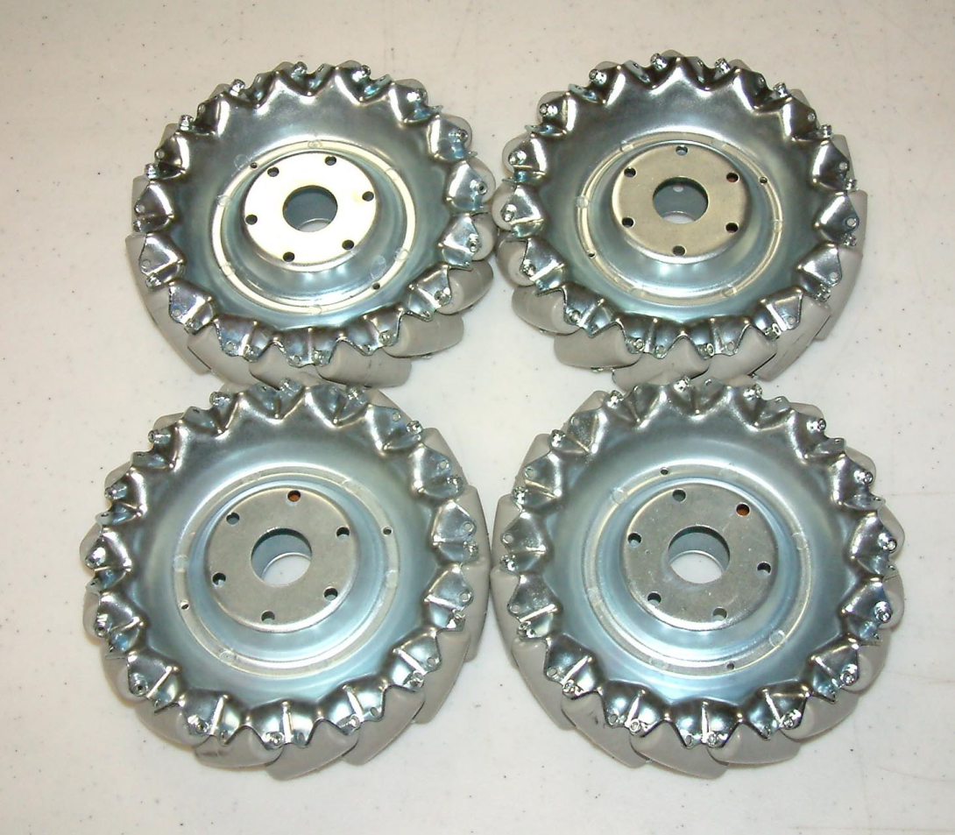
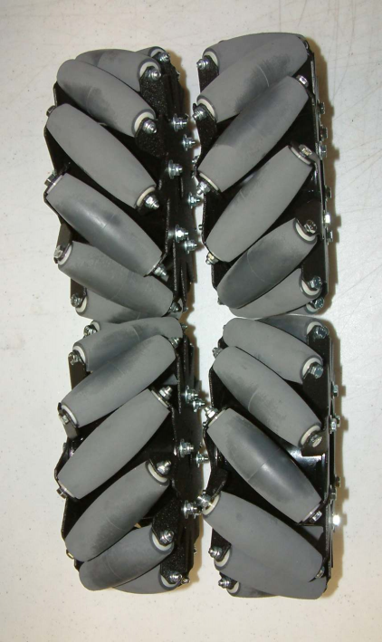
Mecanum Wheels
45° Rollers allow lateral movement

Slide 23
How it works: Forward movement
http://wiki.robojackets.org/images/0/08/2007_TE_Session_-_Drive_Trains_(Handouts).pdf

Slide 24
How it works: Sideways movement
http://wiki.robojackets.org/images/0/08/2007_TE_Session_-_Drive_Trains_(Handouts).pdf

Slide 25
Mecanum Drive
Demo: http://www.youtube.com/watch?v=JGAlalbpBLA&feature=related
Features:
Sideways movement
Drawbacks:
Easy to Push
Wasted energy
Heavy load on resources
More gearboxes
Expensive wheels
Notes:
http://www.youtube.com/watch?v=JGAlalbpBLA&feature=related

Slide 26
Conclusion
Exotic Drives
Cool factor
May give key advantage in a particular game.
Tank Drivetrain
Simple solution - rugged & reliable
Notes:
Irfanview

Slide 27
Videos
Omni, Mecanum, Swerve drive examples
http://www.youtube.com/watch?v=r5WKgQJtToM
Nona-drive (another exotic drive)
http://www.youtube.com/watch?v=_hTyXQUgYLE&feature=related

Slide 28
Electrical subsystem
Presented by:
Alex Shmakov
Jing-Chen Peng
Shikhar Jagadeesh
Notes:
Manual vs Automation

Slide 29
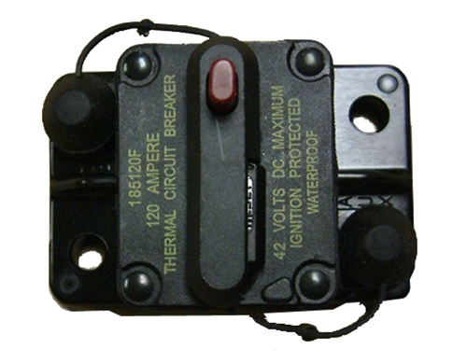
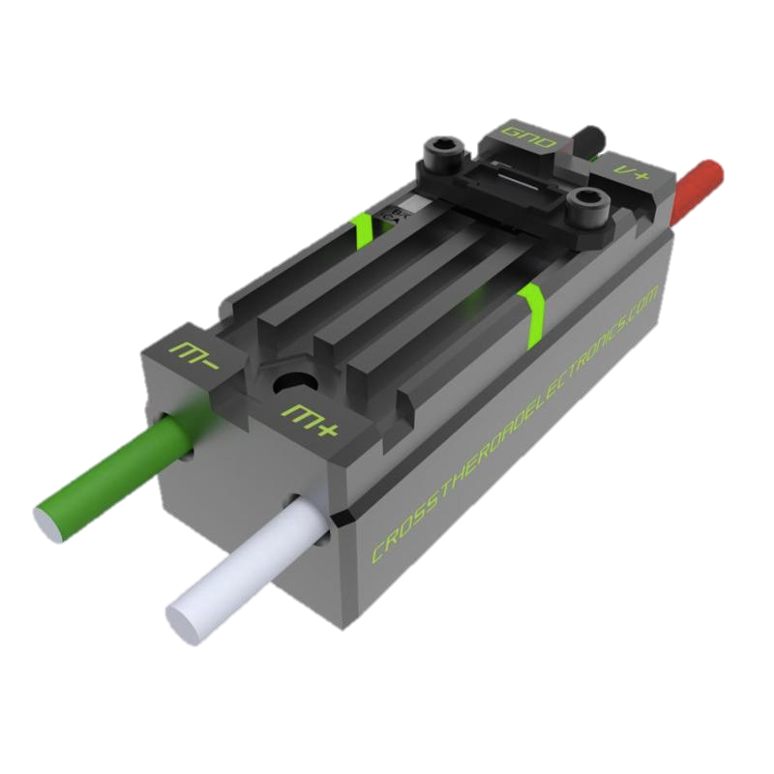
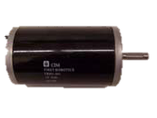
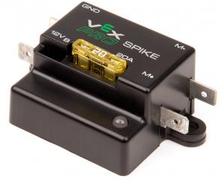
Power Distribution Diagram
Notes:
Make motor in the corner smaller to resemble scaling
Make CPU darker
Put red/black lines closer together
Put currents for the branches – CPU = 20 A, Spike = 20 A, Speed Controller = 40 A,

Slide 30
FIRST Power Distribution Diagram

Slide 31
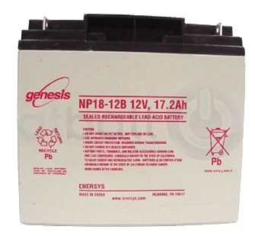
Battery
Voltage: 12 Volts Nominal​ Weight: 13 Pound​ Chemistry: Lead-Acid (Gel)​ Capacity: 18 Ah​ 10.2 Ah when rated for 1 hour​
​
Current: Nominal 150 A​ ⇨Power: ~1600 Watts at 150 A​ ​
Can supply over 700 amperes of current when terminals are shorted.
Notes:
Explain battery safety
Two hands because it is heavy
Nylon stop nut is a tip
Remove #10 screw - done
Smaller than a car battery
Fix spacing
Remove bullet point for take precautions
Change text
NEED TO SAY
Terminals are separate
Wrench
Welded together

Slide 32
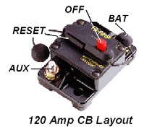
Robot Power Switch
Used to turn robot on and off, including emergency shut off
Also a 120 amp circuit breaker
Must be placed in an accessible location
Notes:
Not located accessibly
Should be in an easy-to-access area
On/Off switch
Fire hazard
Retitle to robot power switch
120 amp circuit breaker
Control should be changed to limit
Exceed 120 amps and it will break
Remove bullet points when not necessary
High current switch
Handles high enough current
Primary importance
Doubles as a circuit breaker

Slide 33
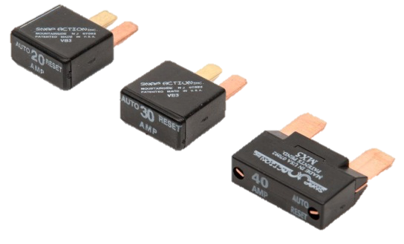

Slide 36
Power Distribution Diagram
18AWG
100A
6AWG
40A
20A
12AWG
18AWG
Notes:
Make motor in the corner smaller to resemble scaling
Make CPU darker
Put red/black lines closer together
Put currents for the branches – CPU = 20 A, Spike = 20 A, Speed Controller = 40 A,

Slide 37
American Wire Gauge
Wire thicknesses are based on the AWG (American Wire Gauge) System
AWG wire thicknesses are based on number of wire draws: Higher gauge = thinner wire
Notes:
Explain safety concerns when using smaller diameter wires

Slide 38
American Gauge System
Draw Plate 1
Draw Plate 2
Draw Plate 3
Undrawn Wire
Gauge 1
Gauge 2
Notes:
oAll wire from battery to PD have min #6 AWG (4.11mm) wire <R39 & Fig.4-8>
o40 amp breakers have min #12 AWG (2.052mm) wire <R44>
o30 amp breakers have min #14 AWG 1.628mm) wire <R44>
o20 amp breakers have min #18 AWG (1.024mm) wire <R44>

Slide 39
RoboRIO

Slide 40
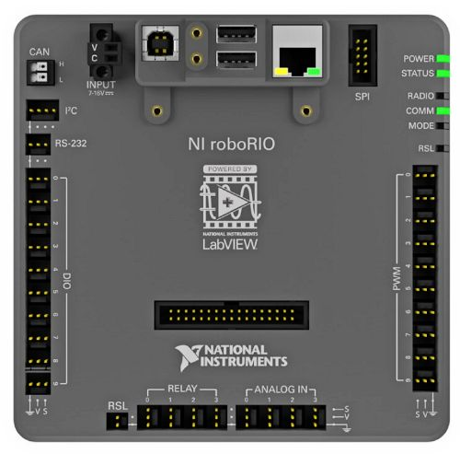
RoboRIO
2014 RoboRIO
Power
6.8-16V via PDP
Processor
Dual-Core ARM Cortex™-A9 at 667 MHz .
Memory
256MB System.
256MB Storage.
PWM
10 Ports
USB
2 USB Host and

Slide 41
Problem!
The roboRIO cannot directly control the motors.
Cannot provide enough power
Solution:
Motor Controllers
Relays
Electronic Speed Controllers

Slide 42
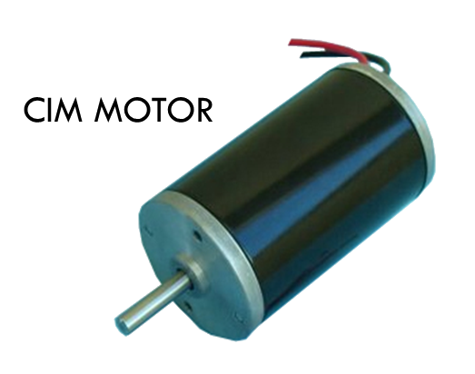
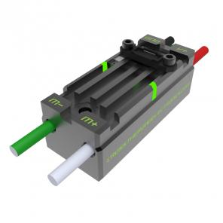
Connections
Motor
roboRIO
Motor Controller
Copper Wire

Slide 43
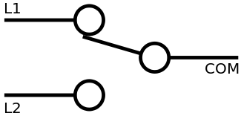
Spike Relays
Relays close or open the circuit based on signals from the cRIO.
Contains two independently controlled SPDT* relays arranged in an H-Bridge
*SPDT = Single Pole Double Throw switch

Slide 44
How an H-Bridge Works `
+12V
S1+S4
FULL FORWARD
S1+S3
BRAKE
S3+S2
FULL REVERSE
S1
S3
S2
MOTOR
S4
Ground

Slide 45
Electronic Speed Controller (ESC)
Control the amount of power sent to the motors in addition to direction that motor turns.
Two types of ESC’s:
Talon SRX
Victor SP
Notes:
2004+ Victor
2009+ Jaguar

Slide 46
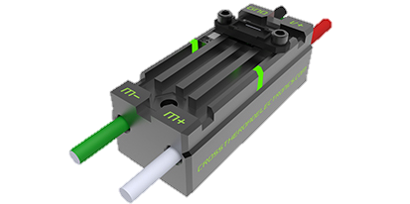
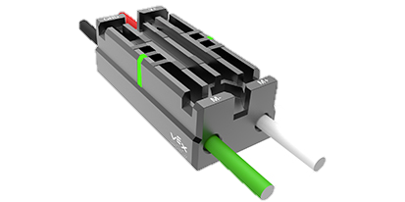
Comparison
Talon SRX | Victor SP
$79.99 | $59.99
Features | Similar Features | Features
CAN & PWM communication 6-28V | Small & light Embedded power and output Completely Sealed 12V Nominal | PWM communication 6-16V

Slide 47
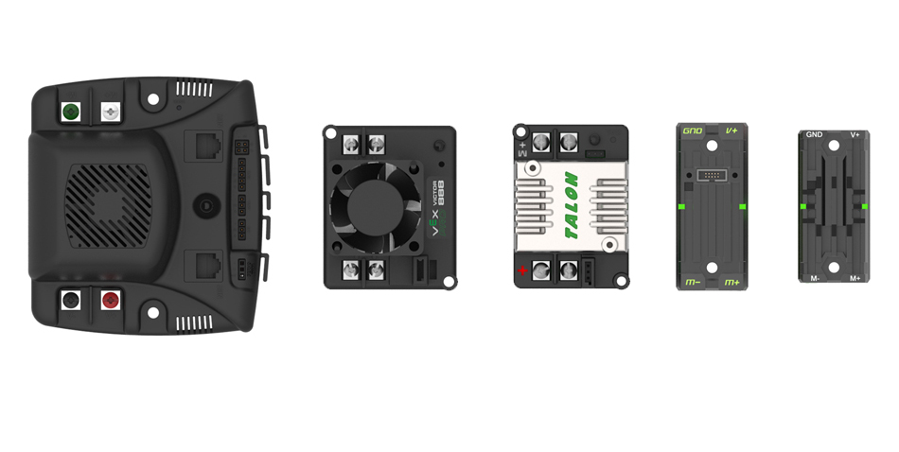
Size Comparison

Slide 48
Speed Controller Communications
There are two ways to communicate with the Jaguar ESC
Servo Wire
Uses Pulse Width Modulation
CAN-bus
Uses “Message based protocol” (like Ethernet)

Slide 49
Pulse Width Modulation (PWM)
Pulse Width Modulation is used in two ways on our FIRST Robots:
To provide a varying amount of power to the motors.
To communicate with the Speed controller.

Slide 50
Variable Power Delivery
The Speed Controller varies the power delivered to the motors by changing the “Duty Cycle.”
DUTY CYCLE (%) = TIME ON
PERIOD
12V
0V
DUTY CYCLE
PERIOD (ms)
12V
0V

Slide 51
Communications using PWM
RC Model Aircraft standard:
The width of the pulse is measured as unit of time. Time which each pulse lasts is the pulse width.
Signal:
2.0 ms = full forward
1.75 ms = 50% fwd
1.5 ms = off
1.0 ms = full reverse
1.5 ms
±
0.5 ms
40 ms
(20ms-50ms)
Notes:
Voltage applied only 50% instead of power
Variable resistor first
On and off so no mechanical switch
Transistor
Introduce new slide for communication (see bottom of these notes)
Remove odd picture
Radio control signal for the Victor
Describe frame from 20ms to 40ms
PWM communication
Immune to electronic noise
Introduce slide for communication
Spike with three wires - 3 wire servo cable
Victor/Jag use PWM data signal + description
Jaguar also has data communication port for the CAN-Bus

Slide 52
CAN-Bus
“CAN” Stands for “Controller Area Network”
Is a single chain of point-to-point connections
The “bus” goes around the chain delivering the signal to different addresses – each ESC has its own address
roboRIO
ESC
ESC
ESC
ESC
ESC
ESC
ESC
ESC

Slide 53
How does the CAN-bus simplify wiring?
roboRIO
cRIO
(Daisy Chaining)
ESC
ESC
ESC
ESC
ESC
ESC
ESC
ESC
ESC
ESC
ESC
ESC
ESC
ESC
ESC
ESC
Although the amount of wires is the same in each case, without the CAN-bus, the wires have to stretch all the way across the robot from the cRIO to each ESC, whereas with the CAN-bus, they are all linked together in a single chain.

Slide 54
Sensors and Electronics
Presented by:
Richard Yang
Brent Yi
Raphael Chang Srinjoy Majumdar
Notes:
Manual vs Automation

Slide 55
Why use sensors?
Increased performance
Speed
Preset Positions
Safety
Prevent robot from damaging itself

Slide 56
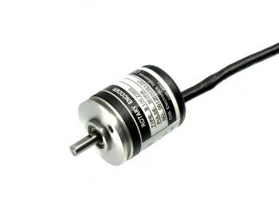
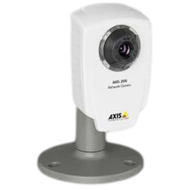
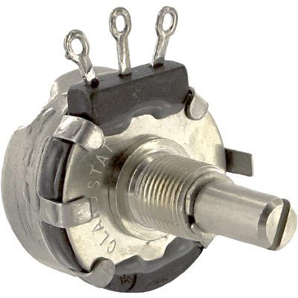
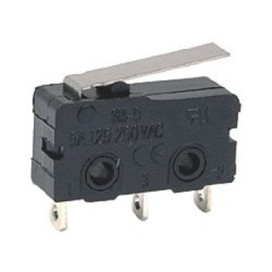
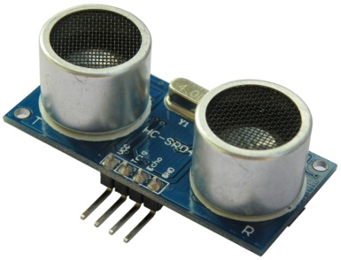
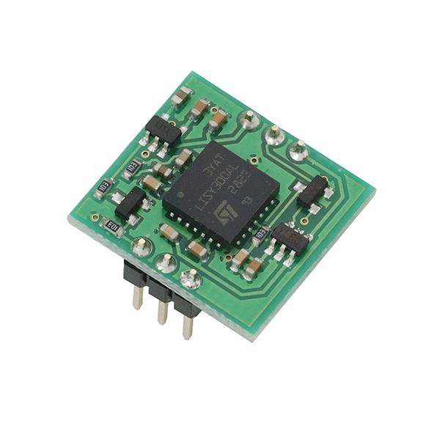
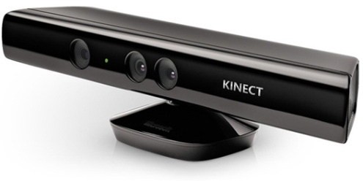
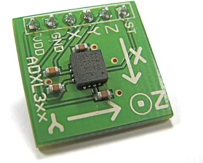
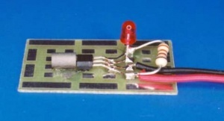
Sensors
Potentiometer
Encoder
Camera
Limit Switch
Ultrasonic
Gyro
Kinect
Infrared Proximity
Accelerometer
Hall Effect

Slide 57
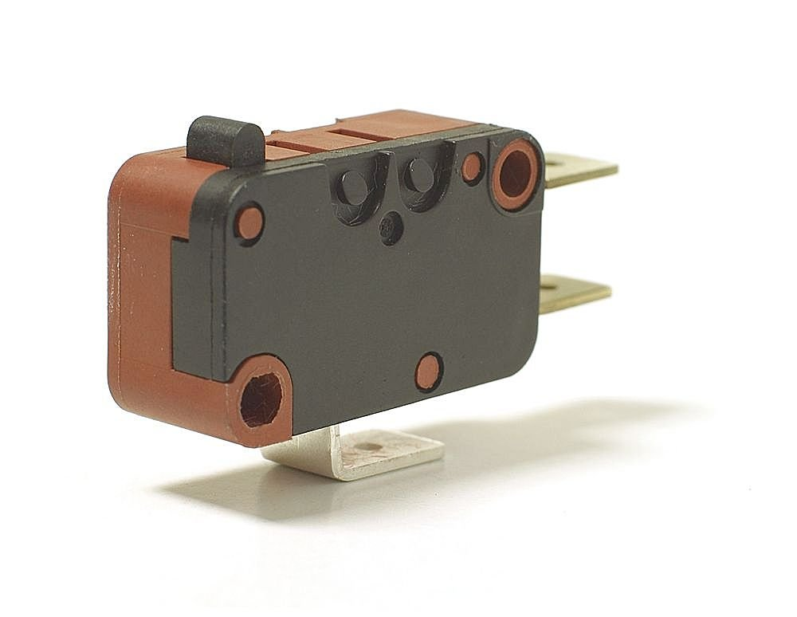
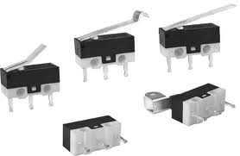
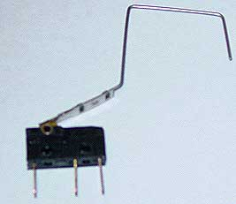
Limit switch
A simple switch
Can be set up to be triggered near a physical limit
~$2

Slide 58
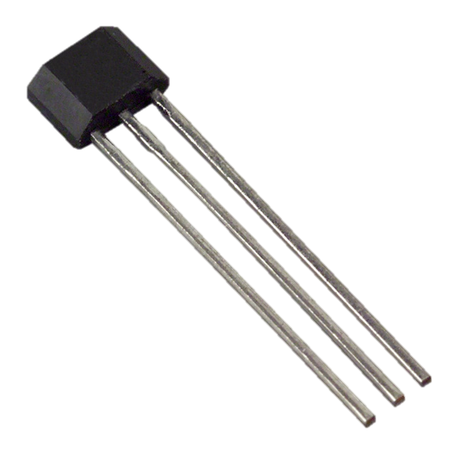
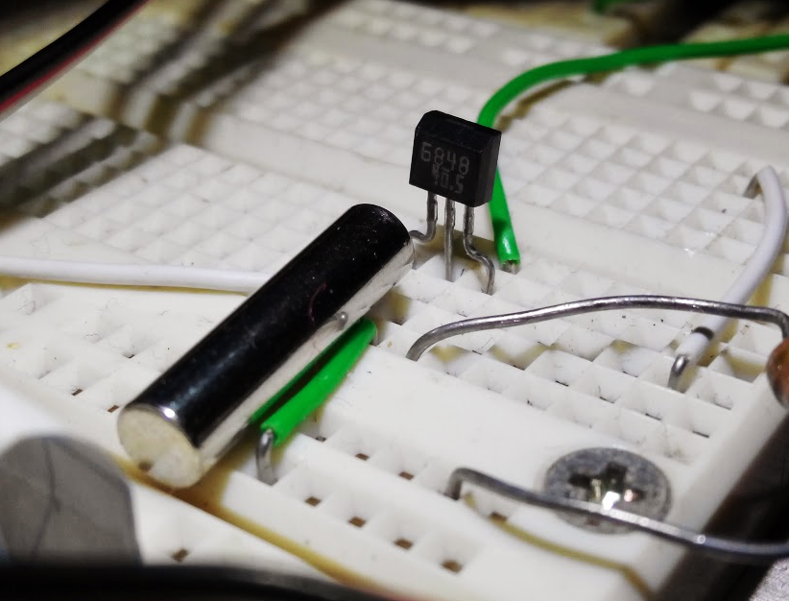
Hall Effect Sensor
Detects a magnetic field
Longer range
Can switch much faster than a mechanical switch
~$2

Slide 59
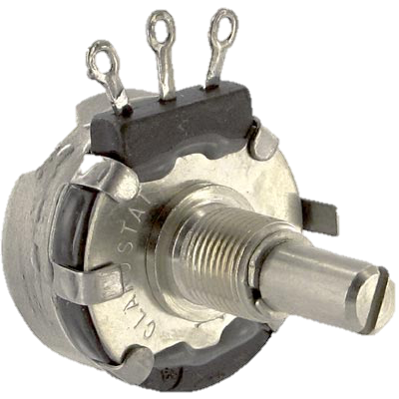
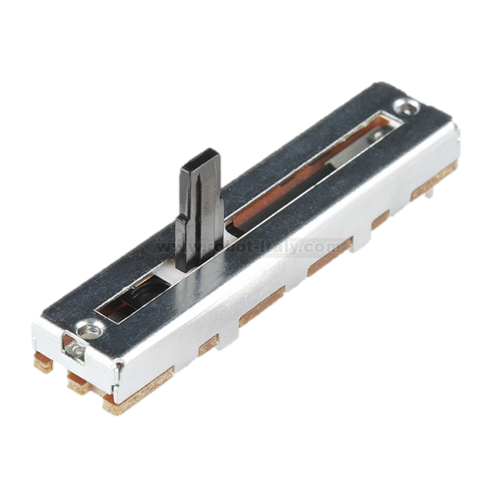
Potentiometers (Pots)
Sensor for measuring position:
Rotational, linear, etc.
$2

Slide 60
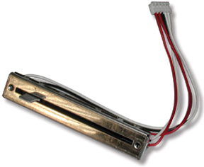
Potentiometers (Pots)
Slider is connected to output.
+5V
+5V
+5V
Output
5V
100%
10 KΩ
2.5V
50%
0V
0%
GND
Ground/0V
Ground/0V

Slide 61
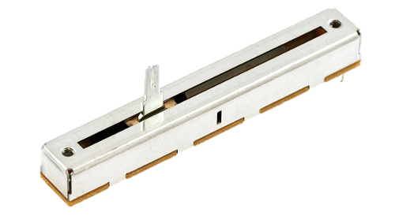
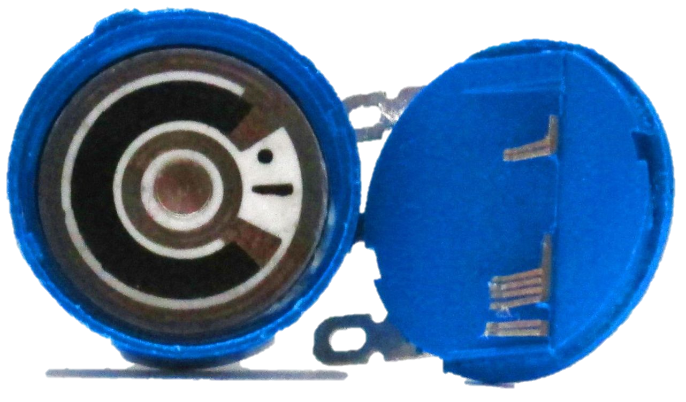
Types of Potentiometers
Slide
Rotary

Slide 62
Pots: Uses
Sense position: e.g. pivoting arm
How to sense position of a lift?
Travel length is 6 feet
No linear pot long enough

Slide 63
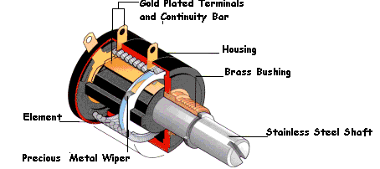
Multi-turn Pots
Multi-turn pot:
Usually 3, 5, or 10 turns
~$10
Alignment is important!
Continuous rotation: use encoder
Notes:
Move pot picture

Slide 64
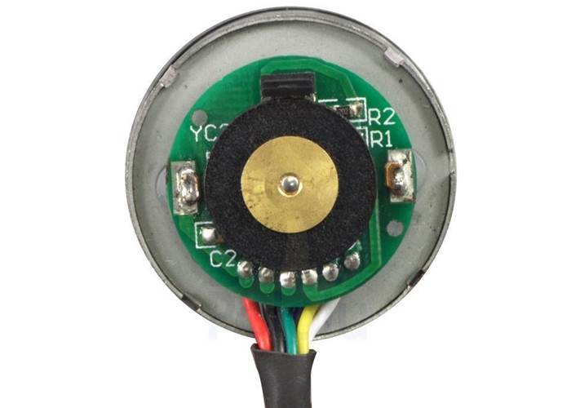
Optical Encoders
Optical Sensor

Slide 65
Optical Encoders
Determining Distance Travelled
Count pulses
Determining Speed
Count pulses over time period
Measure time between pulses (faster and more accurate)
1
2
3
1
2
3
T
Notes:
Do in one slide just say two different ways

Slide 66
Quadrature Optical Encoders
to controller
Optical Sensor (A)
Optical Sensor (B)
to controller
A Channel
B Channel
Notes:
Improve animation and show waveform
Angles?
More than one tick
Directions
Spin animation

Slide 67
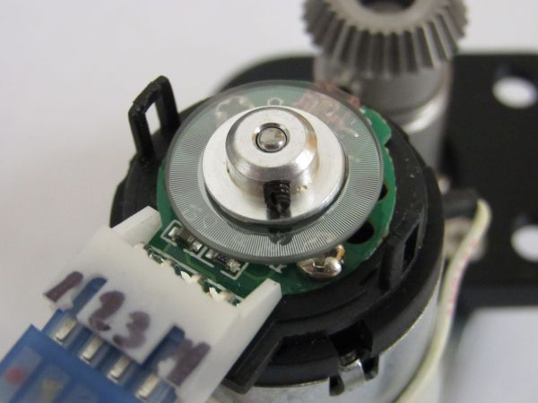
Quadrature Optical Encoders
to controller
Optical Sensor
Optical Sensor
to controller
Notes:
Brush over
Just more ticks
Remove optical sensor

Slide 68
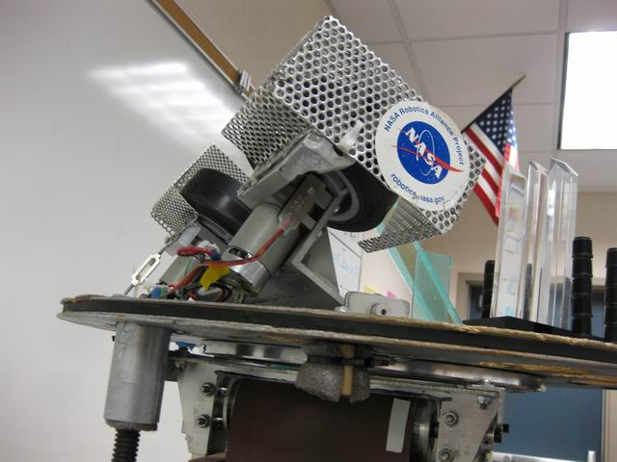
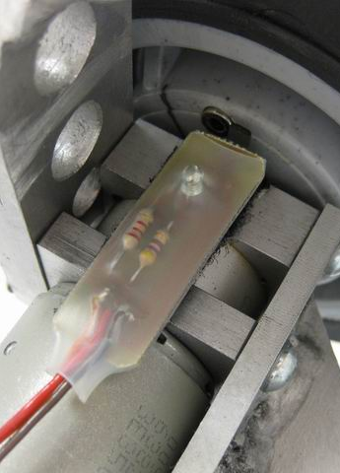
Other Encoders
Our 2006 robot’s ball launcher
Hall Effect Sensor, and embedded magnet in wheel
Using encoder as a speed sensor
for fast-spinning wheels
Notes:
Make your own encoders
Don’t need quadrature

Slide 69
Sensing Distance: Ultrasonic Sensors
Determine distance
Send pulse of sound
Measure time until echo
Notes:
CONS such as sensitivity to soft and irregular surfaces
Noisy environment may cause problems

Slide 70
Infrared Proximity Sensors
Distance sensor
Both digital and analog versions
Compared to ultrasound:
Shorter range
Faster
Notes:
Sensing game pieces inside your robot
Short range non contact sensing

Slide 71
Accelerometer
Detects gravity
Useful for tracking orientation
3 axis accelerometer
Example: Restricting Acceleration
Example: Balancing on Bridge

Slide 72
Yaw Rate Sensor
Also commonly known as a gyro
Indicates rotational velocity
Must take integral for angle
Prone to drift
Calibrate before each use

Slide 73
Camera
Senses field elements
reflective targets, shapes, colors
Needs lots of processing power
secondary computer may be required
Advanced programming
Time-consuming to use effectively
Notes:
CAUTION

Slide 74
Kinect Camera
RGB-D
With proper processing easier to make reliable
Depth image not dependant on lighting
Still not a magic bullet
All the pitfalls of regular camera
Notes:
CAUTION

Slide 75
Conclusion
Use sensors whenever possible
Sensors help make things safe
Benefits must overcome added complexity
Important part of a great robot

Slide 76
Pneumatics
Presented by:
Amrita Iyer
Nikita Seth
Pragna Upputuri Prapurna Upputuri
Notes:
Manual vs Automation

Slide 77
Pneumatics - Definition
Pneumatics is the use of pressurized air to achieve mechanical movement
Nail gun
Jack Hammer
Pneumatics?
Notes:
Presenter: Akhil
Pneumatics is the use of pressurized air to achieve mechanical motion. Pneumatics is most commonly used in tools such as jack hammers, drills, and nail guns.

Slide 78
Overview of Pneumatics System
Notes:
Presenter: Akhil
compressor - generate pressure
actuator - transform pressure to motion
solenoid - controls the motion of actuator
regulator – limits air flow to usable, steady flow rates
tank – store air in
tubings and fittings - let the air flow

Slide 79
Compressor
Transducer of energy in pneumatic system
Can Generate up to 120 PSI (Pounds per Square Inch)
Compacts air
Viair Compressor in FIRST Kit of Parts
Notes:
Presenter: Pransu
The compressor provides the pneumatic system its energy by using the electrical energy from the battery to compress air.
This is the Compressor (Viair 090C air compressor) that FIRST provides to rookie teams.
Pump types:
positive displacement
rotary
lobe
screw
liquid ring
scroll
vane
reciprocating
diaphragm
single acting
double acting
dynamic
centrifugal
axial

Slide 80
Diaphragm pump
Notes:
Presenter: Nikunj
Typically, the compressor utilizes a diaphragm pump, in which the motor is powered by a battery and used to compress air in the enclosed space. The pressure gauge here indicates the pressure at the output of the compressor. When the pressure of the output has reached a certain limit, typically 120 psi, the electrical pressure switch here opens and turns of the compressor. Unfortunately, there are small leaks in the system that vent pressurized air. When the pressure switch detects that the pressure has dropped below a certain value, usually 115 psi, the electrical pressure switch closes and turns the compressor back on.

Slide 81
From FIRST pneumatics manual
Notes:
Presenter: Pransu
This energy from the compressed air gets converted into mechanical motion in the actuators

Slide 82
Actuators
Actuators convert the difference in air pressure to mechanical motion
Linear actuators (also known as cylinders)
Narrower actuators move more quickly
Notes:
Presenter: Pransu
(Demo)

Slide 83
Inside Pneumatic Actuator
Notes:
Presenter: Akhil

Slide 84
From FIRST pneumatics manual
Notes:
Presenter: Akhil
Now that we see the basics behind pneumatics, we want to know how to usefully incorporate it into our robot when we’re designing it. To do this, we need to control several factors that affect the mechanics of actuators. The first factor is output pressure.

Slide 85
Solenoid Valves
Controlled by the robot’s CPU
Solenoids opens a port to pressure when a voltage is applied
Double solenoids controls two ports
When one port is open, the other is closed
Festo single solenoid valve
Festo double solenoid valve
Notes:
Presenter: Akhil
You see how we controlled which way the cylinder moves with a click of a button. Often times we also want to control when we send compressed air to the cylinders or through which ports. For example, suppose you have a pneumatic pistons that you want to use a cylinder to lift something at the finale. We do this with electric solenoid valves. Although these valves are controlled electrically by the robot’s CPU, they can also be mechanically operated by pressing these buttons. A single solenoid valve allows you to open one port of a cylinder to pressure when voltage is applied, or when I press this button, causing the cylinder to either extend or retract. When voltage is no longer applied, the valve releases the pressure to atmosphere, and whatever load is on the piston will cause it to return to its original position.
Orig load: spring, gravity
A double solenoid valve allows you to use the cylinder in both directions. When I press this button or when voltage is applied to this solenoid, the valve would open the blue side to atmosphere and the white side to pressurized air, causing the cylinder have an extending force. When the other solenoid is activated, the white side is open to atmosphere and the blue side to pressurized air, causing the cylinder to have a retracting force.
(Demo)

Slide 86
From FIRST pneumatics manual
Notes:
Presenter: Pransu
(Demo)
But as we can see, there is a problem with this system; the actuator is moving slower and slower. This is because the compressor is forced to constantly compress air in order to move the piston in the actuator but is unable to meet such demands. In order to resolve this issue, we need a method of storing compressed air until it is needed; thus, we need a tank!
\

Slide 87
Tank
Tanks are a reserve of compressed air
Maximum pressure of 120 psi for FIRST competitions
Notes:
Presenter: Pransu
Plastic vs. Metal = weight concern
How many movements can we do with one tank?
(Demo)

Slide 88
From FIRST pneumatics manual
Notes:
Presenter: Akhil
Now, suppose we want 60 psi of pressure but we know that the pressurized air from the compressor is outputting much more than that. So, how would we limit the air flow to the desired amount? By adding a regulator!
Now that we see the basics behind pneumatics, we want to know how to usefully incorporate it into our robot when we’re designing it. To do this, we need to control several factors that affect the mechanics of actuators. The first factor is output pressure.

Slide 89
Regulator
Maintains a constant level of pressure.
Working air pressure
Maximum pressure of 60 psi for FIRST competitions
Notes:
Presenter: Akhil
The regulator limits and maintains a constant level of pressure. You can see here that the pressure at the output of the compressor is at 120 psi, but FIRST only allows us to operate our actuators at a maximum of 60 psi. We achieve this pressure drop by using a regulator. It drops the input pressure to an output pressure that you can set by turning this knob. This gauge above the regulator shows pressure that being outputted.

Slide 90
From FIRST pneumatics manual

Slide 91
Common Valves and Fittings
Pressure switch
Pressure relief valve
Plug valve
Flow-rate valve
Notes:
Presenter: Pransu
Notice this cylinder. On this end it has a common L join, but the one on this side has a screw on top. This is a flow-rate valve. <explanation> Because of this, you can fit two of these valves on the cylinder and that allows you to independently control the extending and retracting speeds.

Slide 92
Finding Linear Force (Extending)
$$D$$
92
Notes:
Presenter: Akhil

Slide 93
Example Calculation
40 psi
$Area=πr^{2}$= $π{\text{(}\frac{0.75}{2} \text{in}\text{)}}^{2}$=0.44sq-in
17.6 lbs
0.75 in
Force = 40 psi X 0.44 sq-in = 17.6 lbs
Notes:
Presenter: Akhil

Slide 94
Finding Retracting Force
D
94
Notes:
Presenter: Akgil

Slide 95
Introduction to Robot Subsystems
Notes:
Introductions raphael

