Slide 1
CAD Assemblies
10.21.15

Slide 2
Overview
Get familiar with Inventor view screen
Know the CAD terminology
Make a basic drivetrain!

Slide 3
Terminology
What are parts and assemblies?
Parts are 3D models that only consist of one file ; They are basic units
Assemblies are 3D models that consist of multiple parts/assemblies put together ; They are complex units
What is the hierarchy?
Parts put together make assemblies
Assemblies put together can make larger assemblies

Slide 4
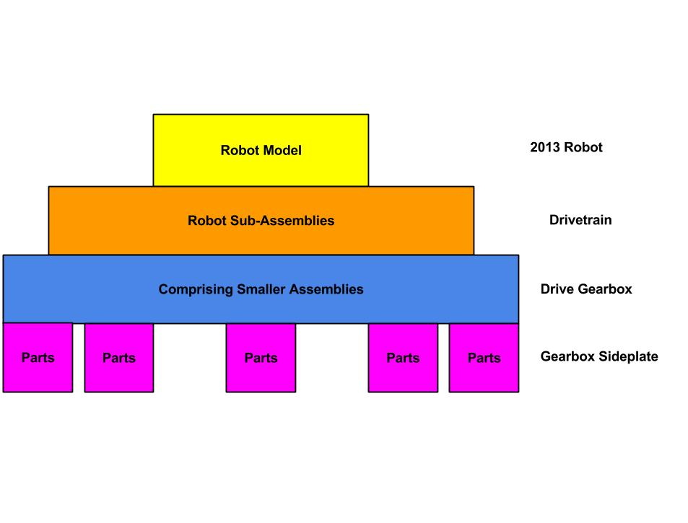
Robot Hierarchy
2015 ROBOT
DRIVETRAIN
DRIVE GEARBOX
GEARBOX SIDEPLATE

Slide 5
How SVN Works
(Marked for commit.)
ADD
Internet
COMMIT
Local Drive
Server (Fremont, CA)
UPDATE
Rule of Thumb: Update before you start doing anything!
**To update, right-click, then click on “SVN Update” and let the system run.**

Slide 6
Ignore Sequence
Go to your “training16” folder
Open the “ignore.txt” file and copy everything in it
Right click and mouse over “Tortoise SVN”
Go down to “Settings”.
In the ignore-sequences box, paste everything from the text file.
Click Apply then Ok.

Slide 7
Open Inventor
Click on the Inventor Icon to launch Inventor 2016
This might take some time...

Slide 8
Change Background
Change Background to “Sky Blue”:
Click on “Tools” then “Application Options” then “Colors”
Select Sky
Click on the drop-down box and click “1 Background Color”.

Slide 9
Open Main Assembly
Click on the “Open” in the “Launch” toolbar
Browse to the extracted .zip file and open “Drivetrain Practice Model.iam”

Slide 10
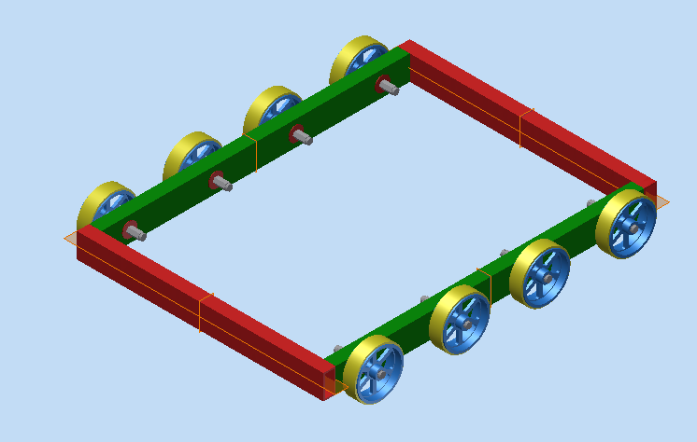
Drivetrain_Assembly

Slide 11
Open Sub-Assembly
Click on the “I” in the top left and click “Open”
Browse to the folder and click on “Frame_Assembly.iam”

Slide 12
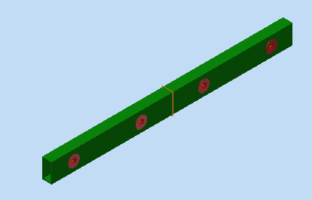
Frame_Assembly

Slide 13
Make an Assembly
Click on the “I” and select the arrow next to “New” and then “Assembly”
Click “Place” (or “P” on your keyboard)
Place one instance of “Frame_Member.ipt”
Right-click on the member and select “Grounded”
Click “Place”
Place one instance of “hex_bearing.ipt”

Slide 14
Constraints
Constraints hold together different parts in specific ways in assemblies
Mate
Flush
Insert
Co-axial

Slide 15
Insert
Inserts a cylindrical object, such as a bearing into a hole of appropriate width
Insert the inside of the bearing (everything except the flange) into the bearing hole
Click on “Constrain” under “Relationships” bar (or “C” on your keyboard)
Go to the fourth icon from the left (Insert)
Make sure the “Opposed” solution is chosen in the “Solutions” box (solution on the left)
First click on the inner side of the bearing flange (you should see an arrow pointing to through inside of the bearing)
Next click on the outer side of the hole on the frame member (refer to picture on next slide)

Slide 16
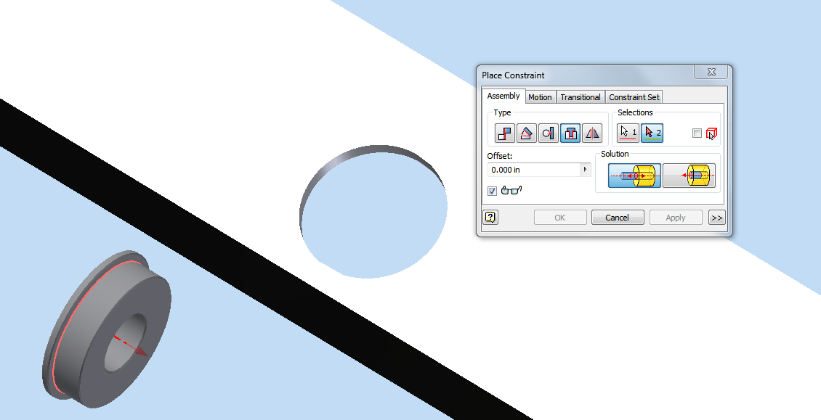
Inserting Bearing

Slide 17
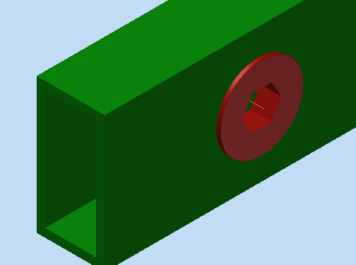
Insert the Bearing

Slide 18
Repeat!
Repeat with 7 more instances of “hex_bearing.ipt”

Slide 19
Save your assembly!
First go into your training16 folder from your explorers window
training16 → Users → create a new folder (“Firstname Lastname”)
Go back to your assembly (Inventor)
Click “cntrl+s”
The only file that should say “Yes” is your assembly itself. (It will say “initial save” next to it.)
Make sure you save your assembly into your users folder!
Ex: “Frame_Assembly_(Yourname)”.iam

Slide 20
Main Assembly
Create a New Assembly
Place one instance of your Frame Assembly and ground it
Place another instance of the same assembly, but leave it ungrounded
Place two instances of “Frame_Member2.ipt”

Slide 21
A Word about
Mate and Flush
Mate joins two opposing faces together
Flush joins two faces so that they turn into one continuous surface

Slide 22
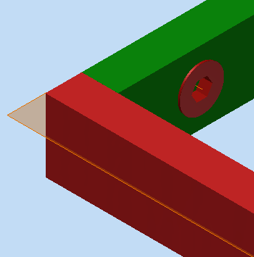
Constraining Parts
Mate faces together to form right-angle with the parts
Refer back to the “Drivetrain practice model” to see how the model should look like. Here, the green frame members should be sandwiched between the red frame members.

Slide 23
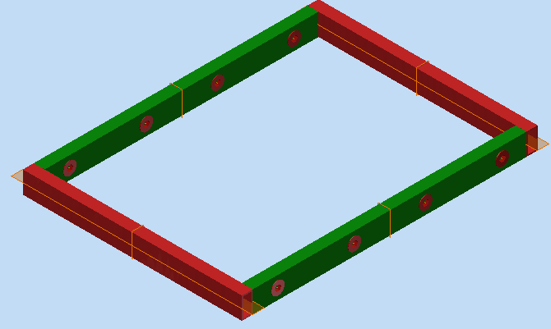
Finish Frame Base
Make Rectangular Frame with Red on opposite sides and Green on opposite sides
Save into your users folder! For example, save it as “Frame_Base_Assembly_(YourName)”.iam.

Slide 24
Make Wheel Assembly
Create a new assembly
Place “4 in wheel”, “roughtop tread”, and “wheel shaft”
Joining the tread and wheel
Mate the inside of the roughtop tread to the outside circle of the 4 in wheel
Mate the outer side of the tread to the inner side of the wheel’s flange
Ground the shaft
On the left finder, open the “Origins” for the shaft and the wheel
Mate the YZ plane of the shaft to the YZ plane of the wheel
Flush the hub of the wheel with the end of the hex part of the shaft (NOT the end of the entire shaft itself)
SAVE into your users folder as “Wheel_Assembly_(YourName)”.iam.

Slide 25
Create Main Drivetrain Assembly
Create new assembly
Add your Frame_Base_Assembly and ground it
Add the wheels
Place 8 instances of your wheel assembly Constrain axis of Wheel Shaft to axis of Bearing
Mate axes of bearing and wheel shaft (mouse over cylindrical part to show axis, then click on axis) → (co-axial constraint)
Mate face of bearing to face of wheel hub

Slide 26
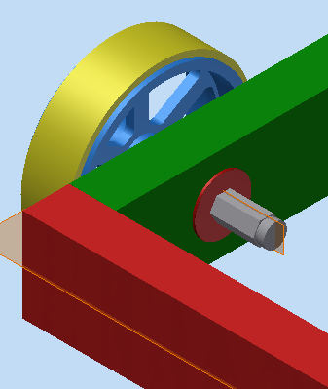
Wheel Inserted
*this is what it should look like*

Slide 27
You’re Done
CONGRATULATIONS!
Make sure to save your main assembly into your users folder! (You can save it as “Drivetrain_Main_Assembly_(YourName)”

Slide 28
HOMEWORK
BUT WAIT…
There’s homework!
(All files that you need (for placing parts) can be found in your training16 folder. Please do not simply place assemblies -- try making the assemblies yourself.)
The following slides detail what your assembly should like. Look through them carefully -- they contain clues!

Slide 29
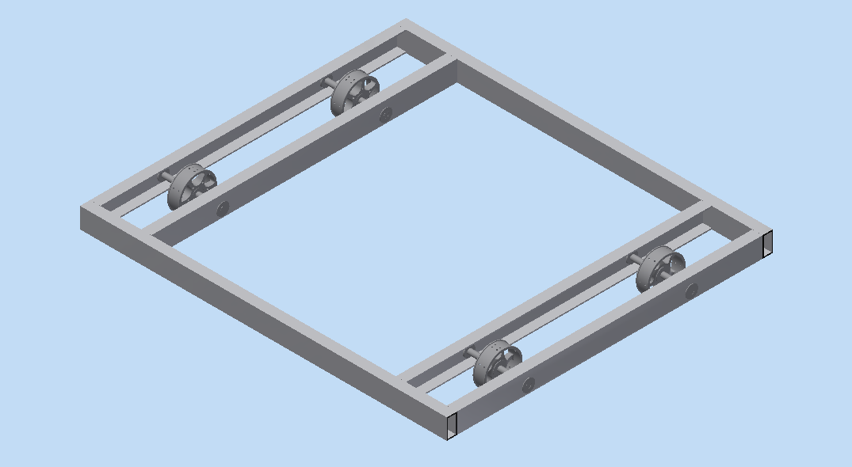
Drivetrain HW Model

Slide 30
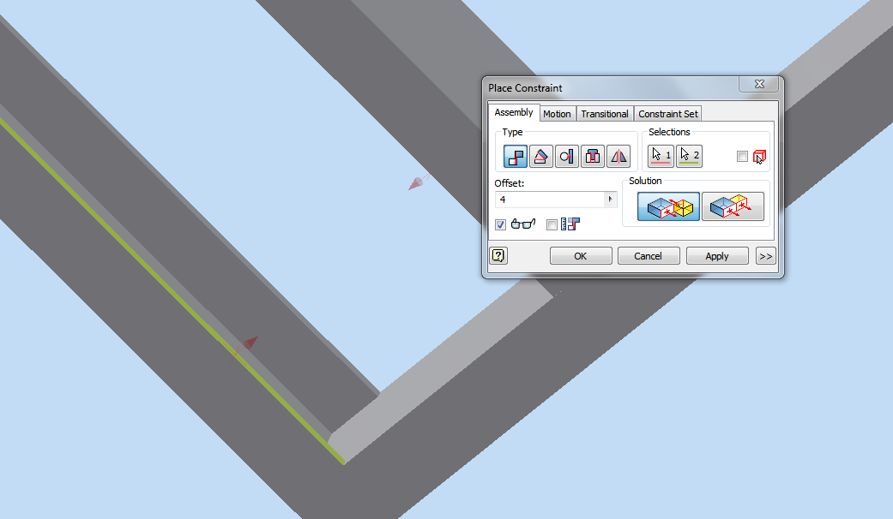

Slide 31
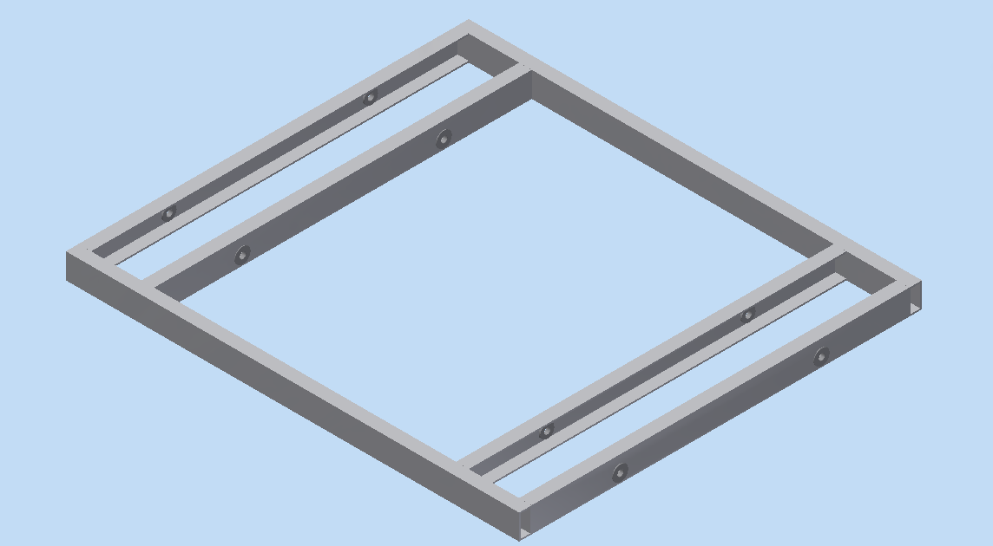
Frame Base Assembly
SAVE AS: “(Initials)_Frame_Base_Assy”.iam

Slide 32
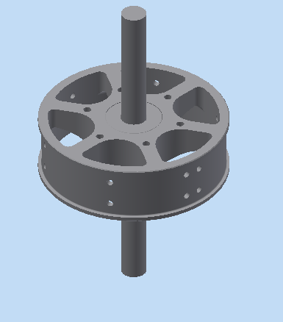
Wheel Assembly
Save As: (Initials)_WheelAssm.iam

Slide 33
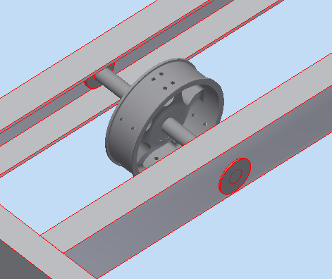
A Closer Look
(Remember, the flange always goes on the outside of the tube.)

Slide 34
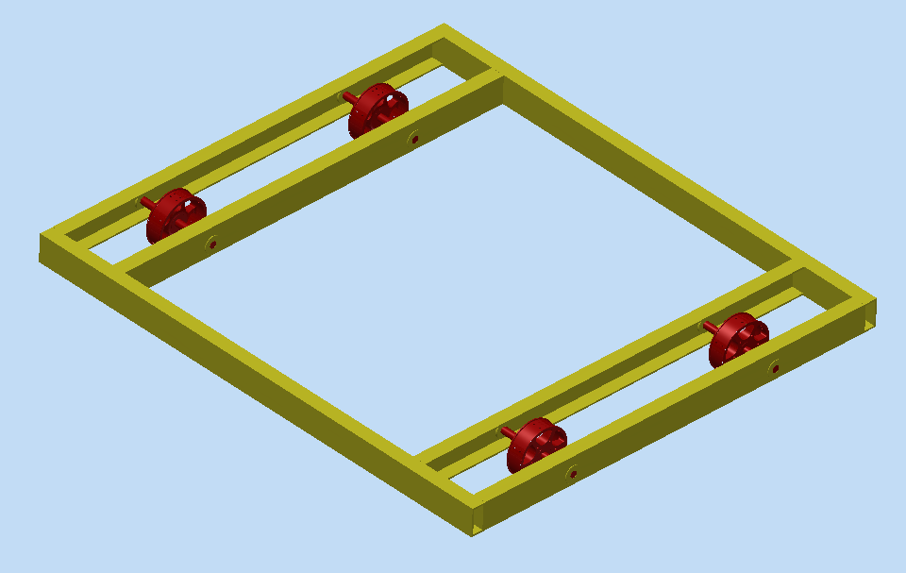
You’re Done!
Try experimenting with color! It’s fun!

